Slide 1
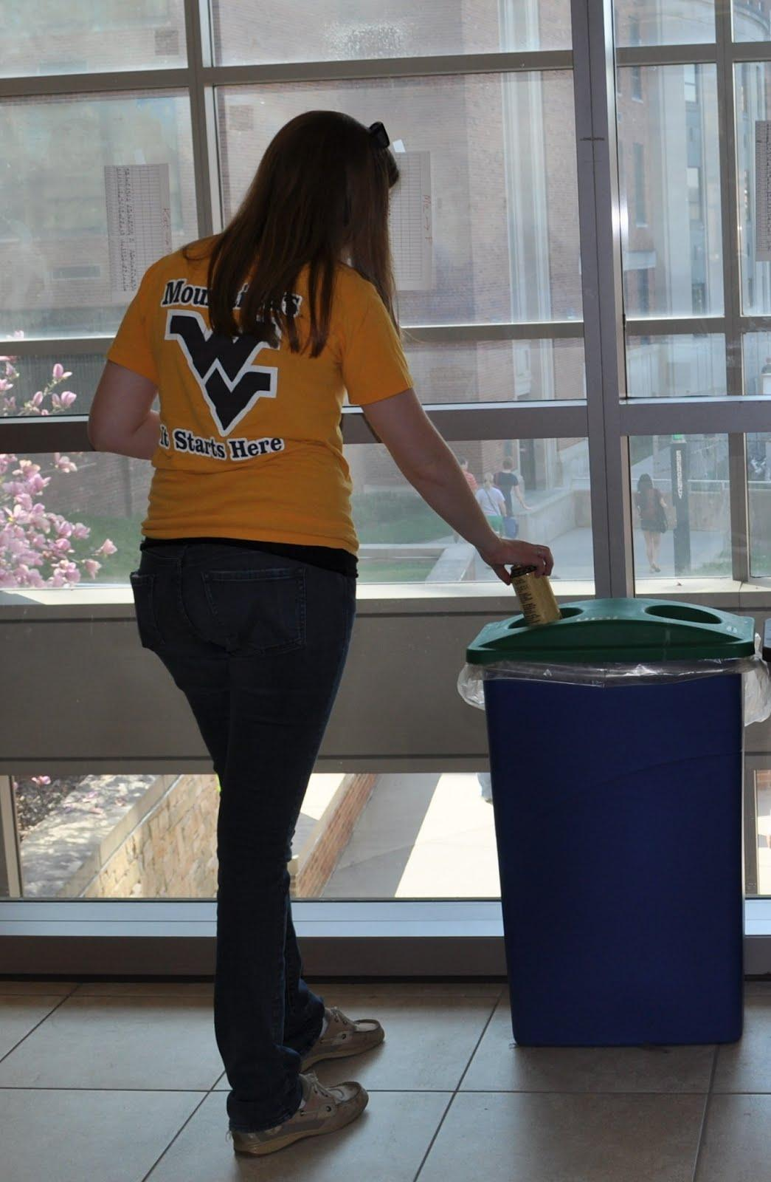
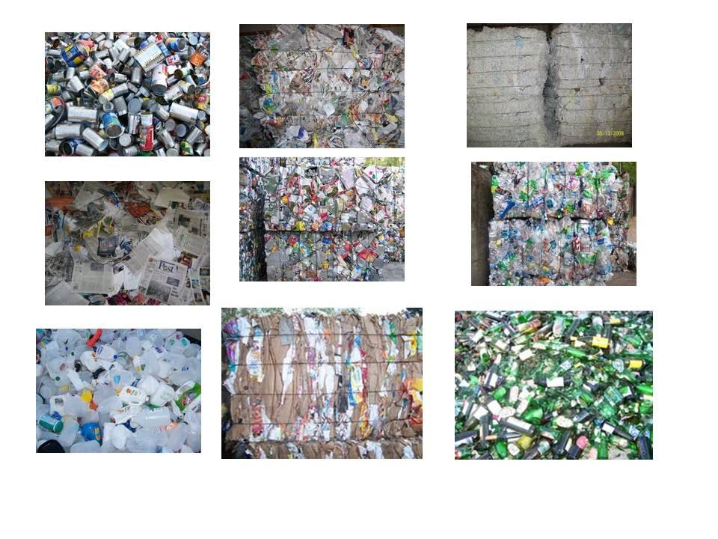
WVU Recycling Capstone
The importance of geospatial principles in creating effective and mutually beneficial neogeography projects for students and stakeholders

Slide 2

WVU Political Science Senior Capstone
Professor: Dr. Hunter
Mentor: Barbara L. MacLennan, WVU Geology & Geography graduate student
Project Leader: Carrie Whitehurst, WVU Political Science undergraduate
Project Liaison: Adam Trunzo, WVU Political Science undergraduate
Bailey Fallon, WVU Political Science undergraduate
Eric Martin,. WVU Political Science undergraduate
Kevin Randle, WVU Political Science undergraduate

Slide 3
Senior Capstone Projects
Give students real world experience
Provide resume building
Build community
Make a university look good
Ineffectual
Time-consuming
Disorganized
Frustrating
Grunt Labor
Good
PROJECT MANAGEMENT

Slide 4
Mentor
Working Relationship
'hybrid social marketing'
Be vested
Professional expectations and behavior
"Invoiced" sub-contractors
Increasing student recycling is $

Slide 5
Approach
' Use what you have' philosophy
Work with students strengths
Provide background information
Listen to the project team - 'student lens'
Don't hold punches about stakeholders

Slide 6
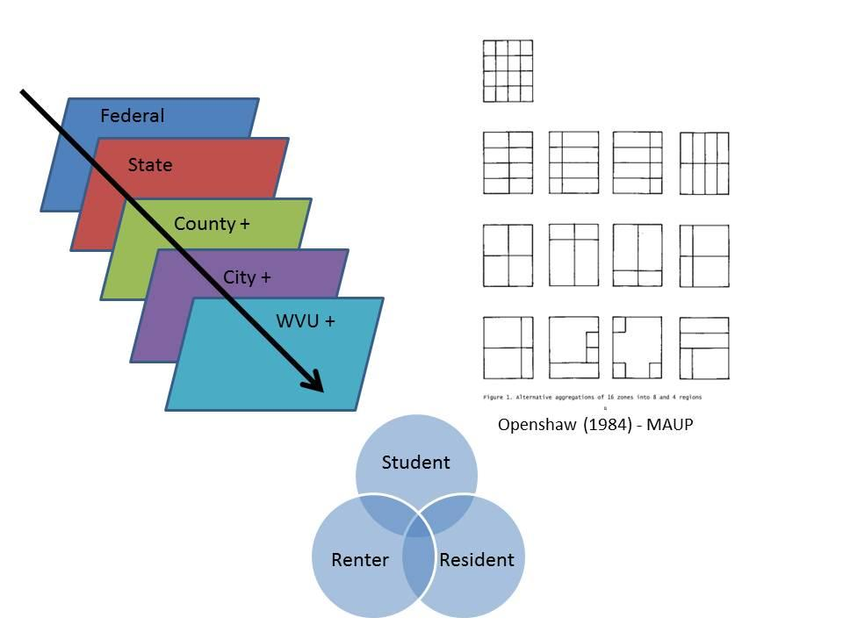
EVERYONE/NO ONE can recycle in Mon County
Scale, MAUP, Ecological Fallacy, 'Policy Sheds'

Slide 7
IMPACT
mpact
What's really cool about it is that it will be the ONLY guide like this in the state that is this comprehensive. Since you're not in this industry day-to-day like me, you probably don't see how many people across our state this is going to affect -- although I do believe you guys get how important this is. Frankly, I am excited to be a part of it. I just emailed Tom Arnold at the City of Morgantown to let him know you guys might be contacting him. ~ Laura Stiller, MCSWA Recycling Coordinator

Slide 8
Capstone
Working Relationship
Treat project like a job
Be open-minded
Listen, but provide input

Slide 9
Project Problem
WVU recycling but no one knows
Fuzzy, unclear jurisdictions
Gaps in student service
No one knows location/types of bins

Slide 10

Approach
Attributes:
Type of Disposal, Type of Stakeholder, Who, What, When, Where, Why, Location, Destination, Jurisdiction, Regulation, Market, Target User
Geo-tagged photos of recycling locations
Upload to Google Maps via Panaramo
Foundation for ARC GIS Analysis

Slide 11
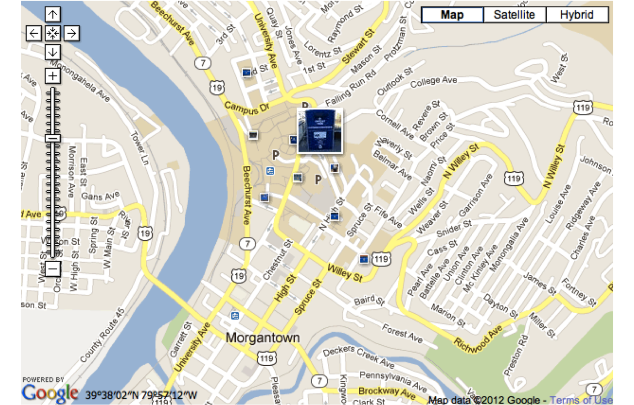
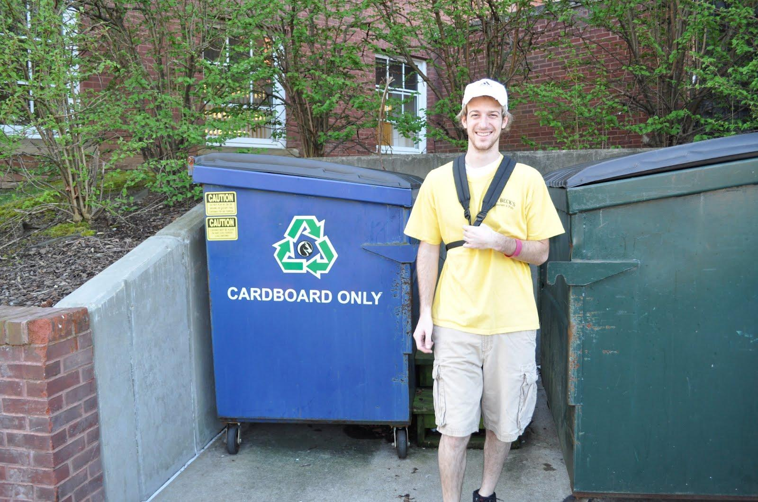
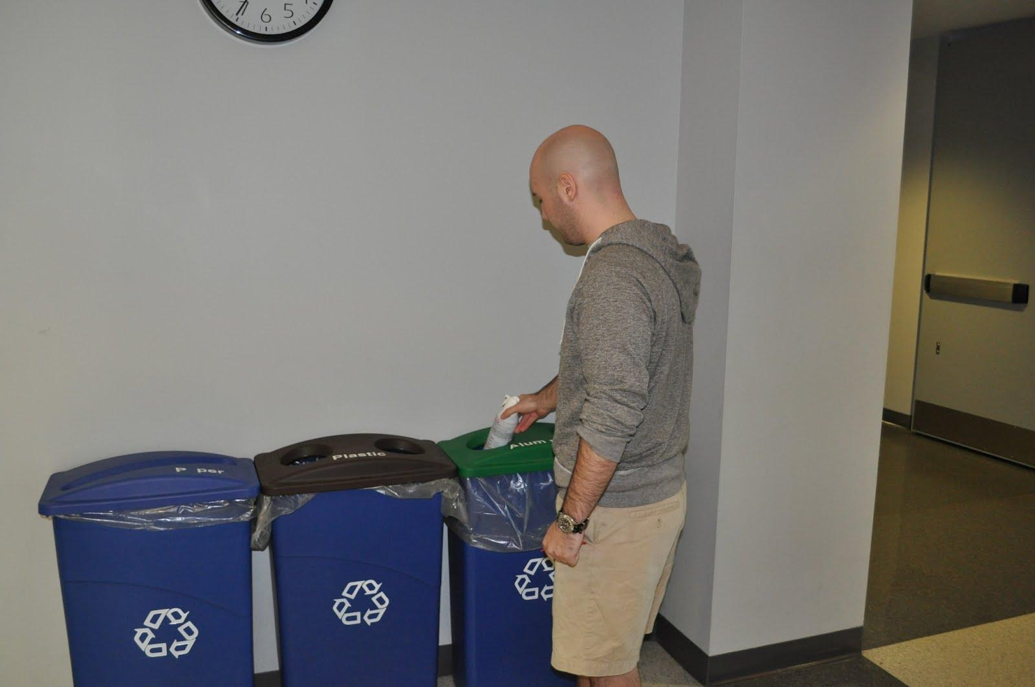
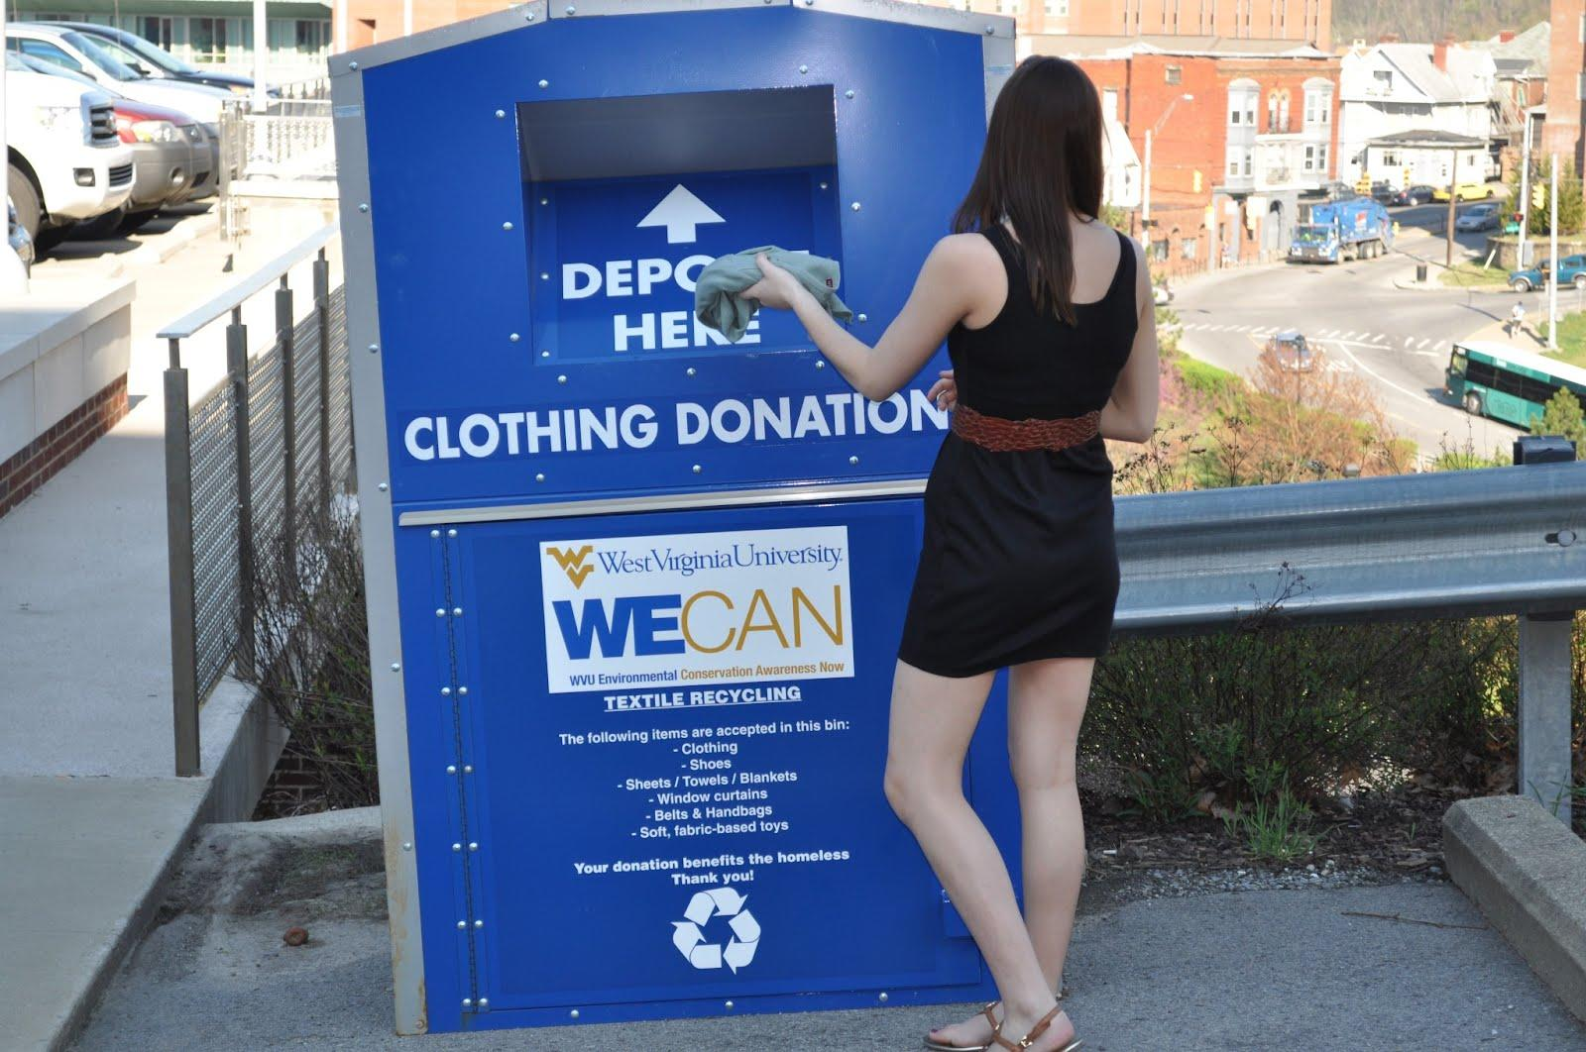
Downtown Map

Slide 12
Results
Visually shows gaps in service for students
"Students as citizens"
Bridge between city and university

Slide 13
Continue
Next year Capstone Students continue work
Be a Capstone project mentor!

Slide 14
QUESTIONS
FEEDBACK

