Slide 1
A GIS Portal for a Multi-State Appalachian Development Highway System
Sang Yoo
Rahall Transportation Institute

Slide 2
Appalachian Regional Commission (ARC)
A Regional economic development agency that represents a partnership of federal, state, and local government
Established by an act of Congress in 1965, ARC is composed of the Governors of the 13 Appalachian states and a Federal Co-Chair, who is appoint by the President
By the same act of establishing ARC in 1965, Congress also authorized construction of the Appalachian Development Highway System (ADHS)
ADHS has been subsequently authorized for funding under TEA- 21/SAFETEA-LU and administered by ARC and FHWA

Slide 3
Nick J. Rahall, II Appalachian Transportation Institute (RTI)
National University Transportation Center (UTC) established in 1999 at Marshall University
Center Theme: Transportation and economic development in mountain regions
Recognized center of excellence in transportation research and economic development, technology development, and training
Funded through the Research and Innovative Technology Administration (RITA) of the U.S. Department of Transportation

Slide 4
The Appalachian Development Highway System
Purpose:
Create Economic Opportunities and Jobs.
Close Gaps from the Interstate System.
Open Areas for Development and Recreation.
Establish Commuter Routes and Freight Routes.
Characteristics:
3,090 Eligible Miles in Length.
31 Corridors.
Mostly 4-lane Highways
Initial Construction Only
Notes:
The ADHS was authorized by Congress to:

Slide 5
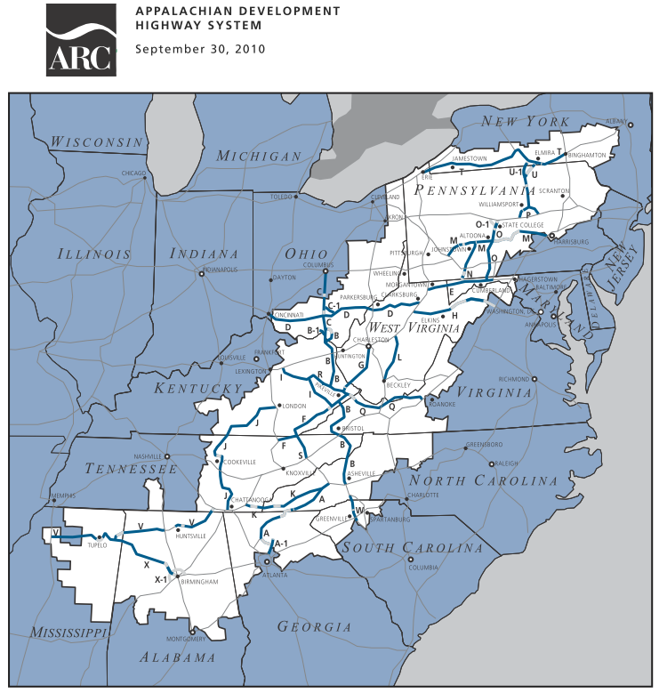
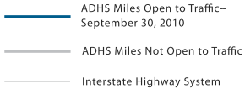

Slide 6
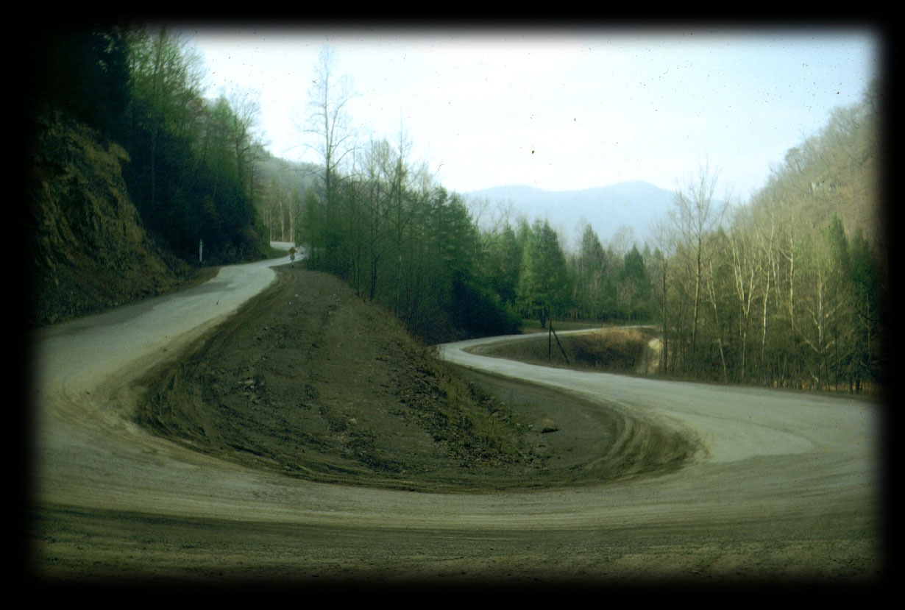
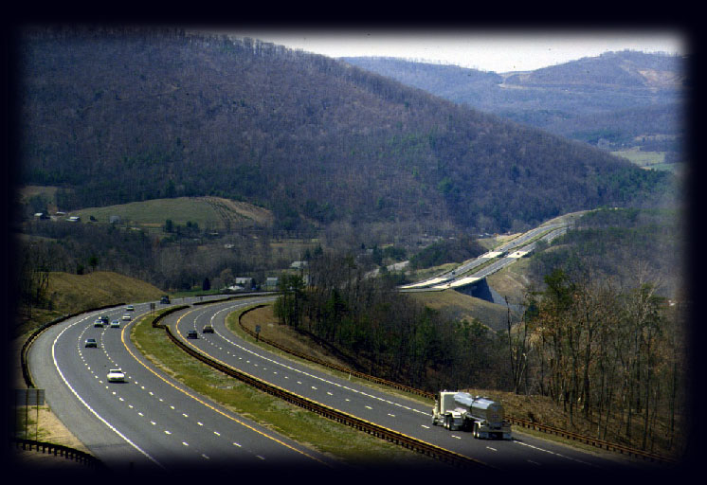
Before the ADHS
Corridor B
After the ADHS
Kentucky

Slide 8
Purpose of the ADHS Cost to Complete Estimate Study
Establish the program funding level
Determine apportionment factor
Develop new policy and legislation

Slide 9
ADHS GIS System
Objective
To develop a GIS system that will help State DOTs to complete ADHS Cost to Complete Estimate.
Expected Functions
Regional and State ADHS Maps
Corridor ADHS Strip Maps
Abilities to view, print, inquire and update ADHS data
Document Management System
Program Cost Tracking

Slide 10
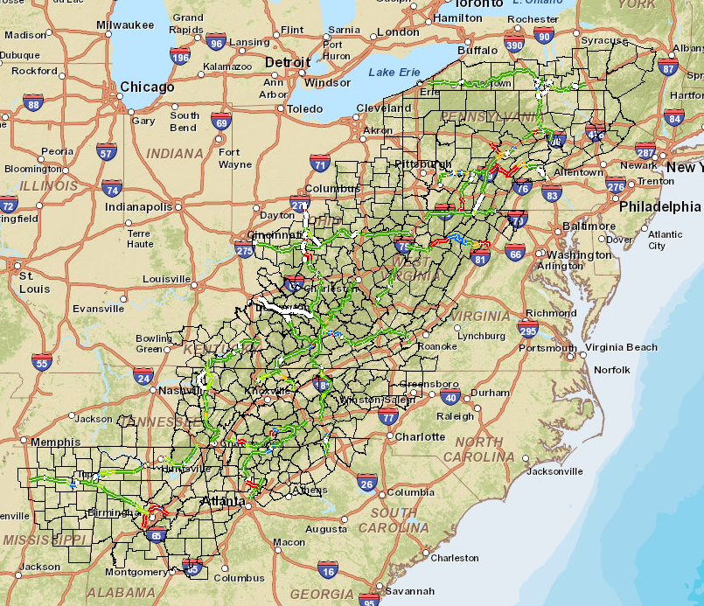
ADHS GIS PROJECT
Cost-sharing partner with ARC
Portions of 13 States covering Appalachia
Phase I - III completed 2002 – 2007
Enhanced phase 2007 - 2010

Slide 11
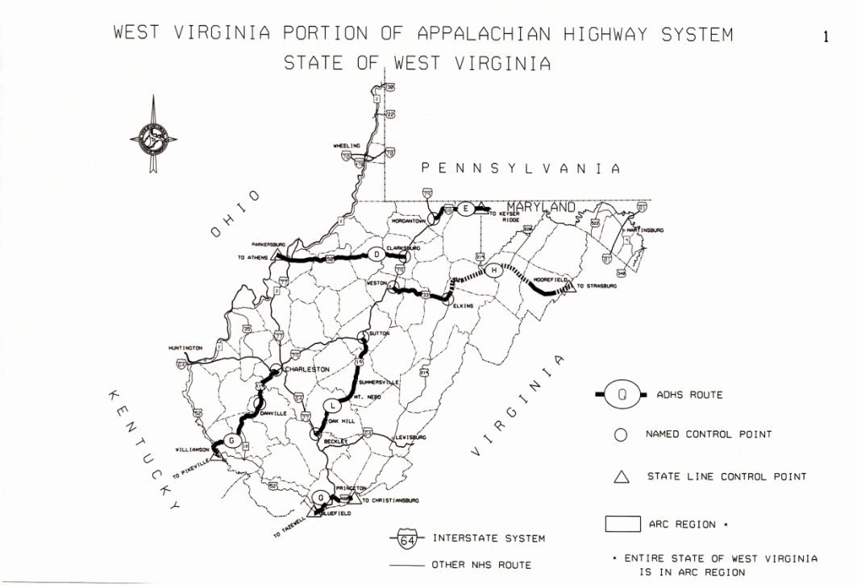
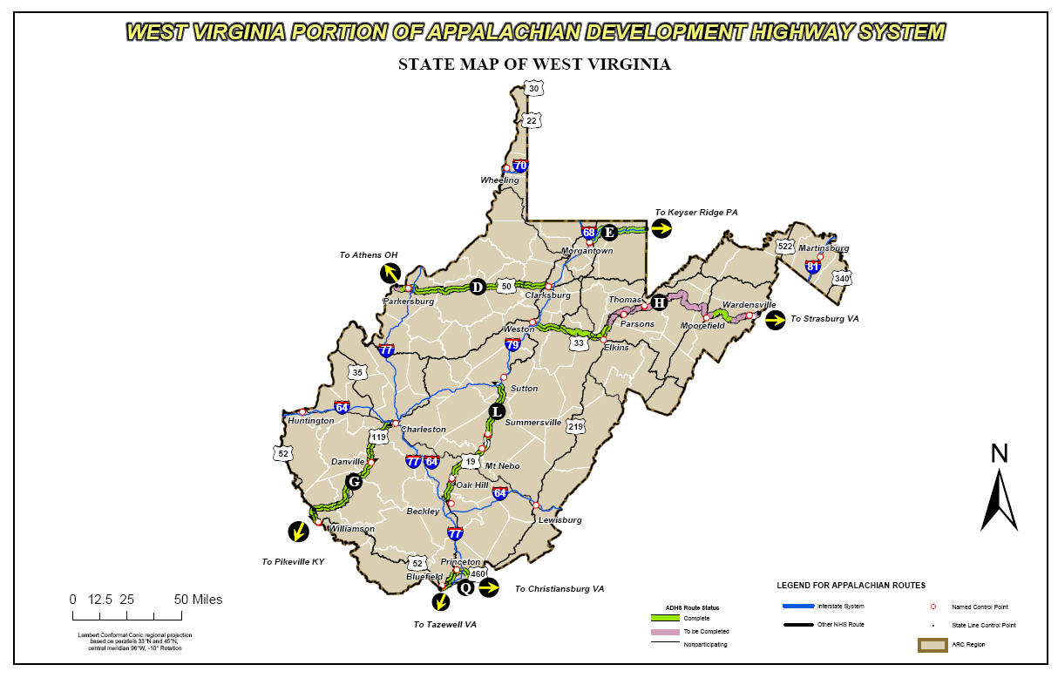
Before the GIS
State Map
After the GIS
West Virginia

Slide 12
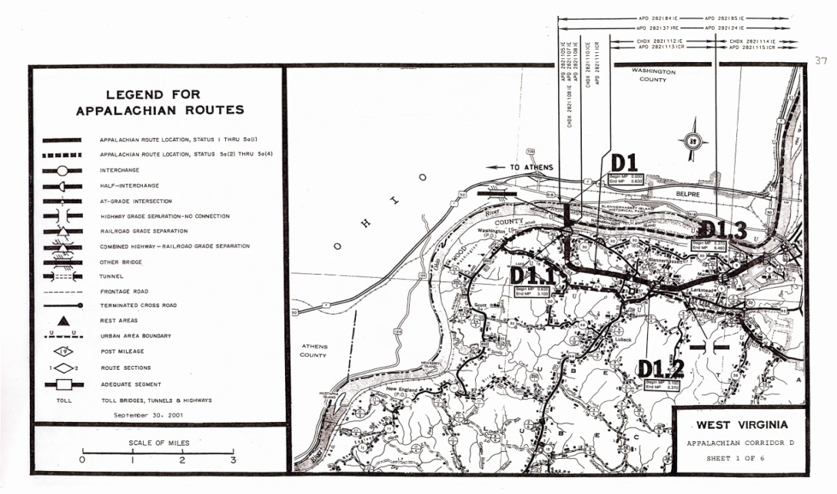
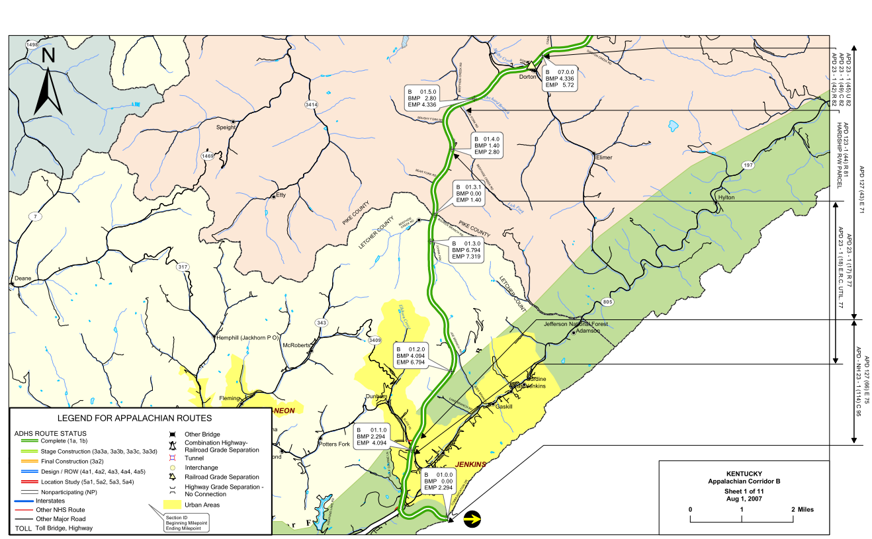
Before the GIS
Corridor D
Strip Map
Scale 1 inch = 1 mile
After the GIS

Slide 13
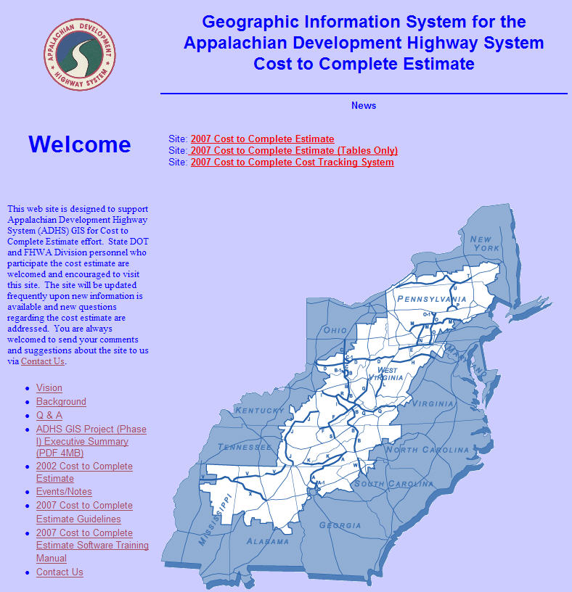
EADHS.ORG
Web portal for ADHS
Cost to Complete
Internet Map – ESRI ArcGIS Server
Cost Estimate Tables
Cost Tracking
Annual Update

Slide 14
Interactive Mapping Site

Slide 15
Interactive Mapping Site

Slide 16
Interactive Mapping Site

Slide 17
Interactive Mapping Site

Slide 18
Table A

Slide 19
Table B

Slide 20
Table C

Slide 21
Document Management Sys

Slide 22
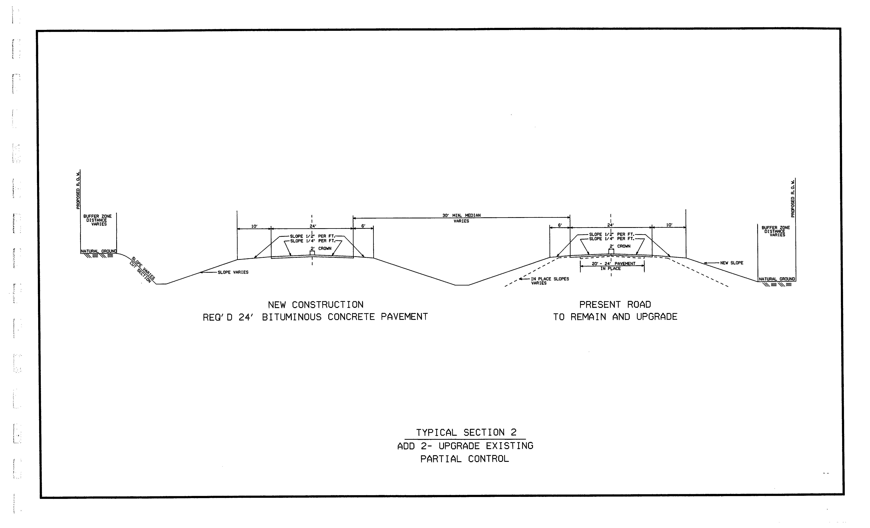
Document Management Sys

Slide 23
Questions

