Slide 1
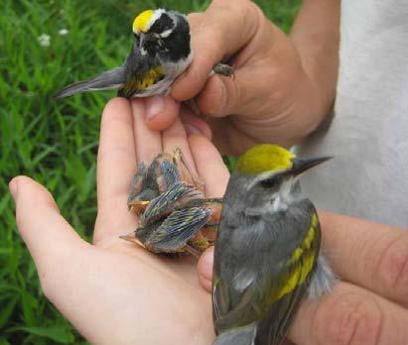
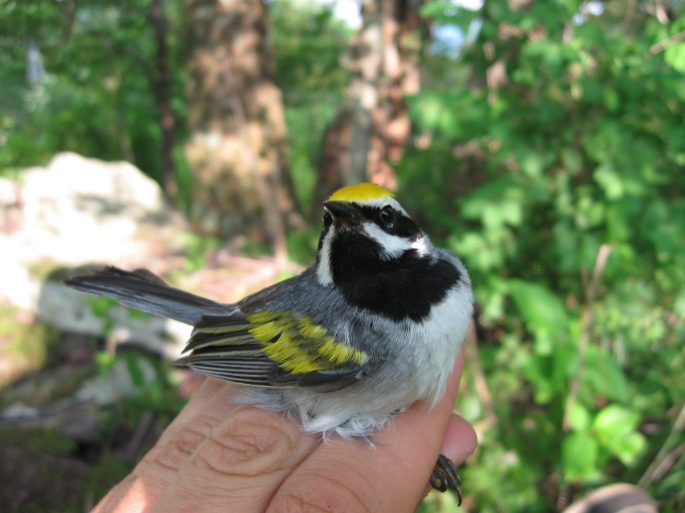

Using Airborne LiDAR for Golden-winged Warbler Management
2013 WVAGP Annual Meeting
Stonewall Resort State Park
Sam Lammie, GISP
slammie@fs.fed.us
Geographer
Monongahela National Forest
200 Sycamore Street
Elkins, West Virginia 26241
Photo credit: Liz Stout
Photo credit: Kyle Aldinger

Slide 2

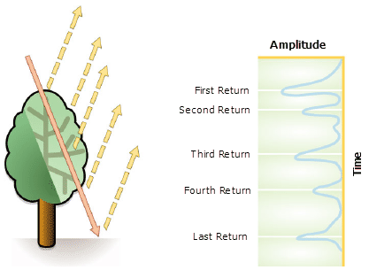
“It's faster than a speeding bullet. It can measure buildings in a single pulse.” (GCN, 2013)
Airborne LiDAR
By measuring the time it takes light to bounce off an object, and knowing the speed of light (186,000 miles per second), one can detect the distance of the object.
(Source: ESRI)
Challenge is in firing rapid pulses of light (up 150,000 per second)
Using Airborne LiDAR for Golden-winged Warbler Management
Airborne LiDAR – using 1064-nanometer laser beams
Bathymetric LiDAR Systems – using 532-nanometer laser beams

Slide 3
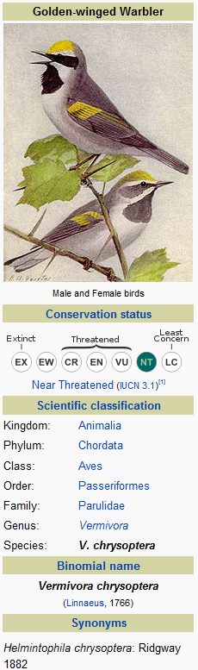
Background
The Golden-winged Warbler is one of the most critically threatened, non-federally listed species in eastern North America.
The rate of population decline has accelerated in the past decade, with the most precipitous declines in the Appalachian region, particularly West Virginia.
Because a variety of habitats are used by Golden-winged Warblers, they can be used as an umbrella species to address the needs of other species that require a range of early successional habitats.
Source: Wikipedia

Slide 4
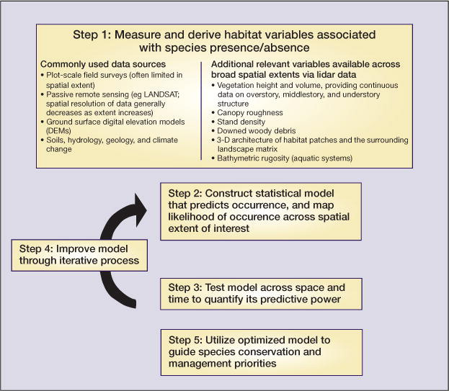
LiDAR shedding new light on habitat characterization and modeling
(Vierling, et al, 2008)
The three-dimensional arrangement of habitat is fundamental to how animals interact with the environment
LiDAR remote sensing is a tool that can characterize three-dimensional habitat structure of terrestrial and aquatic environments in fine detail across broad areas
LiDAR data may replace many labor-intensive, field-based measurements, and can characterize habitat in novel ways
Incorporating LiDAR data into studies of animal–habitat relationships will help to improve models used for species management and conservation.

Slide 5
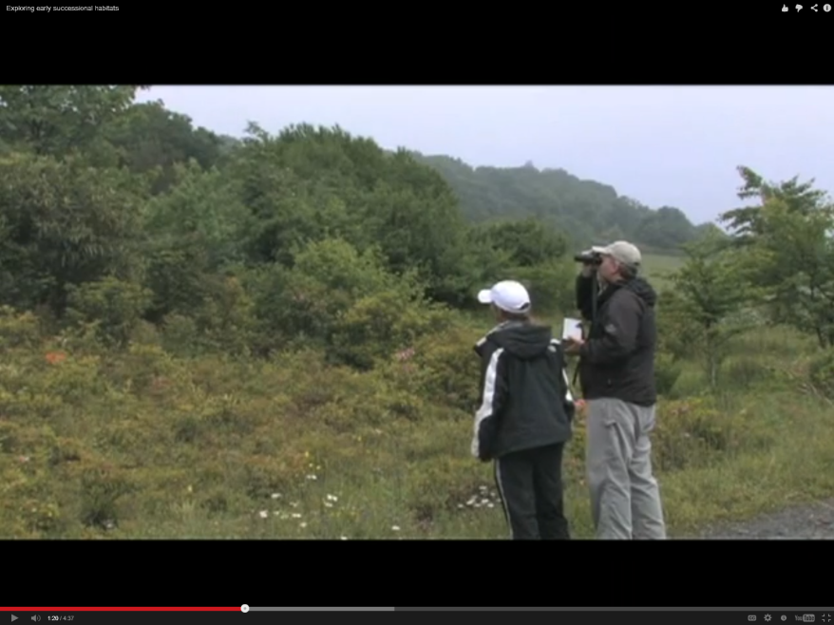
Purpose
Using LIDAR to analyze habitat
structure, both vertically and
horizontally, may be the best option
for measuring habitat complexity
at the appropriate scale.
Standard remote sensing products, using satellite imagery and/or digital aerial photography, provide critical horizontally-dependent, information on vegetation, but are not suitable for mapping vertical structure – a critical habitat component for this species.
“Hardly every see them unless you hear them first”
Early successional state – complicated structure
Golden-winged Warbler Working Group (2009)
Source: Kyle Aldinger (PhD candidate, WVU) and Cathy Johnson (Wildlife Biologist, MNF)

Slide 6
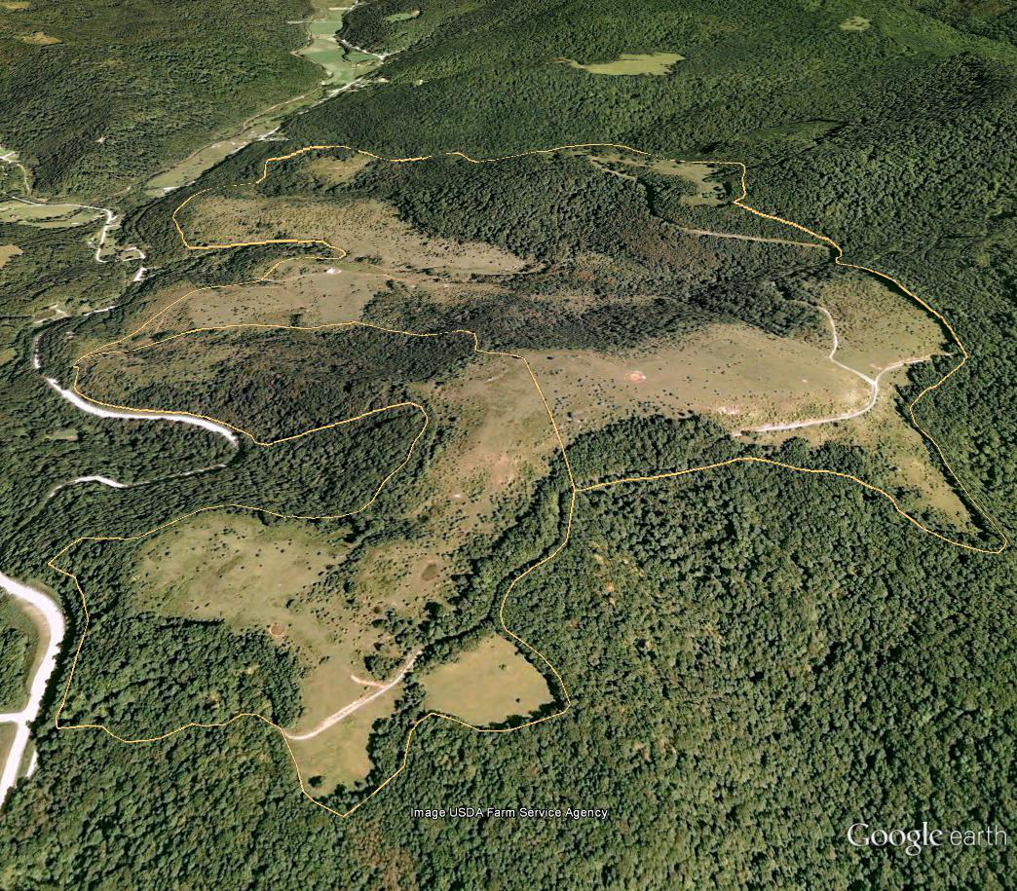
Study area
Gay Sharp/Hoover range allotments
550 acres
elevations ranging from 3,000 – 4,000 ft

Slide 7
Collected by WVU NRAC (June, 2012)
Piper Navajo flown at approximately 2000-ft AGL at an
  average speed of 135 knots
Collected with the following parameters:
  Pulse Rate Frequency of 100,000 Hz
  Scan Frequency of 54 Hz
  Scan Angle of 24 degrees (full Field of View (FOV))
WVU NRAC post-processed the data and a ground model
  was derived from the LiDAR dataset
Deliverables included LiDAR LAS 1.2 files (grouped in ASPRS classes):
  Class 1 default
  Class 2 ground
  Class 3 low veg (<1m)
  Class 4 medium veg (1-3m)
  Class 5 high veg >3m, and
  Bare Earth only LiDAR LAS 1.2 files (Class 2)
  Latest LiDAR exchange LAS format is 1.4 (approved 11/11)
LiDAR data details
Gay Sharp/Hoover range allotments
550 acres
elevations ranging from 3,000 – 4,000 ft

Slide 8
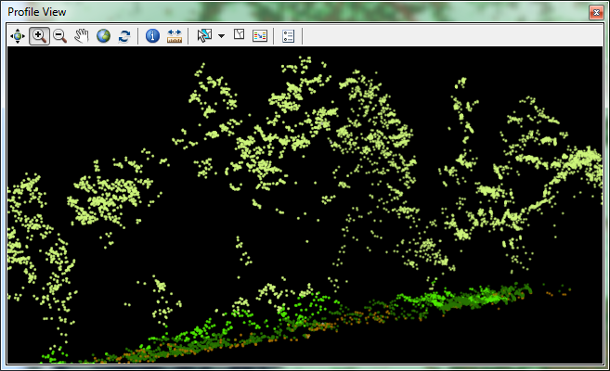
LiDAR Returns
First return
Second return
Third return
Last return

Slide 9
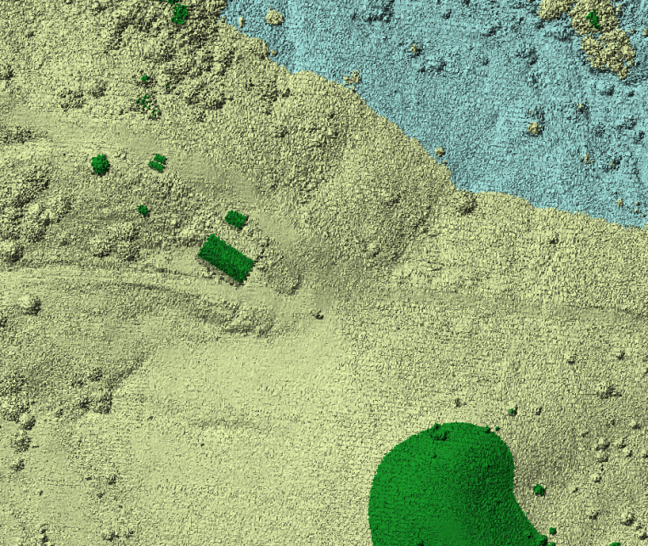
Digital Models
DSM
DEM
Digital surface model (DSM)
Digital elevation model (DEM)

Slide 10
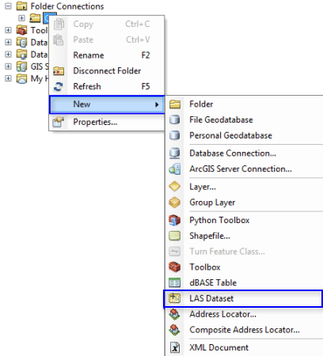
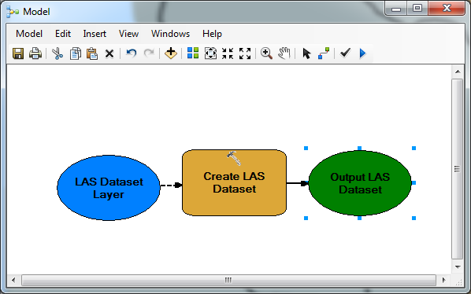
In ArcGIS 10.1, ESRI introduced LAS files, a new dataset type, which is a pointer type to collections of LAS files (or tiles) and allows you to display point clouds or surfaces (in 2 or 3D), run statistics, and even edit the point clouds.
ArcGIS 10.1 and LiDAR
.las Files

Slide 11
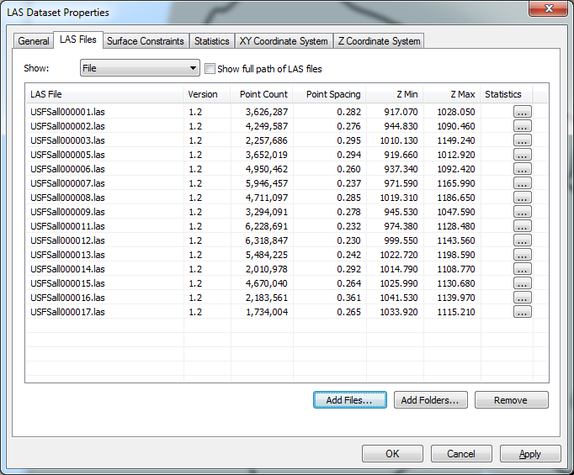
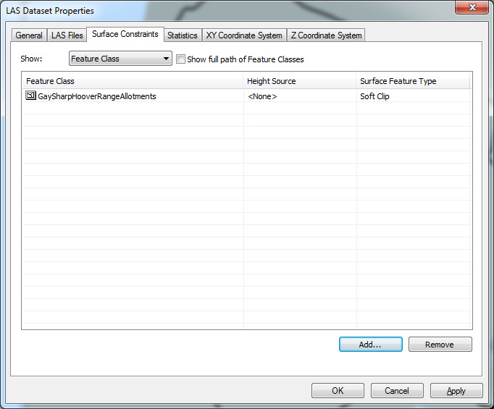
Building the LAS Dataset
54,000,000

Slide 12
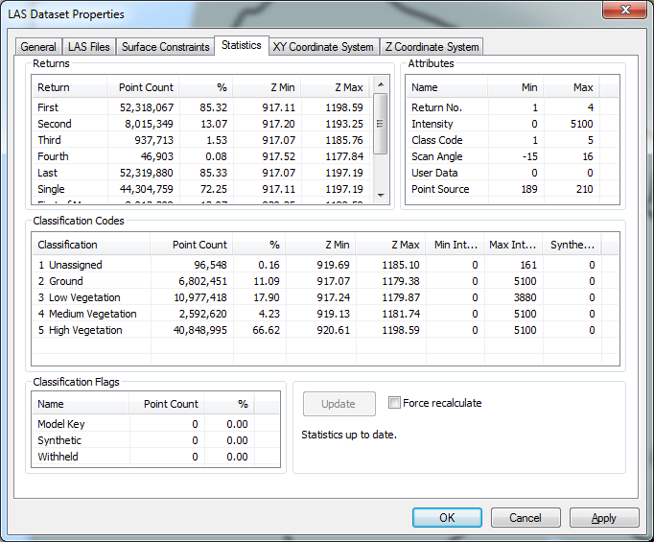
Generating Statistics

Slide 13
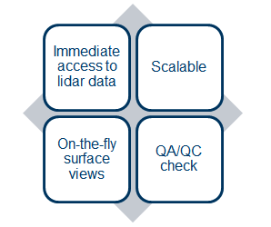
New file type
File-based
Stores references to LAS files on disk
Can reference breakline data
Treats a collection of LAS files as one logical dataset
LiDAR LAS dataset
Advantages:
Direct access to data
File cataloging
View data as pts/TINs
Statistics, QA/QC
Filter/query
Profile and 3D views
File editing
Add/edit constraints
Prefer to organize as tiles for these massive point cloud datasets, but there are several data types available for working with LiDAR data including:
  Terrain
    Introduced in ArcGIS 9.2
    Multi-resolution TIN service model
    Long-term solution for LiDAR projects/surveys
  Mosaic
    Introduced in ArcGIS 10.0, enhanced in 10.1
    Catalog, process, visualize, and share imagery and LiDAR
  LAS
    Introduced at ArcGIS 10.1
(Source: ESRI)

Slide 14
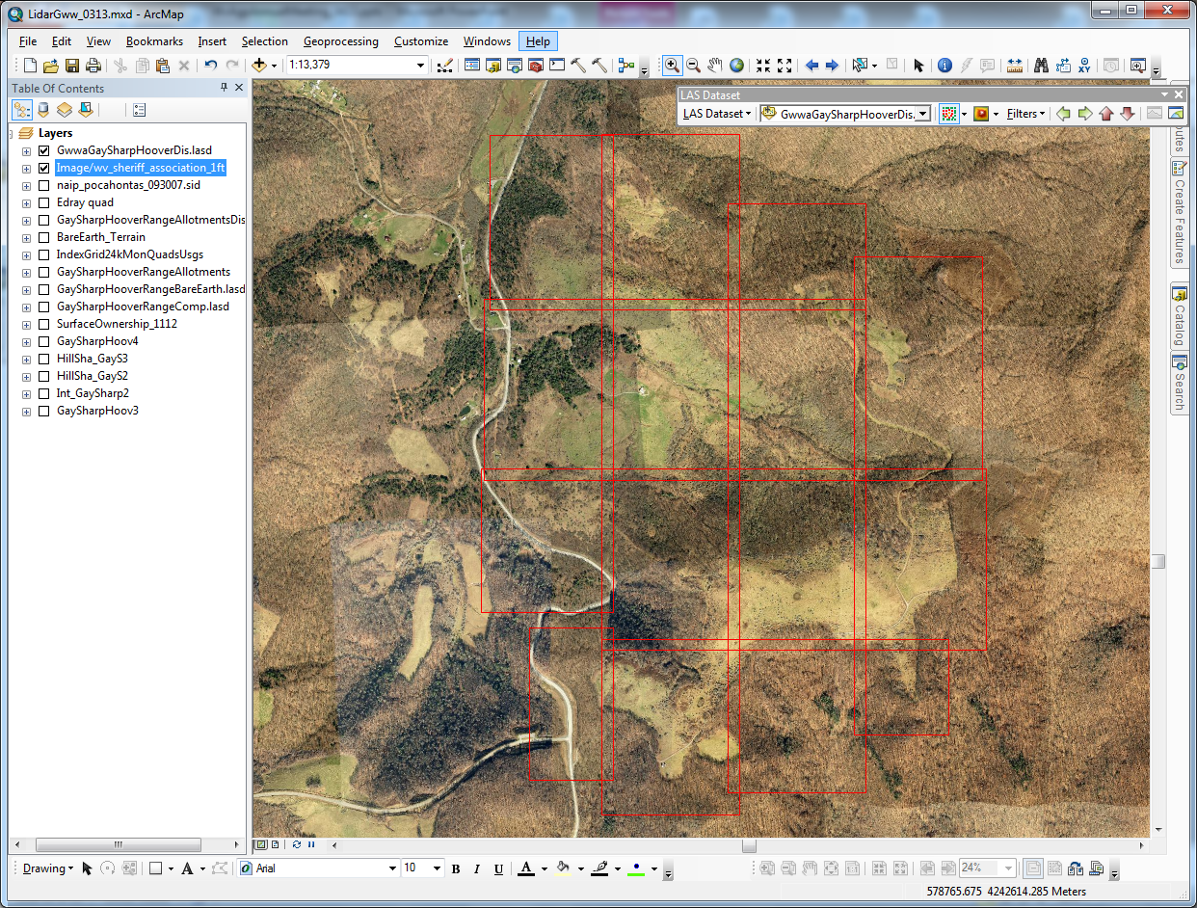
LAS Dataset toolbar

Slide 15
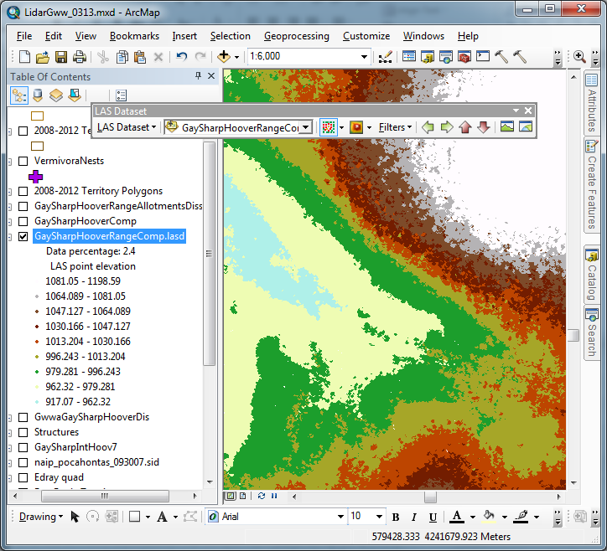
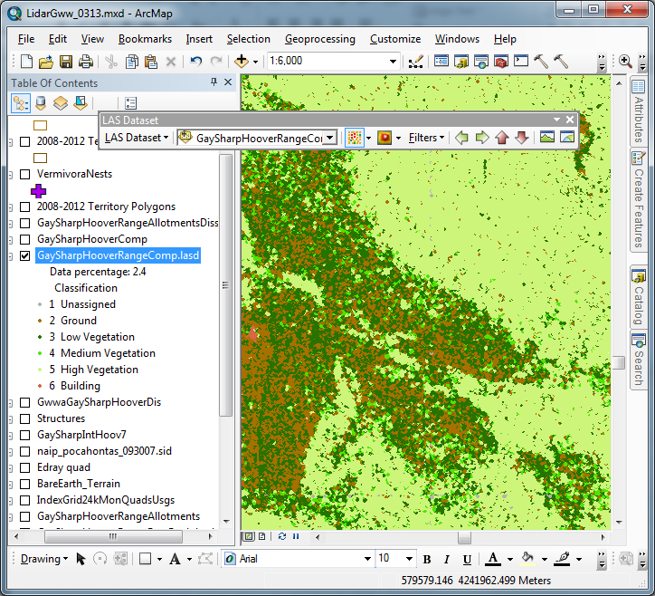
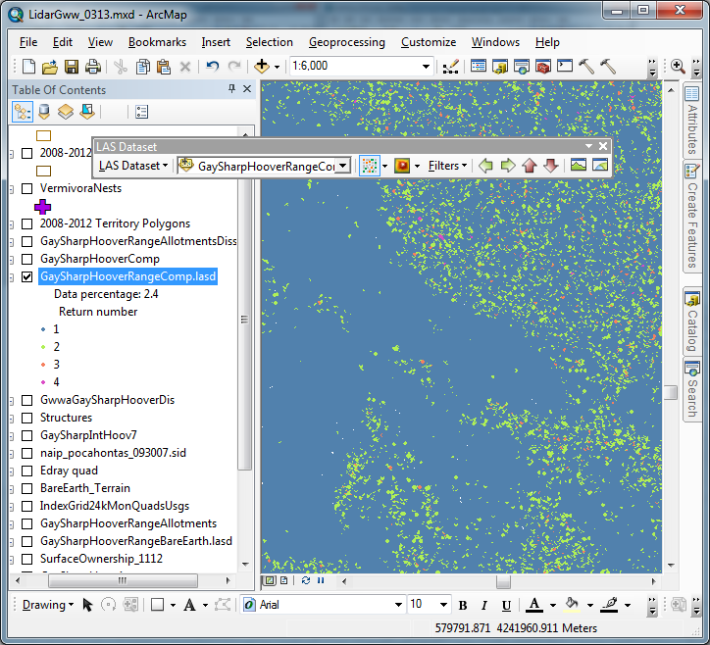
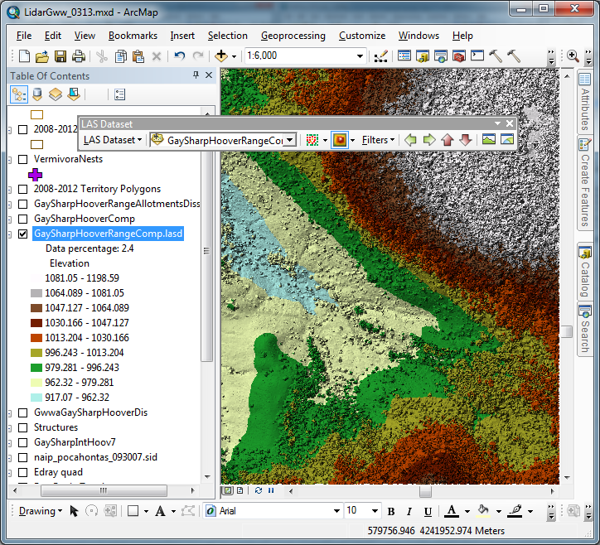
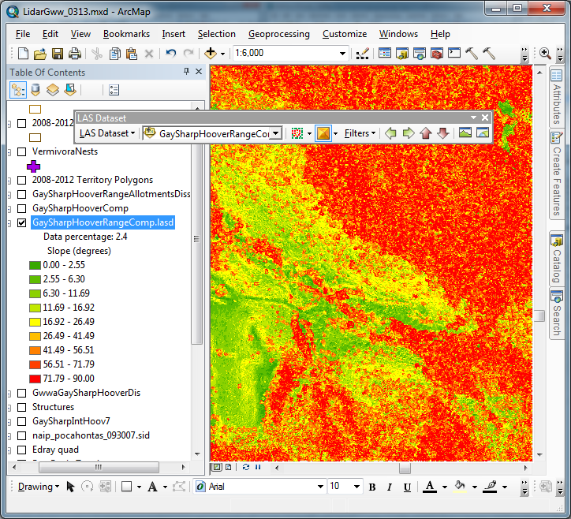
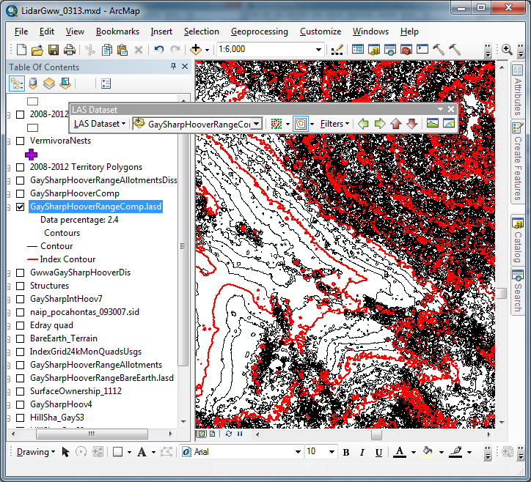
LAS dataset rendered as points:
Elevation Class Return
LAS dataset rendered as a triangulated surface:
Elevation Slope Contour

Slide 16
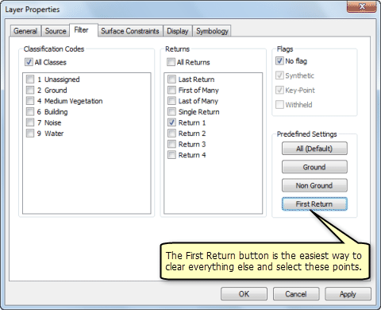
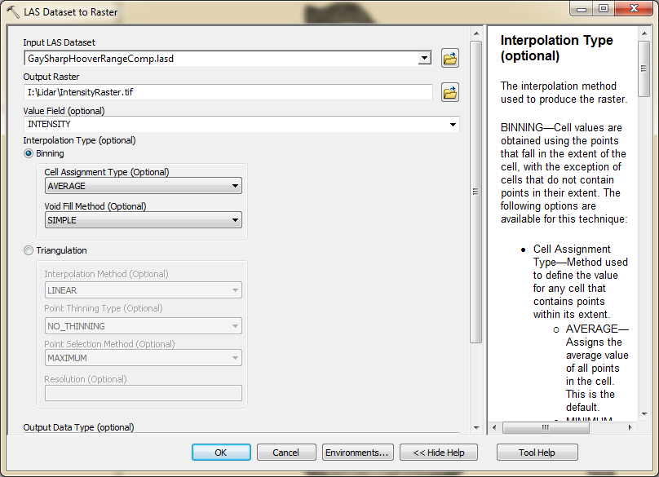
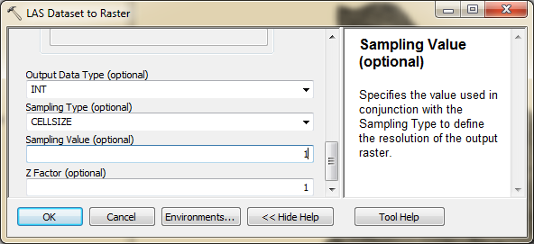
Generating an intensity image
  Define a point filter for first returns
  Run LAS dataset to Raster tool
Source: ESRI
Cell size 2 to 4 times point spacing

Slide 17
  Intensity image is used as an aid in feature detection and extraction, in lidar point classification, and as a substitute for aerial imagery when none is available.

Slide 18
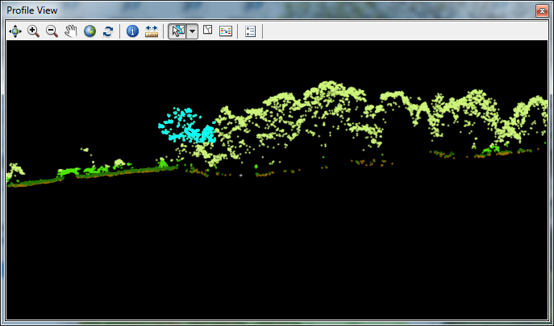
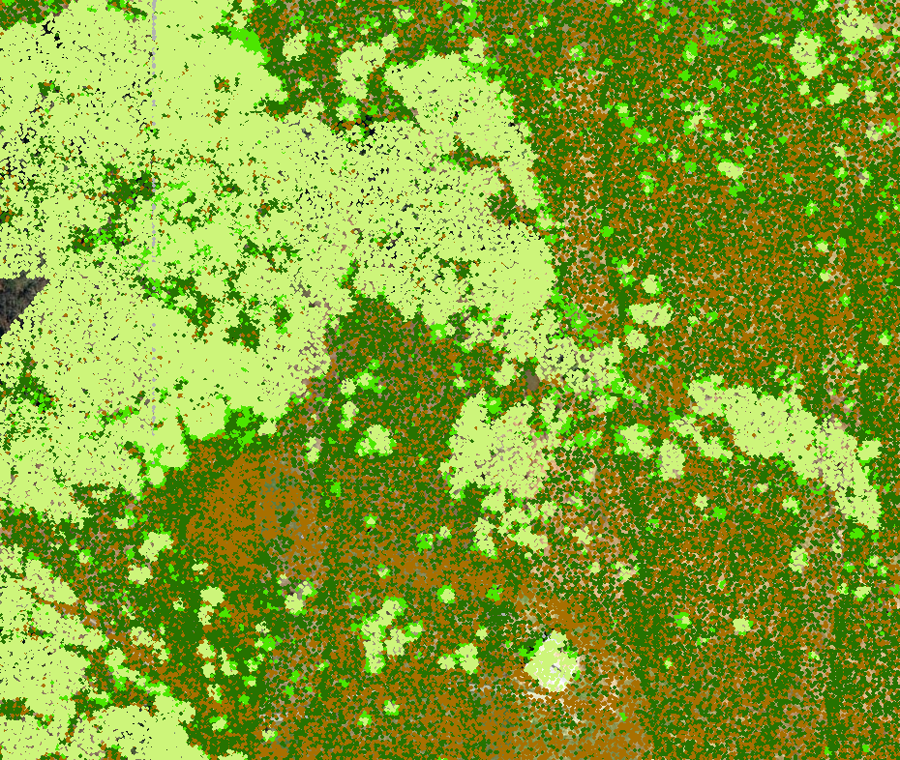
Editing LiDAR data
LAS point clouds can be profiled, displayed and edited
Surface constraints can be added or removed

Slide 19
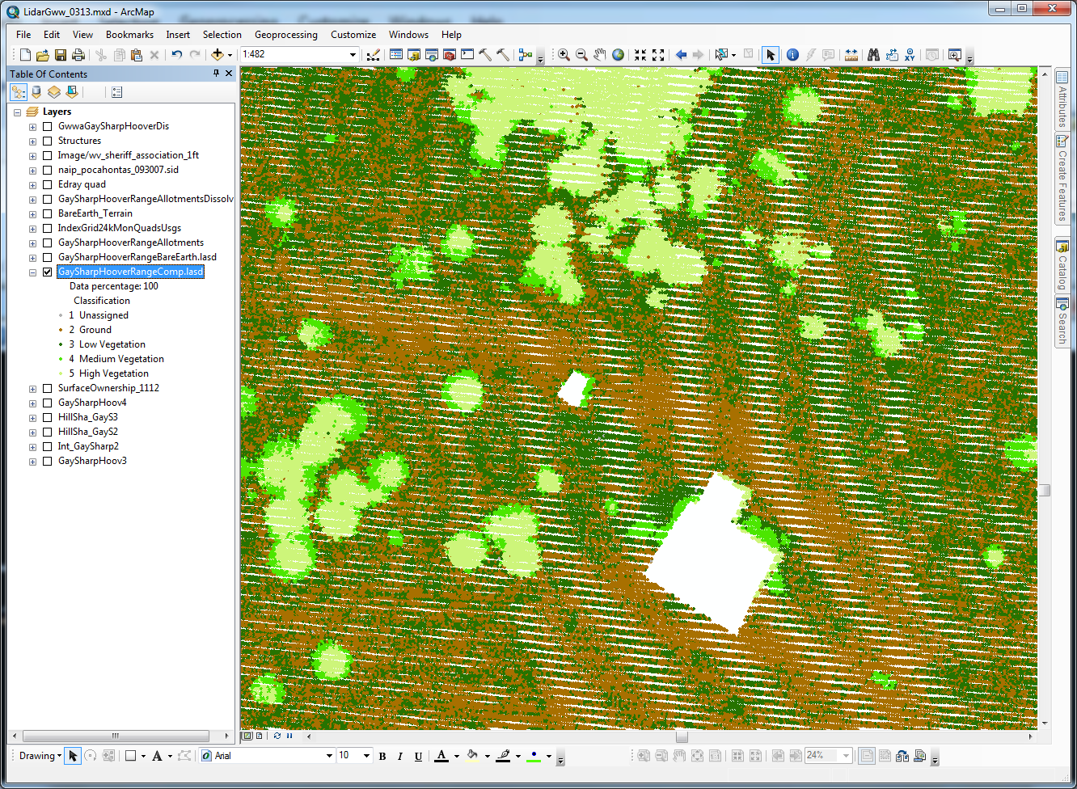
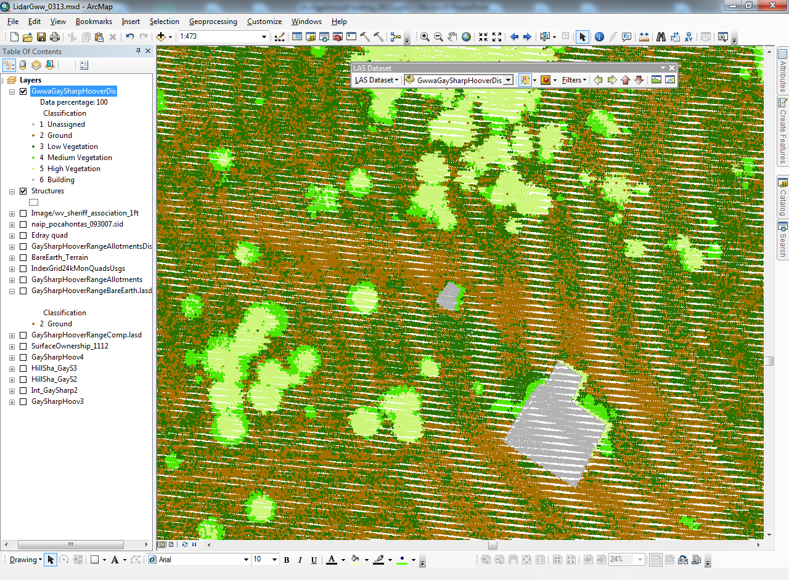
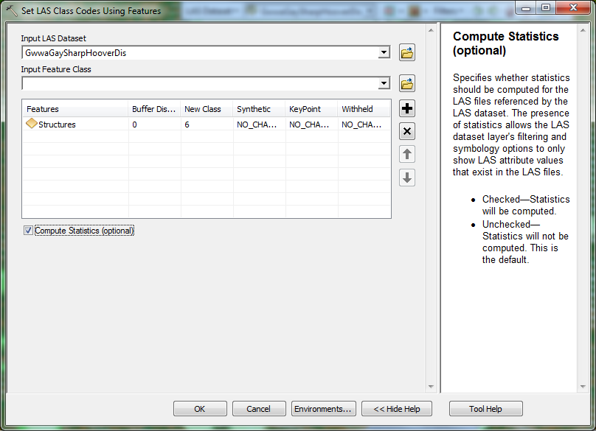
LiDAR 1.2 spec

Slide 20
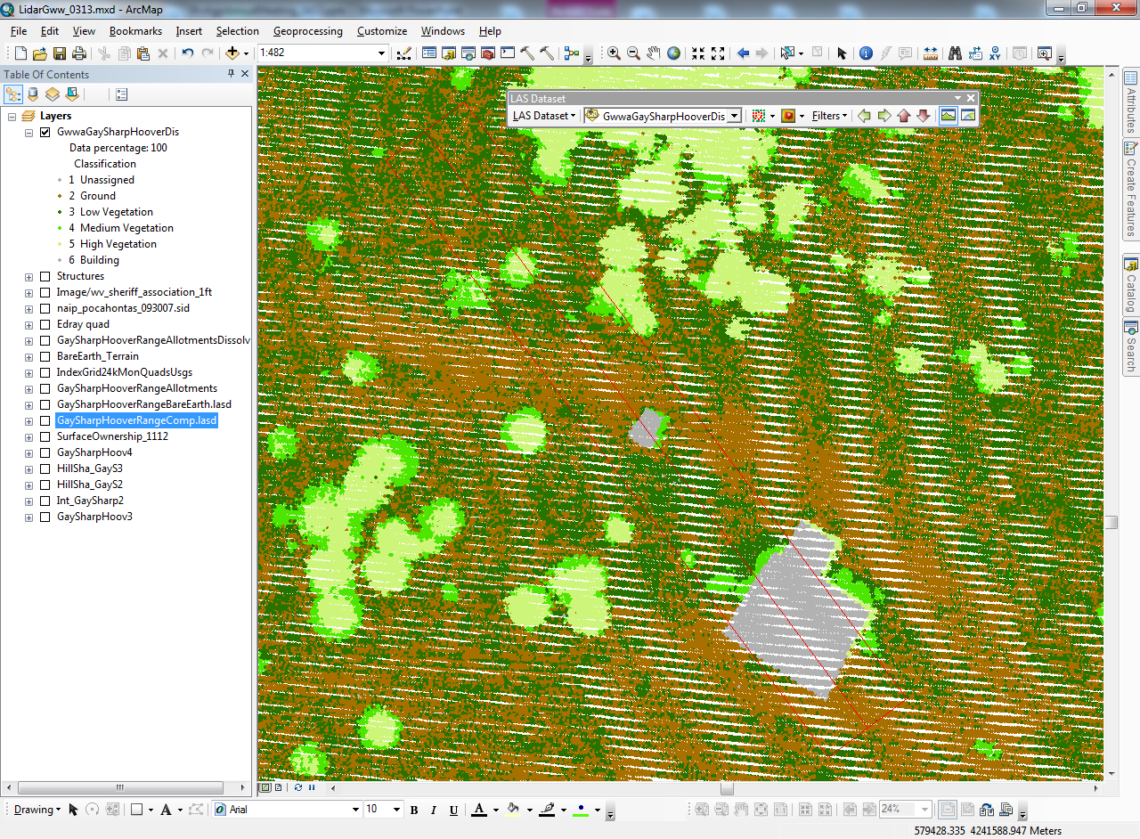
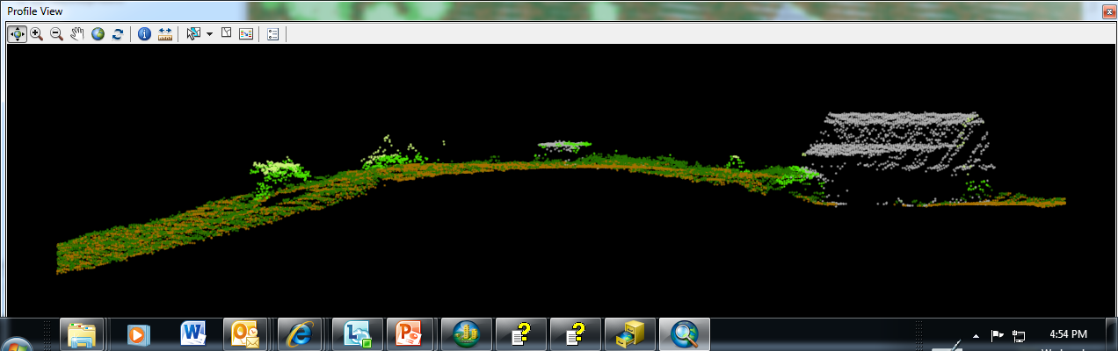

Slide 21
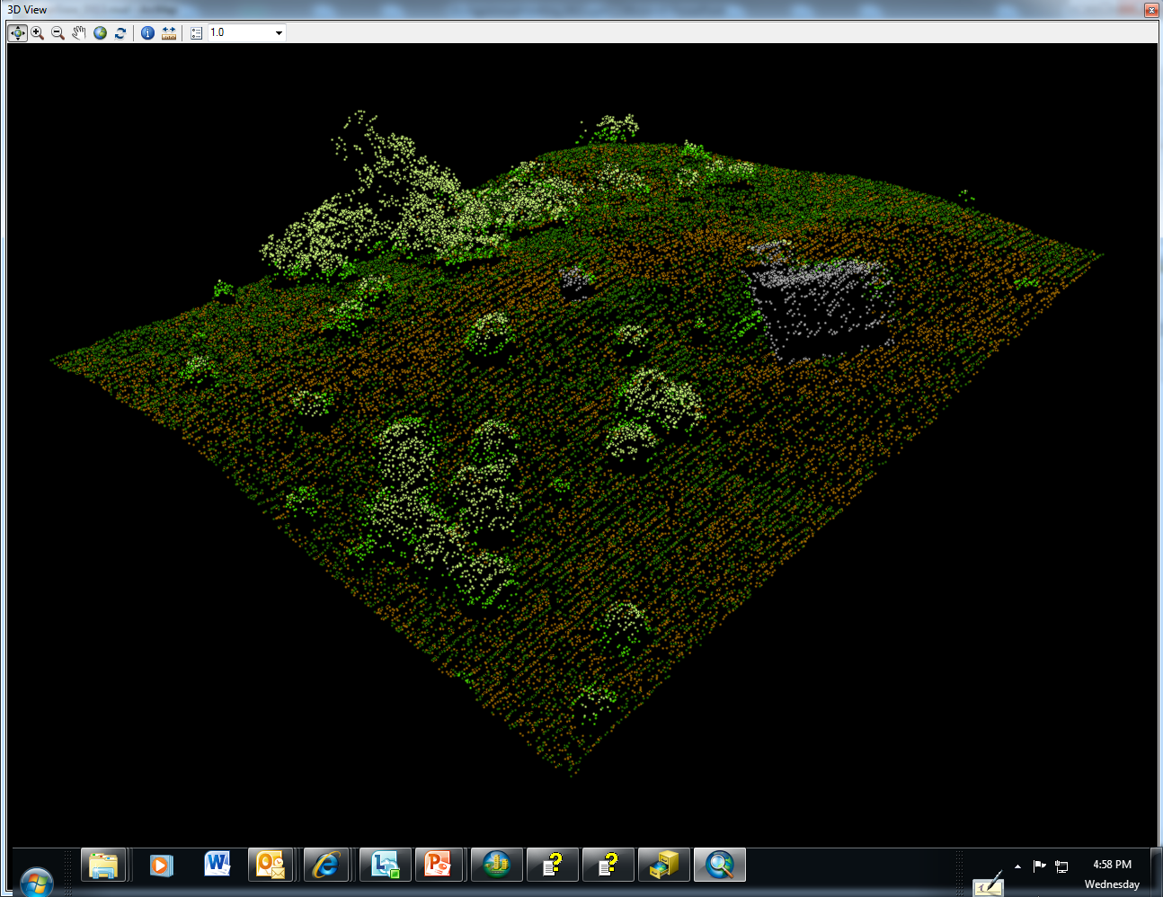

Slide 22
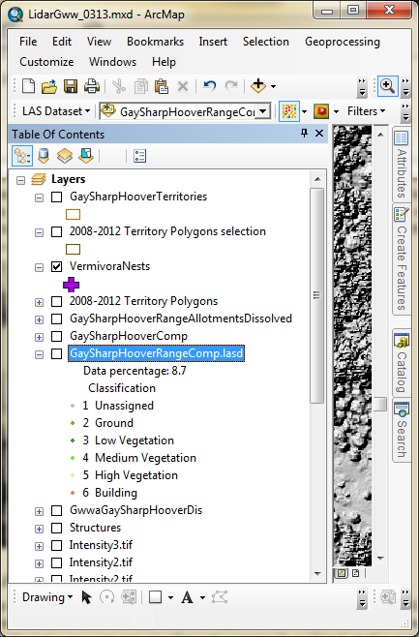
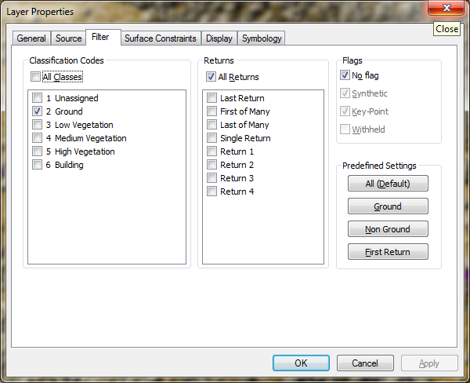
Filtering point cloud for display

Slide 23
Ground
High Vegetation
(>3 m)
Low Vegetation
(<1 meter)
Point clouds over DSM
Medium Vegetation
(1 – 3 m)

Slide 24
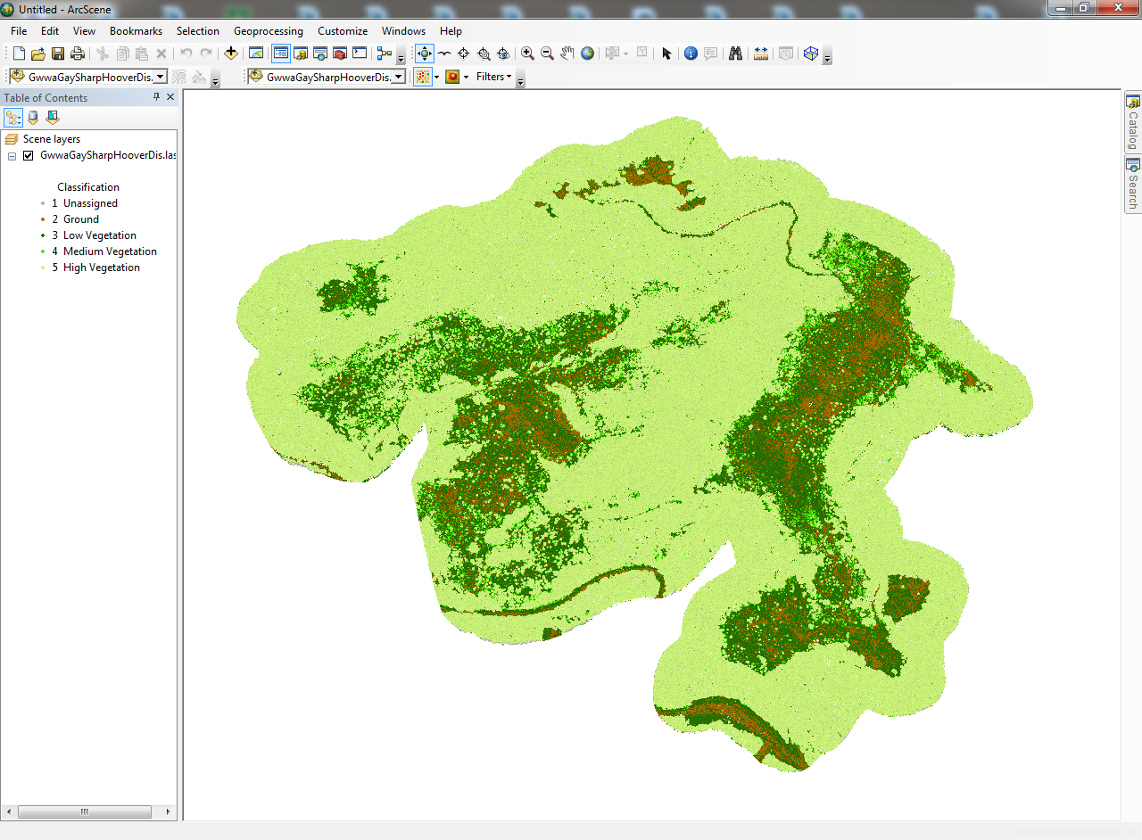
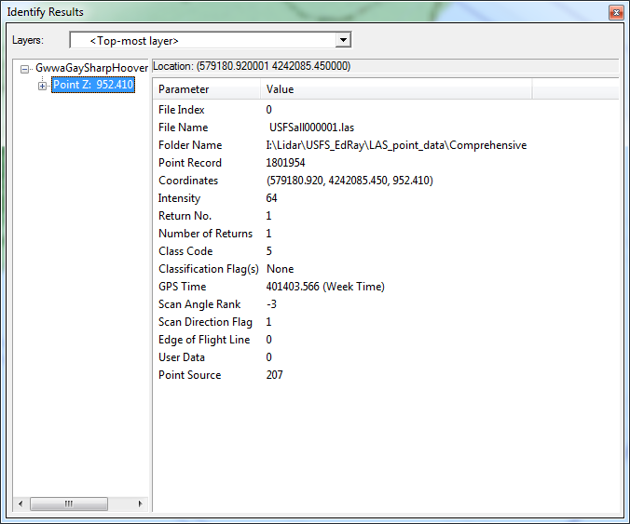
Point cloud shown in ArcScene by classification codes

Slide 25
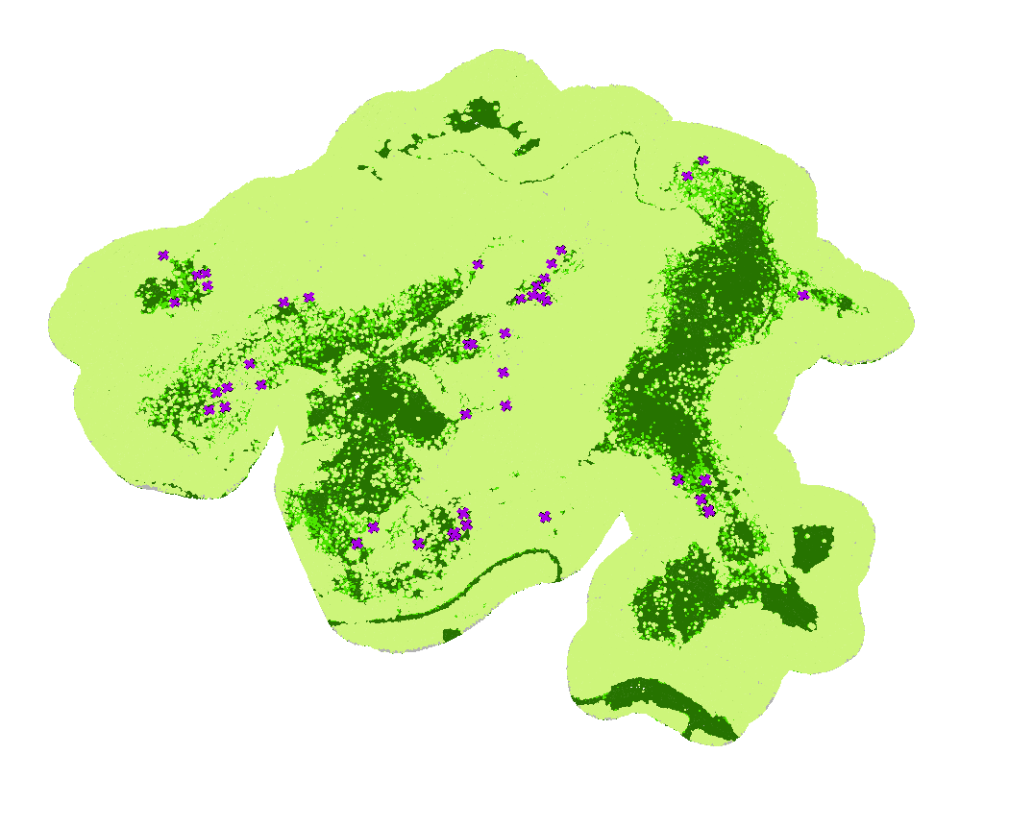
ArcScene
GWWA nest locations

Slide 26
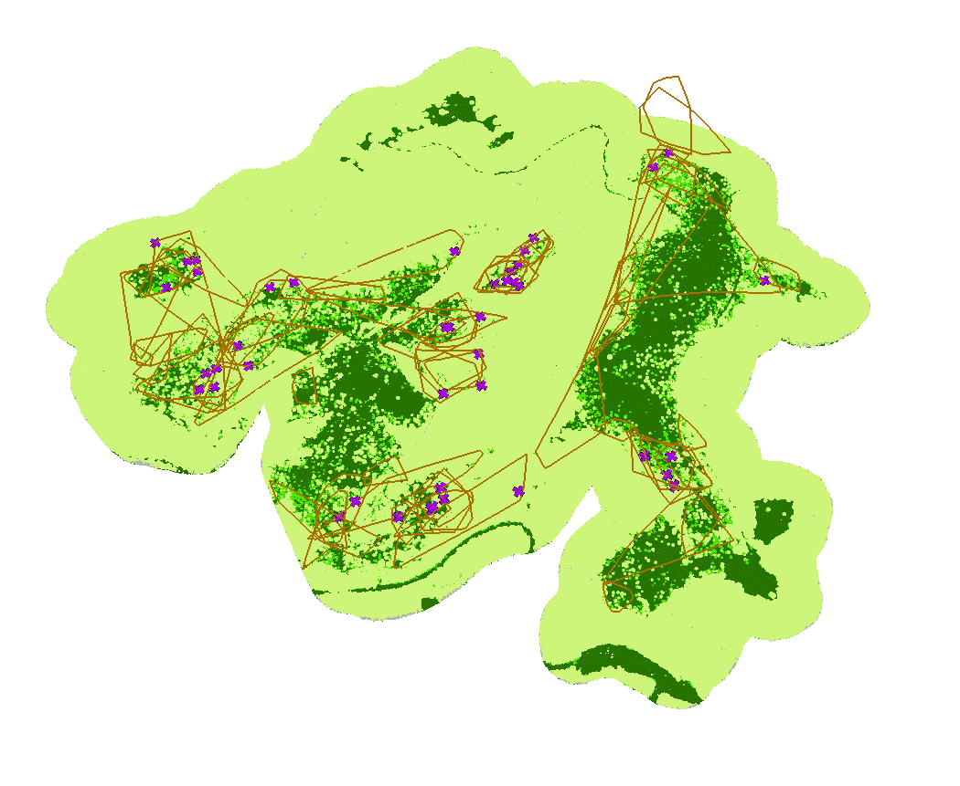
ArcScene
GWWA nest locations
Profile
GWWA territories

Slide 27
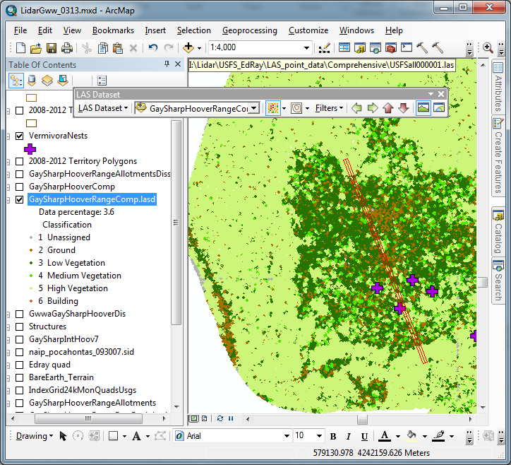
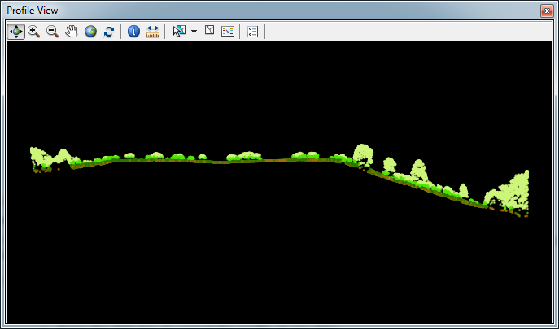
(<1 meter)
(1 – 3 m)
(>3 m)

Slide 28
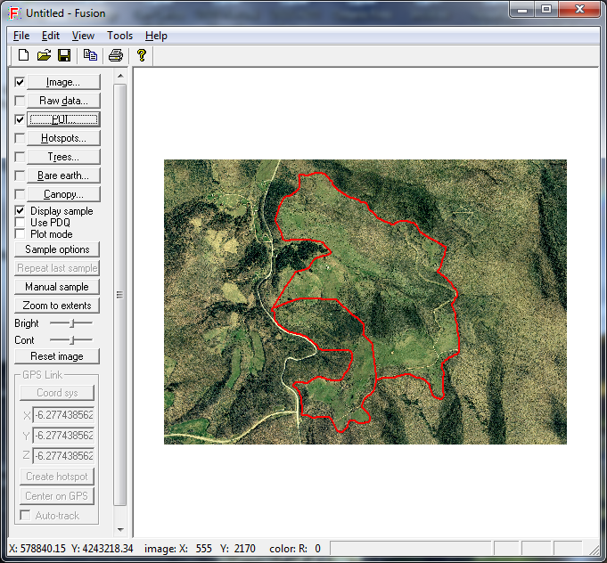
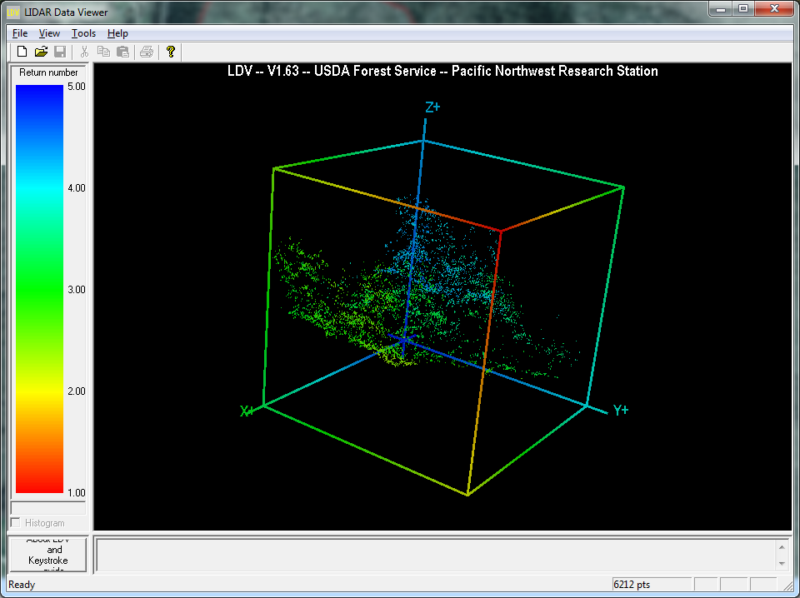
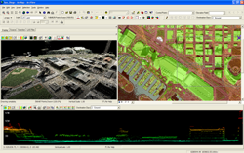
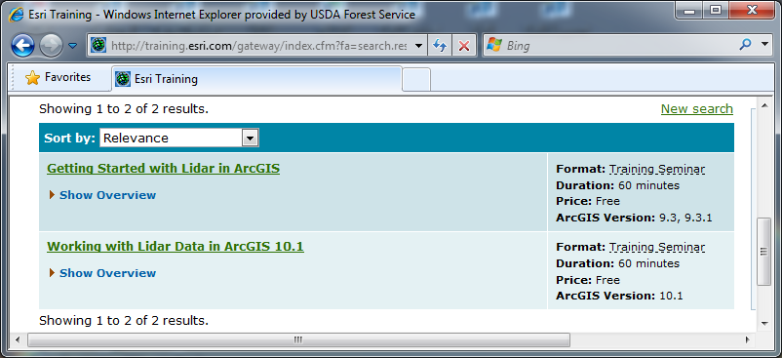
Other Resources
Free software
  Fusion Version 3.21 (October, 2012 build)
  FugroViewer Version 1.52
Intergraph (ERDAS) Imagine
QCoherent’s LP360
Videos
  YouTube videos
  ESRI training videos
  (two free 60 minute videos)

Slide 29
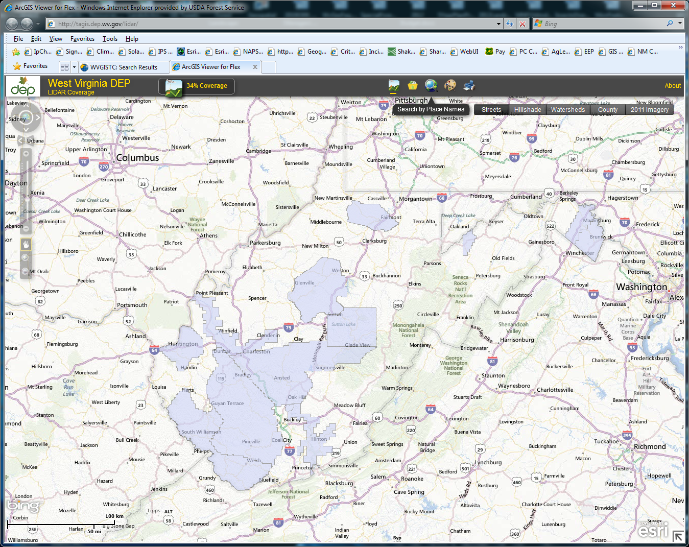
Current WV LiDAR Coverage
2013 WVAGP Annual Meeting
Stonewall Resort State Park
Sam Lammie
Geographer
Monongahela National Forest
200 Sycamore Street
Elkins, West Virginia 26241

