Slide 1
LiDAR Landslide Mitigation
Bob Hickey

Slide 2
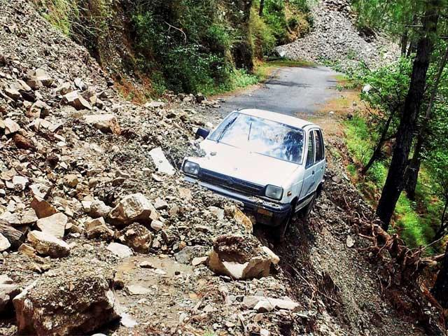
The term landslide includes a wide range of ground movement, such as rock falls, deep failure of slopes, and shallow debris flows.
Although gravity acting on an over-steepened slope is the primary reason for a landslide, there are other contributing factors

Slide 3
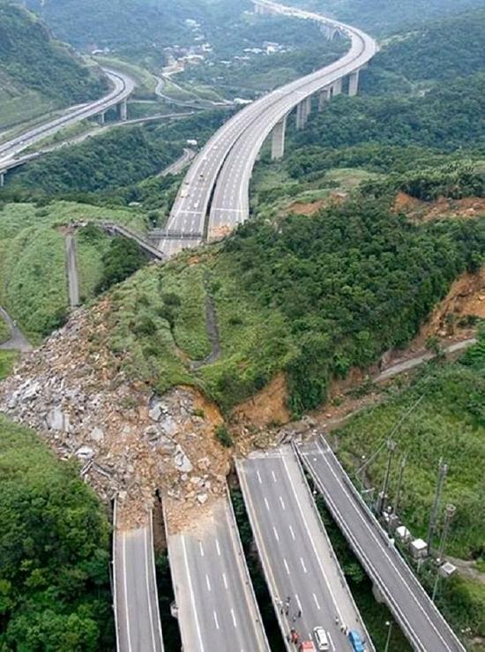
Causes -
erosion by rivers, glaciers, or ocean waves create over steepened slopes
slopes weakened through saturation (Oso)
earthquakes create stresses causing weak slopes to fail
volcanic eruptions produce loose ash deposits, heavy rain, and debris flows
excess weight rain or snow, stockpiling of rock or ore, from waste piles, or from man-made structures

Slide 4
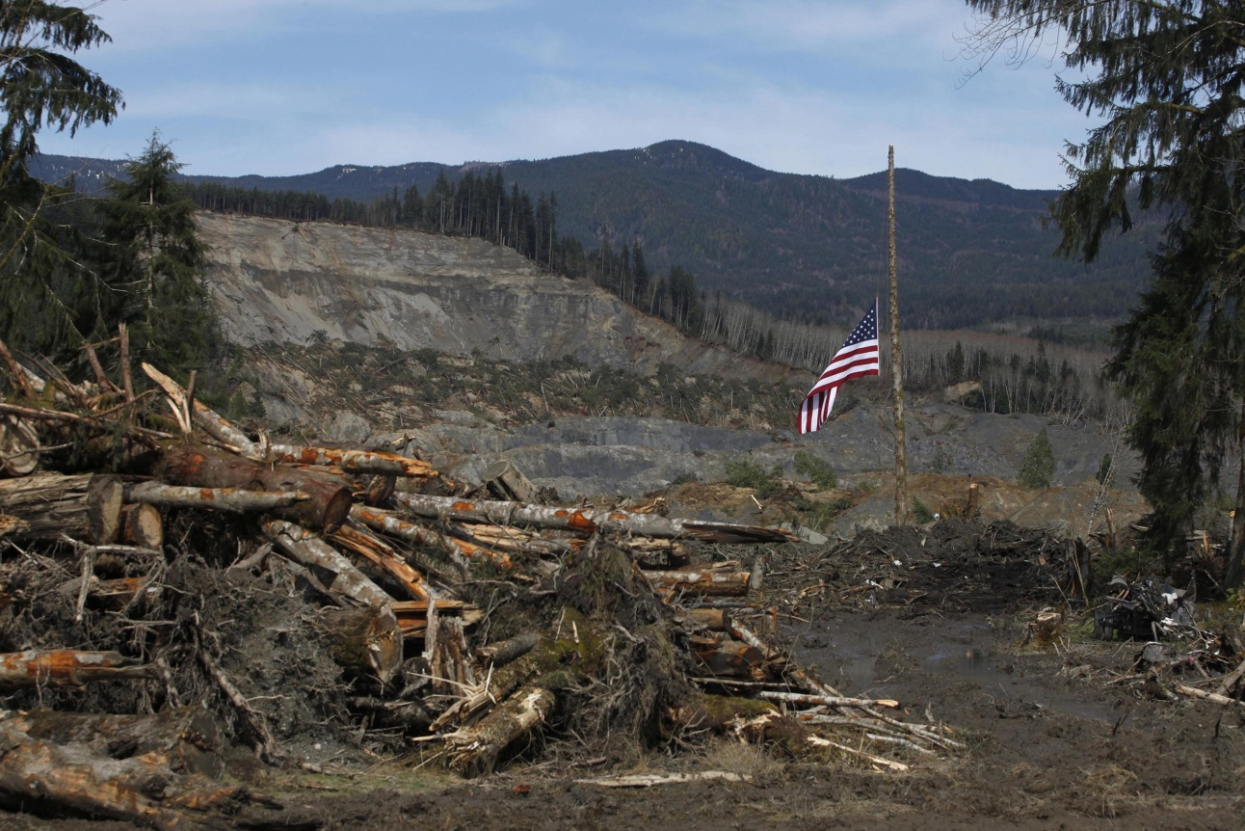
Landslides are a serious geologic hazard common to almost every State in the United States.
Landslides in the United States cause approximately $3.5 billion (year 2001 dollars) in damage, and kill between 25 and 50 people annually
(source geology.com)

Slide 5
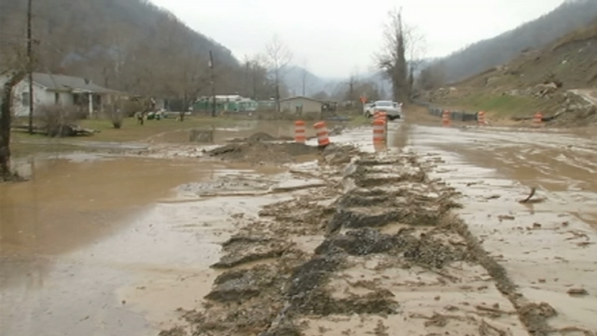
Logan County Landslide (Dec, 2013) 100 people were “locked in” w/ cost of recovery est. over $1 million.

Slide 6
Academic Perspective
“West Virginia has one of the greatest landslide risks of any in the country“. We may in fact have the highest per capita landslide damage rate of any of the 50 states…more data is needed to get a better grasp on the land”
Steve Kite, Chair of the Dept. of Geology & Geography at WVU
(Source: WV Public Broadcasting, April 25, 2014)

Slide 7
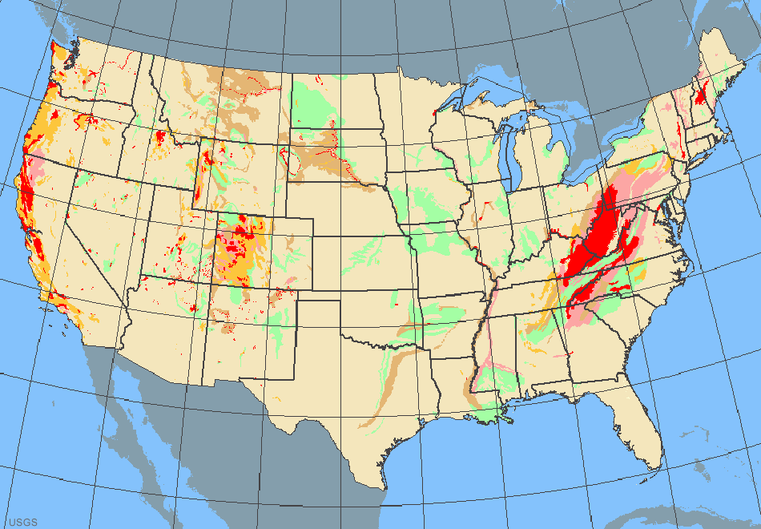
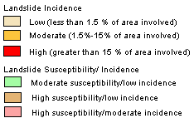
Source: USGS

Slide 8
Oso Landslide
In March 2014 a landslide engulfed 49 homes and other structures in an unincorporated neighborhood known as "Steelhead Haven“.
It also dammed the river, causing extensive flooding upstream as well as blocking State Route 530.
Excluding landslides caused by volcanic eruptions, earthquakes or dam collapses, the Oso slide is the deadliest single landslide event in United States history.
The mud, soil and rock debris left from the mudslide covered an area 1,500 ft (460 m) long, 4,400 ft (1,300 m) wide and deposited debris 30 to 70 ft (9.1 to 21.3 m) deep.
41 confirmed deaths, with 2 still missing.

Slide 9
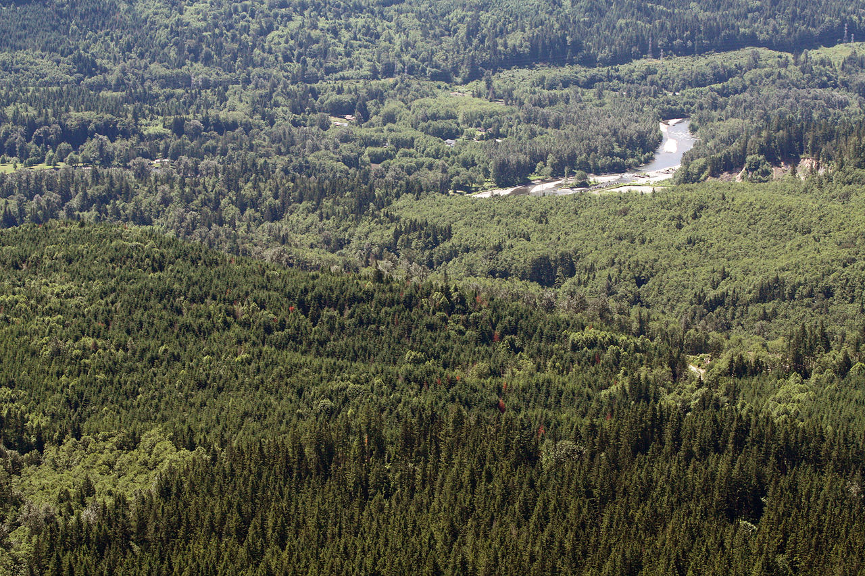

Slide 10
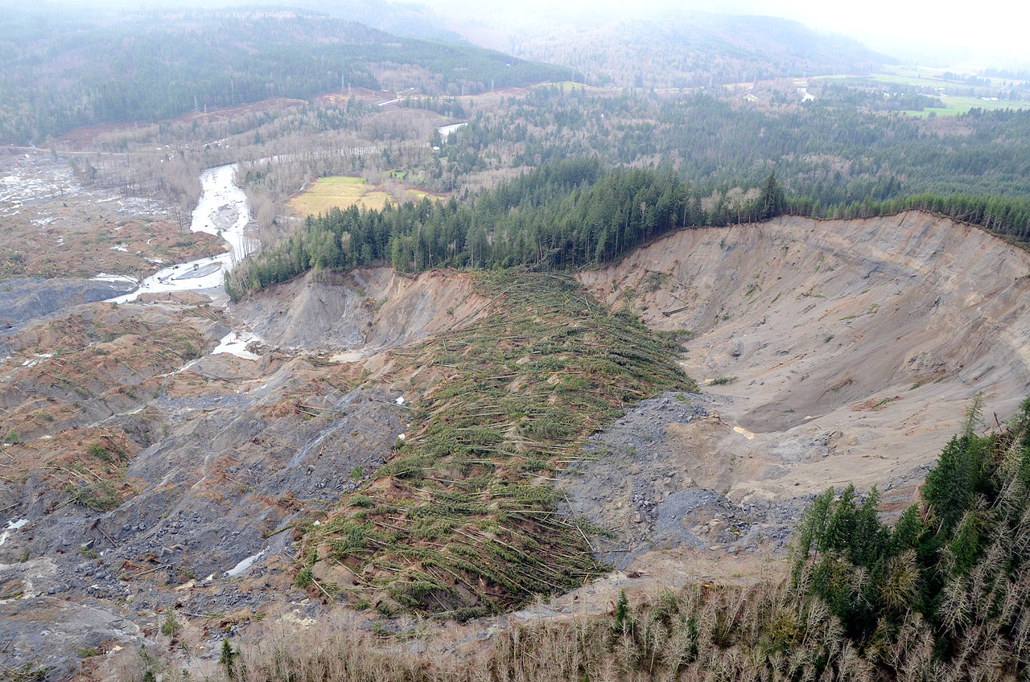

Slide 11
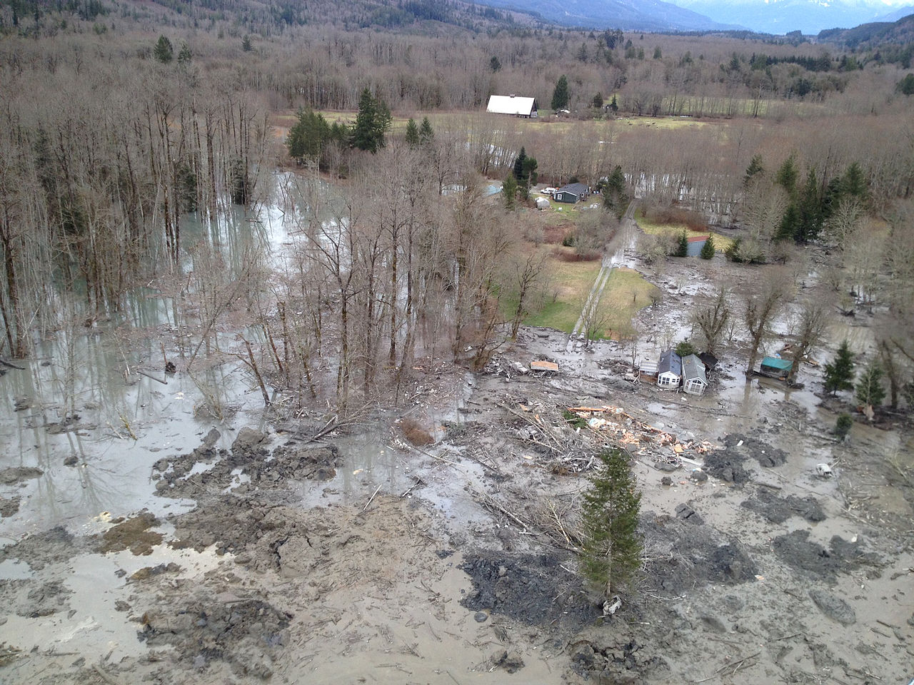

Slide 12
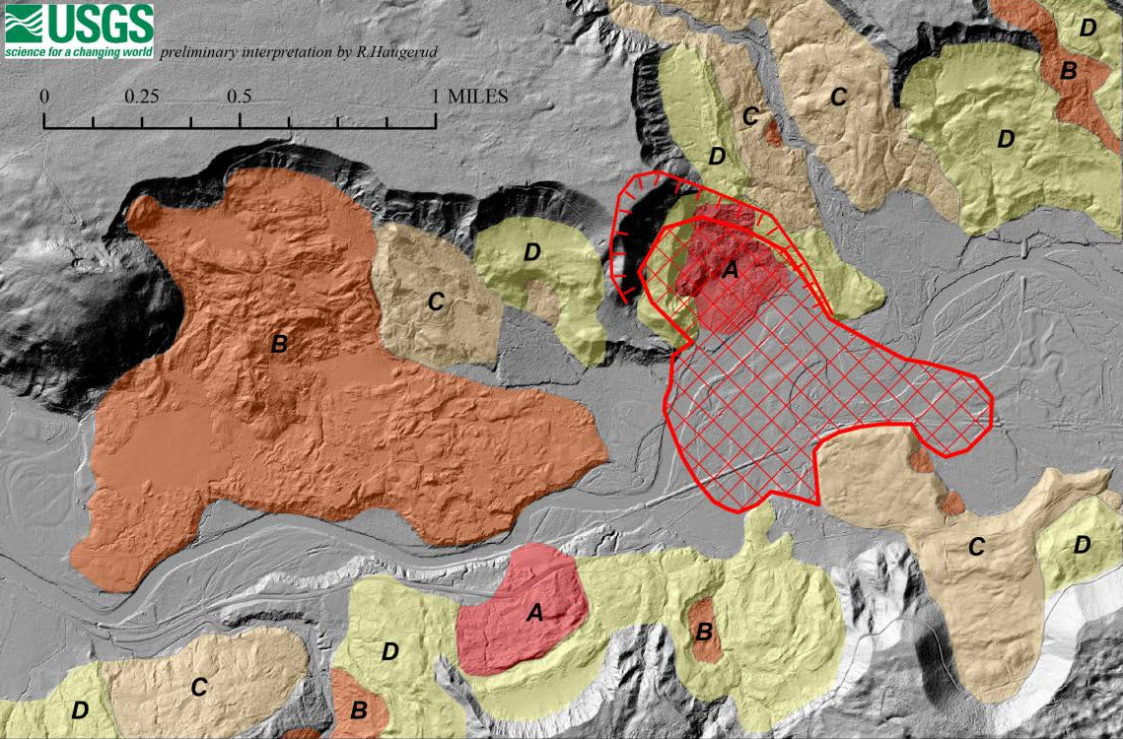

Slide 13
OSO Video

Slide 14
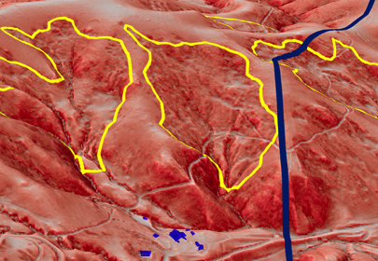
Terrain Failure Detection

Slide 15
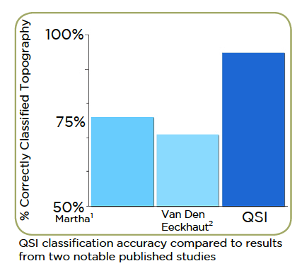
Methodology
Incorporates existing techniques from published literature and adheres to the rigors of scientific methods.
Statistical analysis has indicated terrain classification accuracy of greater than 90%; a vast improvement compared to existing detection methods. - (Martha & Van Den Eechhaut)
Martha, T.R., et al, 2013. Landslide hazard and risk assessment using semi-automatically created landslide inventories. Geomorphology 184, 139–150.
2. Van Den Eeckhaut, M., et al, 2012. Object-oriented identification of forested landslides with derivatives of single pulse LiDAR data. Geomorphology 30–42.

Slide 16
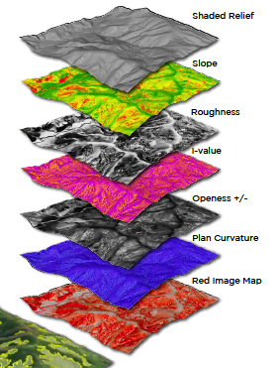
Methodology
Ground-classified LiDAR points are processed to create a variety of raster images, which reveal landform features unique to landslides and faults.
Input into QSI’s proprietary machine learning tool include: shaded relief, slope, roughness, plan curvature, and other DEM derived topographic characteristics
Note: QSI’s proprietary tool builds on the work with support of vector machines by Chih-Chung Chang & Chih-Jen Lin (ref: www.csie.ntu.edu.tw/-cjlin/libsvm)

Slide 17
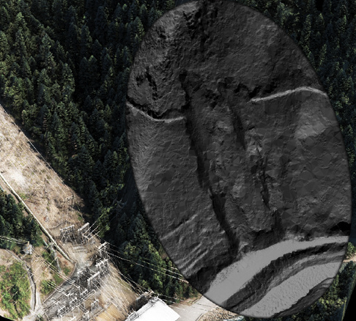
Methodology
High resolution LiDAR penetrates dense forest canopy resulting in a high resolution ground model. In addition to facilitating a highly automated failed terrain classification process, high resolution ground models accentuate critical geomorphology and reduce instances of omission and false positives.

Slide 18
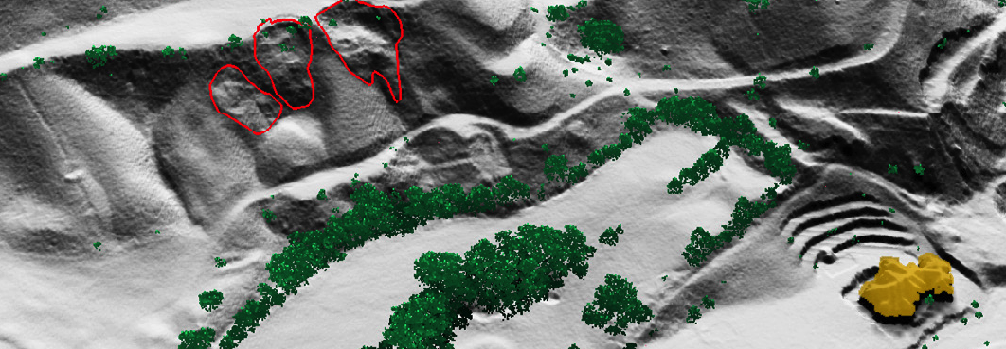
Methodology
Once the automated detection is complete, QC methods are performed to eliminate false-positives, analyze potential omissions, refine the geometry of slope failure delineations, and liniment detections. Upon completion the areas are automatically assigned respective slope angle, aspect, mean annual precipitation, vegetation cover, and soil attributes.

Slide 19
Deliverables
Potential landslide hazard areas as attributed polygons (esri shapefile format)
Area of polygon
Average slope and aspect
Map unit symbol (standardized by US Soil Survey)
Soil unit name
Annual precipitation
Soil types found within polygon
Percent vegetation cover
Liquid Limit (LL)
Plastic Limit (PL)
Plasticity Index (PI)

Slide 20
Deliverables
Red Image Maps – Images composed of separate color ramps that represent topographic openness, slope and roughness
Google Earth KML of project area and all slope failure areas. – The KML provides a shareable visualization of the analysis that can be opened and viewed along with satellite imagery
Attributed Soil Map (shapefile) as polygons. Soil types and attributes are determined using the USDA Web Soil Survey

Slide 21
LiDAR Derived Terrain Fault Analysis
Utilizing an automated approach, QSI has developed and accurate and efficient methodology, that detects areas of failed terrain using high-resolution LiDAR data. The result is a robust and cost-effective dataset that indicates the presence of landslides, fault line and other forms of failed terrain.

Slide 22
Terrain Failure Detection
Video

Slide 23
Thank you

Slide 24
Openness is proposed as a visualization technique for the archaeological
interpretation of digital terrain models derived from airborne laser scanning. In contrast to various shading techniques, openness is not subject to directional bias and relief features highlighted by openness do not contain any horizontal displacement.
Additionally, it offers a clear distinction between relief features and the surrounding topography, while it highlights both the highest and lowest parts of features. This makes openness an ideal tool for mapping and outlining of archaeological features. A comparison with sky-view factor and local relief model visualizations helps to evaluate advantages and limits of the technique.

