Slide 1
Addressing Session
WV GIS Conference

Slide 2
Discussion Points
Geographic Support System Initiative (GSS-I)
Master Address File (MAF)
Sharing Address Data

Slide 3
The GSS-I Partnership Program
Launched in October 2012
Opportunity for tribal, state, county, and local governments to continually exchange address & spatial data with the Census Bureau
Recognizes local governments as a definitive authority for quality address and street data within their communities
Leverages the Census Bureau’s broad partner network to encourage participation

Slide 4

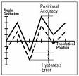
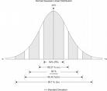
Key Components of the GSS-I
    An integrated program that utilizes a partnership program for:
      Improved address coverage
      Annual, transaction-based address and spatial feature updates
      Enhanced quality assessment and measurement
Address Updates
Quality Measurement
Street/Feature Updates
123 Testdata Road
Anytown, CA 94939
Lat 37 degrees, 9.6 minutes N
Lon 119 degrees, 45.1 minutes W
Notes:
The GSS Initiative is a multi-year effort aimed at improving the overall coverage and quality of the Master Address File for the 2020 Census.
A primary component of the GSS Initiative is the Partnership Program which is designed to acquire address information from partners each year leading up to 2020.
This new program combines elements of previous programs, including the 2010 Local Update of Census Addresses (LUCA) program, the annual Boundary and Annexation Survey, and the MAF/TIGER Enhancement Program (2002-2008).

Slide 5
Benefits of Participation
Expanded ROI – encourages re-use of local government geospatial data investment
Reduces redundant federal data collection efforts
Increases usage of high-quality local government data for multiple federal programs, including the 2020 Census and the USGS National Map
Provide maximum input into the American Community Survey and closes the gap between partner addresses and Census addresses for Local Update of Census Addresses (LUCA) program in 2020.
Notes:
RELATED TO POINT 4:
The LUCA program had a large footprint on the 2010 Census.
We processed over 41 million State, Tribal and Local addresses in LUCA 2010 and we hope that working with our partners throughout the decade will lessen that LUCA footprint for 2020. This benefits both the partner and the Census Bureau.

Slide 6
What is the Basic Process?
Research and Identify potential data Partners.
Acquire partner data and perform Content Verification to determine general usability
Crosswalk, standardize, match, and geocode partner addresses and structure points using the Master Address File (MAF)
Match street centerline data to identify differences, calculate spatial accuracy using GPS control points
Ideal Scenario: new addresses are added to the MAF, new streets are added to TIGER, address and spatial inconsistencies are submitted for resolution
Notes:
This list describes the high-level process for a typical GSS Initiative Partnership Program participant.
The Content Verification process is conducted by Regional Office geographers, and ensures that the data acquired from partners is appropriate for detailed evaluation.

Slide 7
Data Content Guidelines
The Census Bureau has released Data Content Guidelines to describe the minimal and optimal information required for Addresses (including structure points), Street Centerlines, and Metadata provided by partners for the GSS-I
Data Content Guidelines are located at:
http://www.census.gov/geo/www/gss/gdlns/addgdln.html
Notes:
What kind of address and feature data are we looking for?
We have posted our data content guidelines describing the minimal and optimal information needed for the GSS-I on our Census.gov site.

Slide 9
Minimum Address Guidelines - MATCHING
To successfully match to the MAF, a partner address must include:
  Complete Address Number
  Complete Street Name
AND at least one of the following:
  Address Coordinate (latitude, longitude)
  ZIP Code
  Postal City and State
  Census 2010 Tabulation State, County, Tract and Block Code
This minimum information allows the Census Bureau to update the source data for an existing MAF address record, adding to our confidence that the address is valid.
Notes:
As a reminder -

Slide 10
Is the address…
Mail-able
Deliverable
Locatable
Geocode-able
Notes:
Every map made for a purpose. Every geographic Tool was created for a purpose

Slide 11
No national addressing system
What Kind of Address Data?
• City‐style addresses
and/or
•Non city‐style addresses (i.e., Rural Route #) that ‘ideally’ meet:
USPS minimum delivery requirements, and
the ‘FGDC Address Standard’ (U.S. Thoroughfare, Landmark, and Postal Address Data Standard)
See the Census Bureau Address Data Content Guidelines:
http://www.census.gov/geo/www/gss/gdlns/addgdln.html
Notes:
No National Addressing System. Up until now, relied on USPS minimum delivery req, . . . . FGDC Standards.

Slide 12
Master Address File (MAF)
Continuous Update for complete and current Address Coverage
Support of American Community Survey, Current Surveys
Best available data from Partners, Delivery Sequence File (USPS), Commercial and Field collection
Census 2010

Slide 13
MAF Challenges
Addressing Standards
  USPS minimum delivery requirements
  FGDC Address Standard’ (U.S. Thoroughfare, Landmark, and Postal Address Data Standard)
Data updates previously limited to:
  US Postal Service Delivery Sequence File
  Local of Census Addresses (LUCA)
  Census field operations

Slide 14
MAF Challenges (continued)
Not all addresses in the Census are in the USPS Delivery Sequence File (DSF):
  13% of the addresses in the final census universe have never appeared on any DSF since 1997
Not all addresses in the DSF can be geocoded to the MAF

Slide 15
MAF Challenges (continued)
Constraints in working with partners to build and maintain the MAF
  Requires close collaboration with the U.S. Postal Service
  Requires substantial partnership program with tribal, state, and local governments (approximately 40,000)
  Two-way address sharing is difficult and tenuous under confidentiality constraints of Title 13
Notes:
EMPHASIZE need to continually UPDATE MAF with current accurate local data

Slide 16
Title 13 U.S.C. Restrictions
US Census is prohibited from distributing or disclosing your individual addresses and coordinate points.

Slide 17
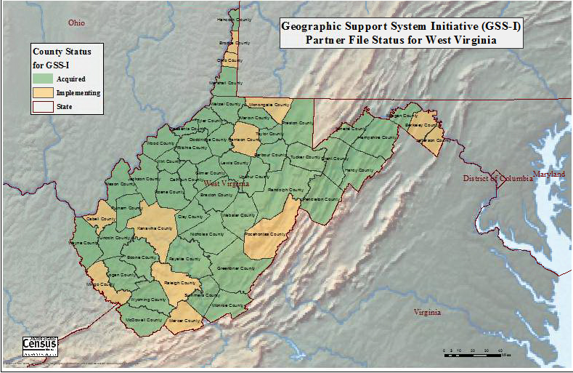
GSS-I Status for West Virginia (FY14)
Notes:
A Closer look
For WV: WVDHSEM, Jennings Starcher provided us a state-wide dataset.
Jennings let us know which counties had complete/incomplete E911 data and which counties were ready to be run through our process for GSSI. This processing is going on now.

Slide 18
WVDHSEM Dataset
State-wide, consistent
Current – within the last 2 years
Complete Metadata
Meets GSS-I minimum data Guidelines
Residential vs Non-Residential
MATCH RATES for WV Counties 86% to 96.5%
Notes:
While we are still processing the WV files, we are seeing . . .

Slide 19
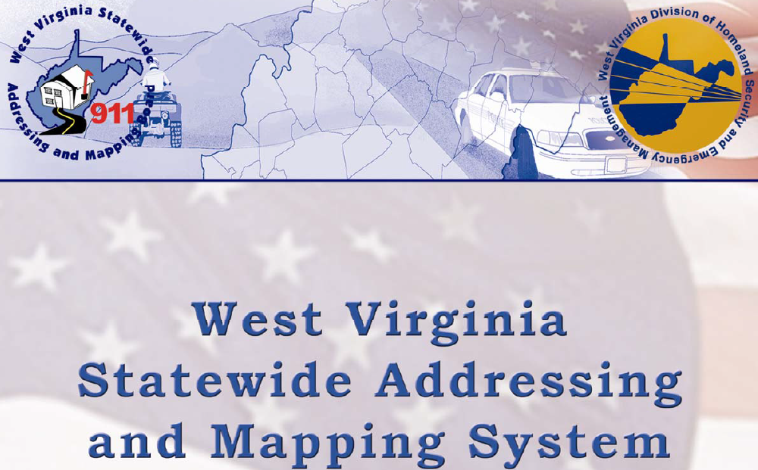
WV Data Specifications

Slide 20
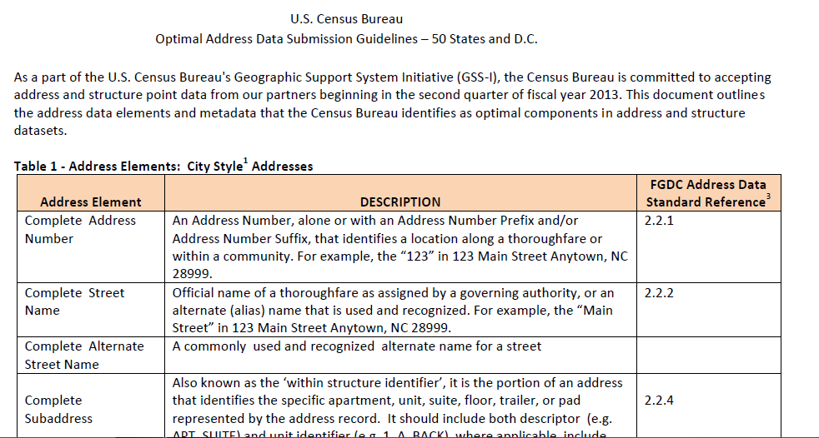
US Census - Optimal Address Data Submission Guidelines

