Slide 1
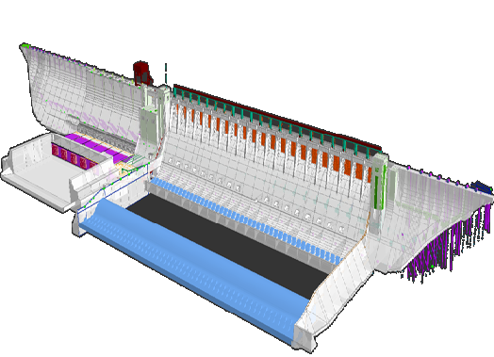
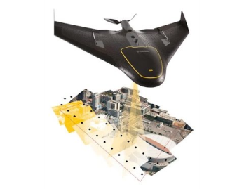
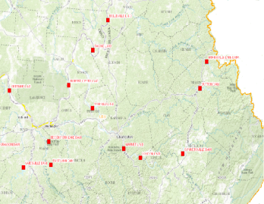
U.S. Army Corps of Engineers Geospatial and UAS Program
Huntington District
Michael Koon, GISP, CMS-RS
Geospatial Section
2016
West Virginia GIS Conference

Slide 2
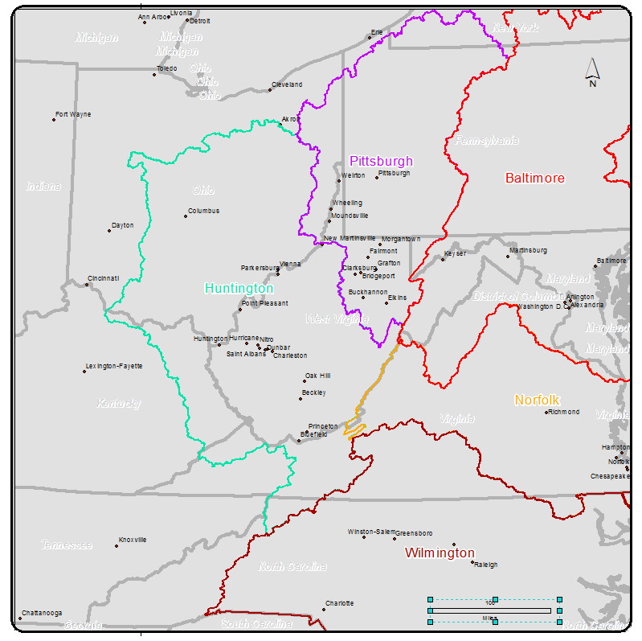
USACE POCs
Huntington District
Michael Koon
(304) 399-6974
michael.d.koon@usace.army.mil
Mack McCarty
Pittsburgh District
Kristen Scott
(412) 639-1205
kristen.l.scott@usace.army.mil
Baltimore District
Jared Scott
(410) 962-7445
Jared.m.scott@usace.army.mil
2016
West Virginia GIS Conference

Slide 3
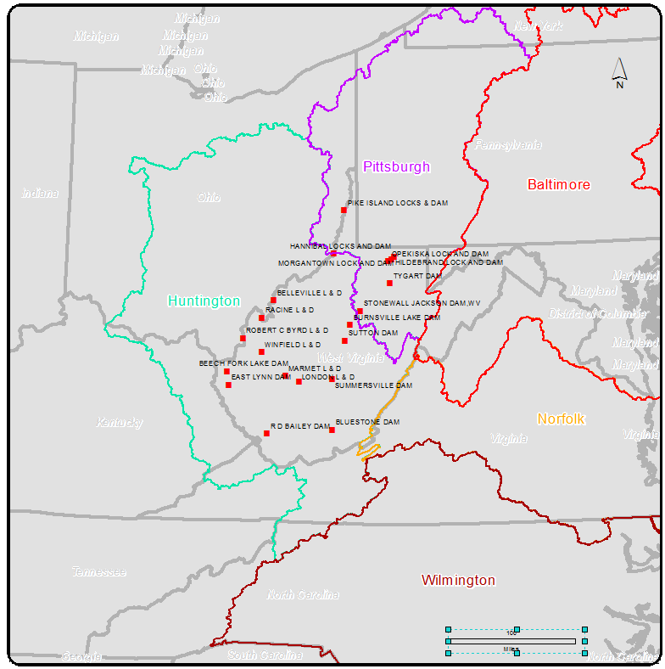
USACE Huntington Geospatial Program
Geographic Information Systems
Software\Enterprise\Database Support
Tools \ Web Applications
Production Services
Mapping
LiDAR, Photogrammetry
UAS, Satellite
Surveying
Conventional, Terrestrial, Mobile
Unmanned Aerial System (UAS)
Geospatial Data Integration
2016
West Virginia GIS Conference

Slide 4
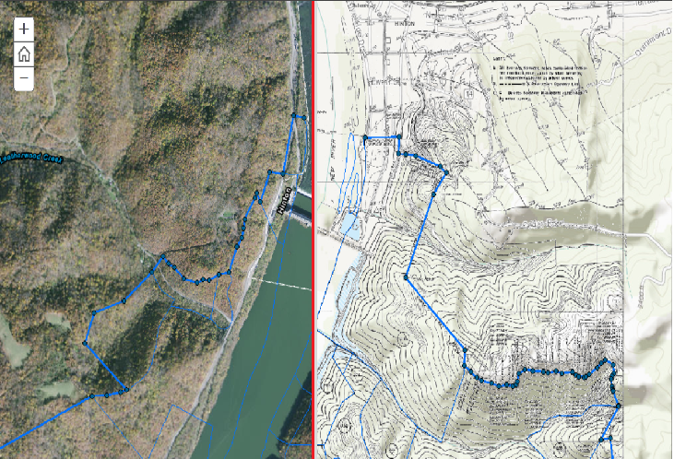
GIS
Data Migration and Conversion
Real Estate
National Levee Database
SDSFIE
Watershed Modeling
Enterprise DB\ Web apps\Tools
DMZ (Public Facing)
3DGIS\CIM Data Management System
2016
West Virginia GIS Conference

Slide 5
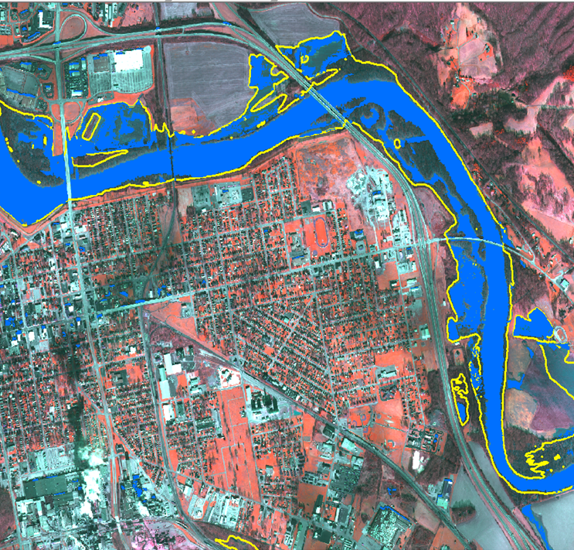
Mapping
LiDAR, Photogrammetry, UAS
High Density Terrain
Orthoimagery Development
Multispectral Imaging
Satellite
Multi\Hyperspectral
GC\RPC\LiDAR
Orthorectification
Image Processing
Products and Uses
Planning and Design
Flood Inundation Modeling and Calibration
Erosion\ Change Detection
Construction Monitoring
Historical Documentation (flood events)
2016
West Virginia GIS Conference

Slide 6
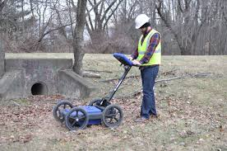
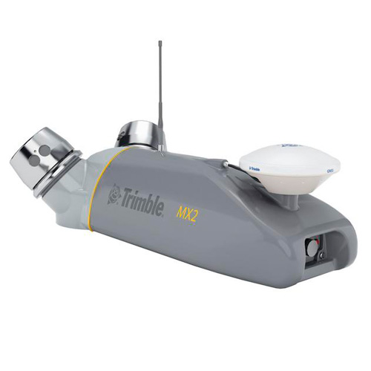
Surveying
Conventional
Terrestrial LiDAR
Mobile LiDAR
Utility
GPR
2016
West Virginia GIS Conference

Slide 7
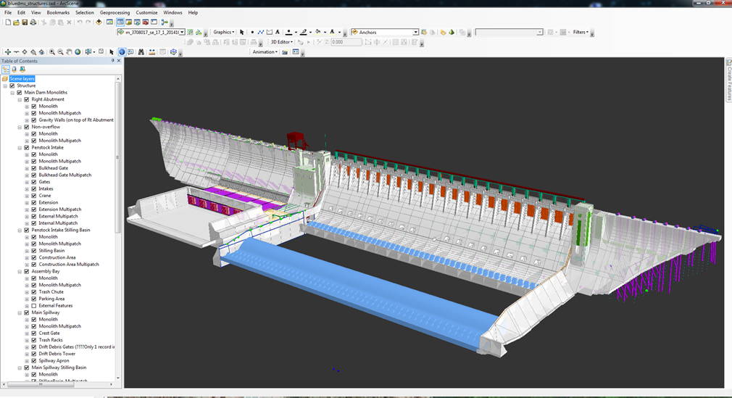
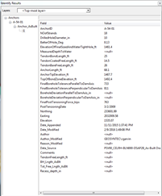
Geospatial Data Integration
3DGIS\CIM (Civil Information Modeling) DMS
Hybrid of GIS-BIM-CADD-Mapping-Surveying to provide a “Living Model”
Precise 2D and 3D Geometric representation of all project features
All features are alive with attributes, no more dummy lines.
Includes Geologic and Soils Data.
Precise locations of existing underground utilities and features.
Used to verify that project construction meet design specifications and design intent.
For example, the model will be used to verify that the alignment and depth of high-strength anchors are in a suitable geologic material for the required bonding zone
3D GIS Model showing upstream view of external dam features and GIS Table of Contents. Features are linked to database of reports and logs with real-time data feeds.
2016
West Virginia GIS Conference

Slide 8
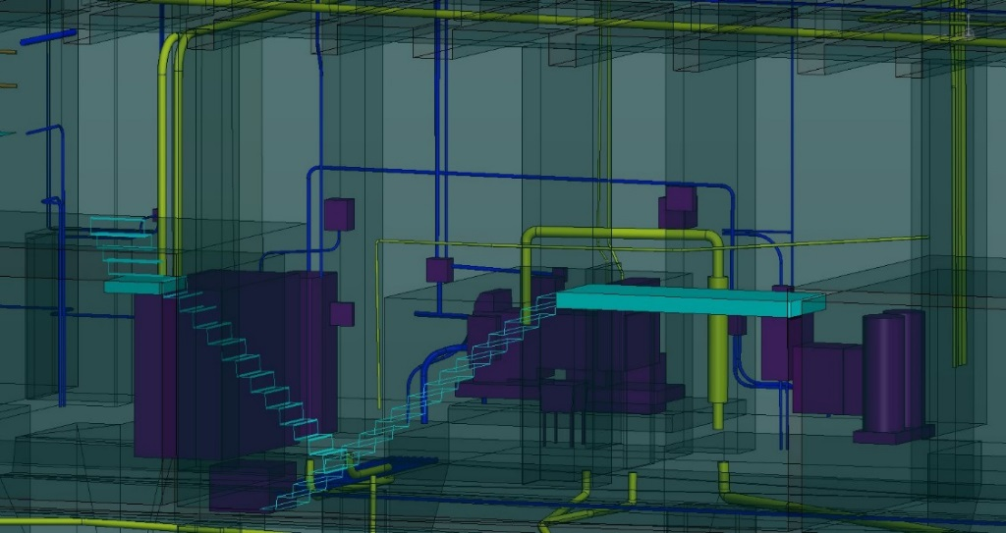
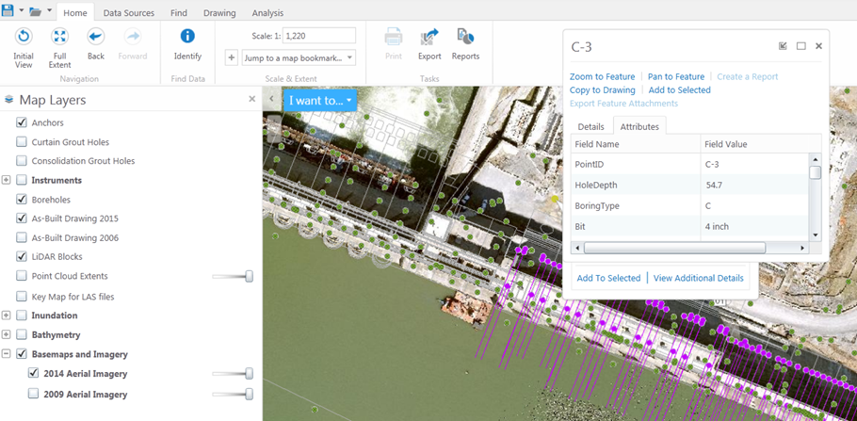
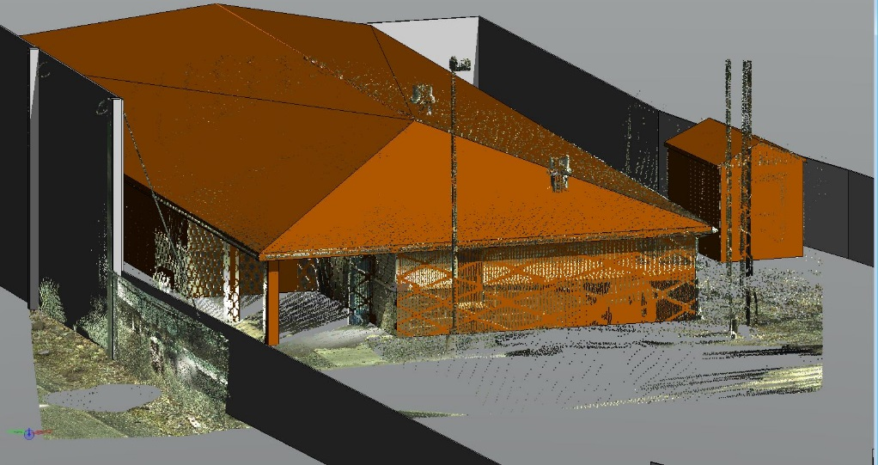
Geospatial Data Integration
Dam internal features digitized from LiDAR points
3DGIS\CIM (Civil Information Modeling) DMS
Plan View Desktop GIS showing Structures, Anchors, and Instruments
Webmapping from
Same Source Models
Generation of structures from LiDAR point cloud in Microstation
2016
West Virginia GIS Conference

Slide 9
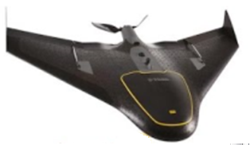
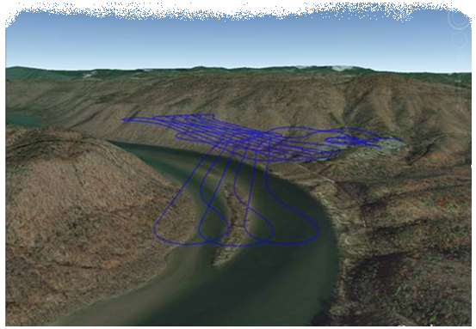
UAS Program
UAS Introduction
UAS Safety
Flight Planning
Flight Operations
Launch
Online
Landing
Data Processing and Quality Control
Deliverables
2016
West Virginia GIS Conference

