Slide 1
State Government Session
2016
West Virginia GIS Conference

Slide 2
Department of Commerce WV Geological & Economic Survey
“Geology Underlies It All . . . “
Providing Geospatial Data and Services to the Mountain State
Mary C. Behling
Senior Geologist and Head
Information Services Program May 4, 2016
2016
West Virginia GIS Conference

Slide 3
WV Geological & Economic Survey
Stewards of geologic information for West Virginia for 119 years . . .
❖ Geoscience research, data, mapping, publishing, service
⬇ Geologic mapping (bedrock, surficial)
⬇ Oil and gas resources, subsurface geology
⬇ Coal resources, coal chemistry, mining
⬇ Other economic resources (sand & gravel, limestone, sandstone, clay & shale, etc.)
⬇ Environmental geology, karst, natural hazards (landslide susceptibility)
⬇ Geothermal energy potential
⬇ etc. (e.g., geologic structure, earthquakes, etc.)
2016
West Virginia GIS Conference

Slide 4
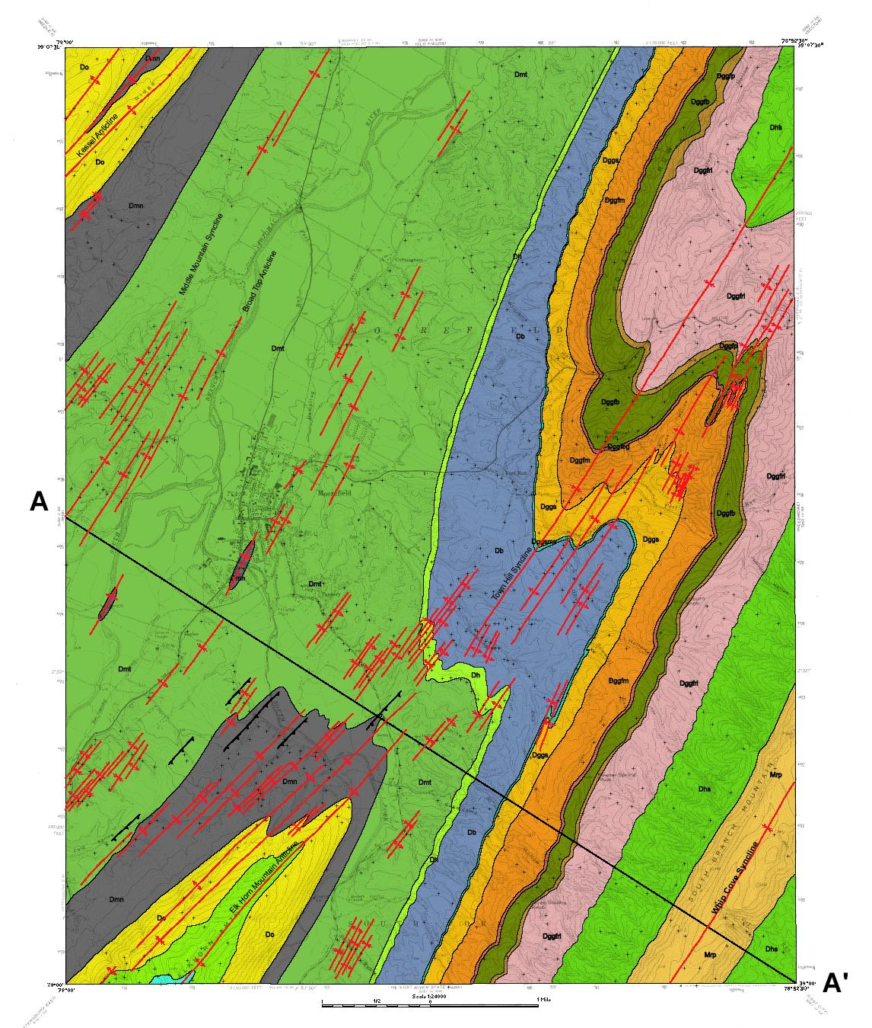
Digital Bedrock Geologic Maps contain up to 14 digital geologic layers, using ArcGIS:
◦ geologic formation contact lines and polygons
◦ faults, structural fold axes
◦ bedding points/orientation, control points
◦ structure contour lines
◦ surficial/Quaternary alluvium contacts
◦ cross-section-line
◦ igneous intrusive features
◦ coal beds
◦ metadata
◦ etc.
o  Moorefield Geologic Quad
2016
West Virginia GIS Conference

Slide 5
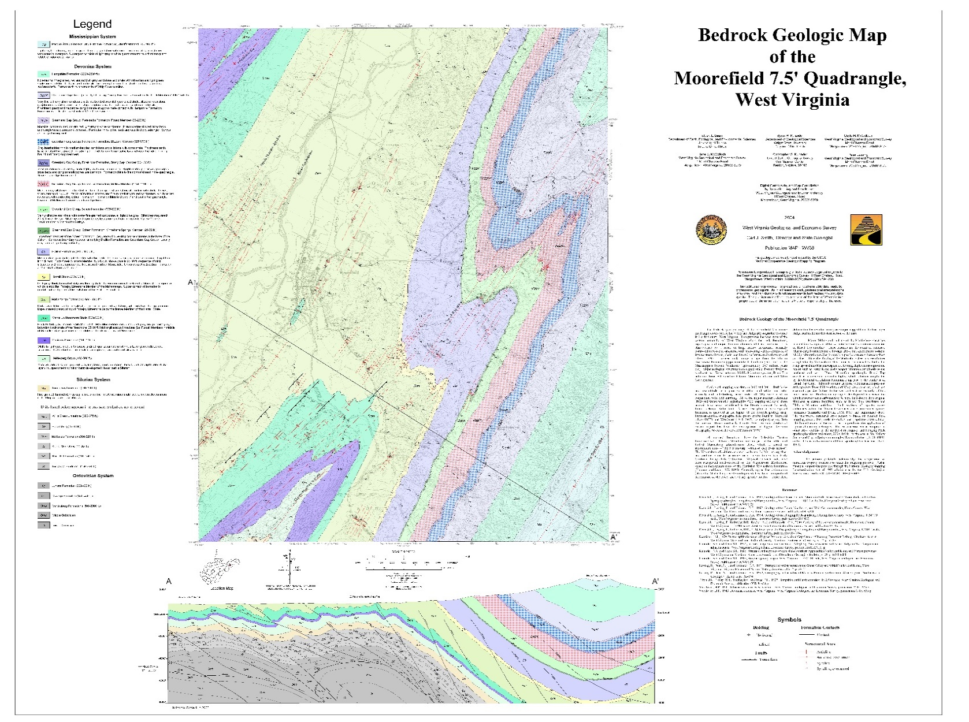
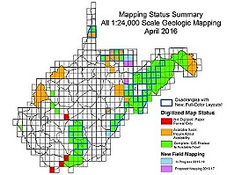
GIS Layout “Package”
✓ GIS package includes digital geologic layers plus: georeferenced USGS topo base, scanned georeferenced original source material, text files, stratigraphic column, legend, cross- section, quadrangle boundary
✓ 108 quads completed in GIS format
★ 22% “Earth Day” discount extended!!
2016
West Virginia GIS Conference

Slide 6
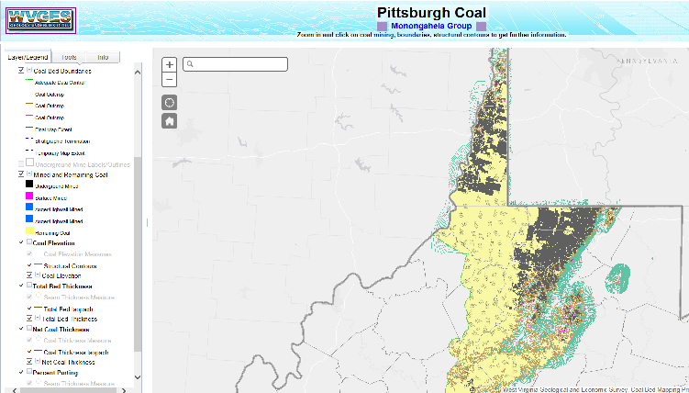
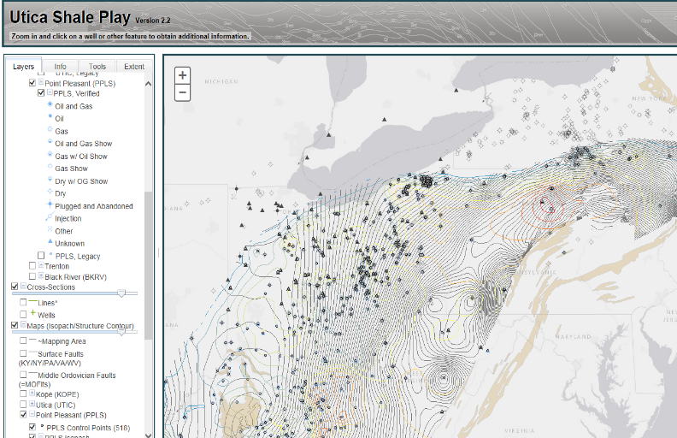
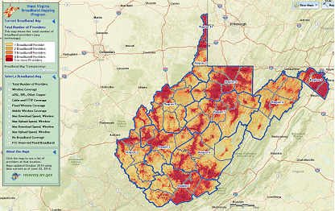
WV Geological & Economic Survey
Interactive mapping applications: ESRI’s ArcGIS Server
Mapping Coal Beds and Mining (80 coal seam services, 14 data layers per seam: outcrop, mining types, coal thickness, partings, overburden, etc.)
Mapping the “Utica Shale” Play in the Appalachian Basin
(5 states + other researchers,
8 stratigraphic units, well data, maps, cross-sections, etc.)
Mapping Broadband Coverage in West Virginia
2016
West Virginia GIS Conference

Slide 7
WV Geological & Economic Survey
ESRI’s ArcGIS REST services:
http://atlas.wvgs.wvnet.edu/arcgis/rest/services
♦ Coal
♦ Oil & Gas
♦ Utica Shale (multi-state)
♦ Geothermal
♦ Broadband
♦ 3DEP
♦ Geology
(contact: John Bocan, Rich Binns)
2016
West Virginia GIS Conference

Slide 8
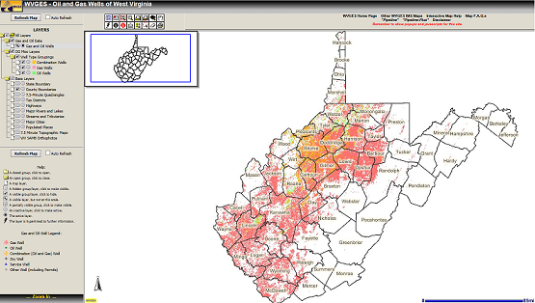
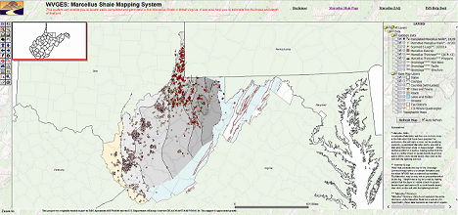
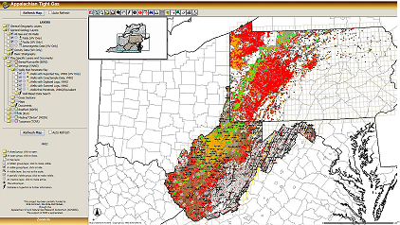
WV Geological & Economic Survey
Interactive mapping applications: ESRI’s ArcIMS: (transitioning over to ArcGIS Server (i.e., what’s next . . . )
WV Oil & Gas Wells
(“well header data”, 152,000+ wells)
Marcellus Shale
(wells, thickness, logs, structure, outcrop, etc.)
Appalachian Tight Gas Sands
(2+ states, 6 plays, cross-sections, maps, data/logs/documents, downloadable files, etc.)
2016
West Virginia GIS Conference

Slide 9
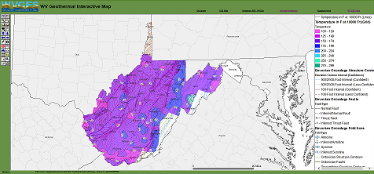
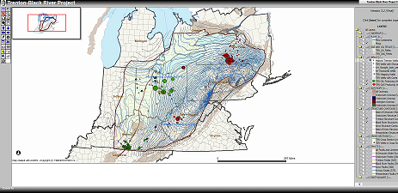
WV Geological & Economic Survey
And more interactive mapping applications: ESRI’s ArcIMS: (transitioning over to ArcGIS Server (i.e., what’s next . . . )
Geothermal Potential
(by temperature at depth,
and depth at temperature)
Trenton-Black River Map
(Appalachian Basin: wells, logs, fields,
structure, outcrop, cross-sections, etc.)
2016
West Virginia GIS Conference

Slide 10
WV Geological & Economic Survey
And some new mapping projects on the horizon . . . ( ☺ )
2016
West Virginia GIS Conference

Slide 11
WV Geological & Economic Survey
Contact us:
West Virginia Geological and Economic Survey
1 Mont Chateau Road
Morgantown, WV 26508
Phone: (304)594-2331
http://www.wvgs.wvnet.edu
2016
West Virginia GIS Conference

Slide 12
WV DNR Wildlife Resources GIS and Tech Support
Introductions
Major projects:
Evaluating mobile data collection and GPS options
Getting new GIS Server on-line
General printed maps for visualization and data collection
Data management and editing:
WMA boundaries, fisheries layers, etc.
2016
West Virginia GIS Conference

Slide 13
WV DNR Wildlife Resources GIS and Tech Support
Major projects continued:
Climate interpolation for Breeding Bird Atlas
State Wildlife Action Plan data organization and metadata
Biotics base map data: WV-specific services
Hunting and Fishing tool redesign with WV GIS Tech Center:
Flex to JavaScript
Elk model comparison: Life requisite versus Delphi habitat model
Deer model update:
2015 WV Terrestrial Habitat and 2014 Crop Data Layer
2016
West Virginia GIS Conference

Slide 14
Department of Environmental Protection
Michael Shank
2016
West Virginia GIS Conference

Slide 15
Department of Tax & Revenue
Travis Payne
2016
West Virginia GIS Conference

Slide 16
Report by West Virginia Department of Transportation
Yueming Wu, Ph.D., GISP
GIS Manager
2016
West Virginia GIS Conference

Slide 17
GIS Program
Major Functions
GIS
Mapping
Linear Referencing System (LRS)
13 FTEs + 2 Cartographers + 3 Temps
Completed Projects
Hardware Upgrade
ArcGIS Online for Organization Implementation
New General County Highway Maps
New Tourism Map
Esri Roads & Highways Implementation
Ongoing Projects
Support for wvOASIS
STIP Web Mapping Application
New General State Highway Map
Enterprise LRS Development
95
376
6
95
6
6
265
95
773
2016
West Virginia GIS Conference

Slide 18
Statewide Addressing and Mapping Updates & Upgrades
Update Critical Infrastructure Locations
Update statewide data within the Homeland Security Information Network
http://www.dhsem.wv.gov/Pages/default.aspx
2016
West Virginia GIS Conference

Slide 19
West Virginia
Infrastructure & Jobs Development Council
gis.wvinfrastructure.com
Web functionality upgrades
Statewide data updates
Submission guidelines
Interagency data access
External data access
2016
West Virginia GIS Conference

