Slide 1
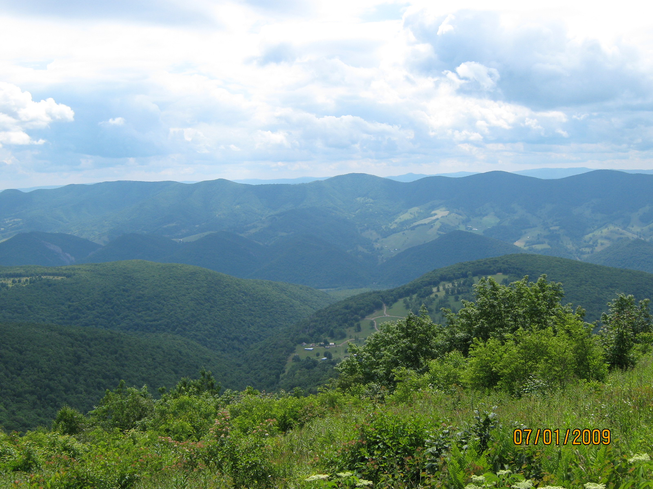
DOF Use of ArcGIS Explorer Online
WVAGP Membership Meeting
Charleston, WV - November 3rd, 2011
Steve Harouff
WVDOF - GIS Specialist
Also - GIS Subcommittee Representative for
NAASF - Forest Resource Planning Committee (USFS)

Slide 2
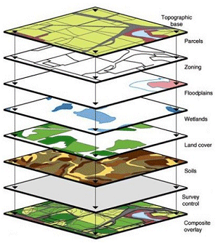
DOF Use of ArcGIS Explorer Online
DOF Programs – Managed by 100+ employees
Wildfire Protection
Land Owner Assistance
Forest Stewardship
Managed Timberland
Forest Legacy
Water Quality -Logging Sediment Control Act (LSCA)
Forest Products Utilization and Marketing
State Lands (7 State Forests)
Chesapeake Bay
Urban Forestry
Notes:
Layers of information

Slide 3
DOF Use of ArcGIS Explorer Online
ArcGIS Explorer Online - (AGX DEMO)
Free lightweight web based geo-browser
Requires an Esri user account that is free, and provides 2 GB of storage
Can share data through online maps/presentations privately with colleagues as members of WVDOF user group, or
Share publicly, via social networking and websites
Access to many public data layers and base maps
http://www.esri.com/software/arcgis/explorer-online/index.html

Slide 4
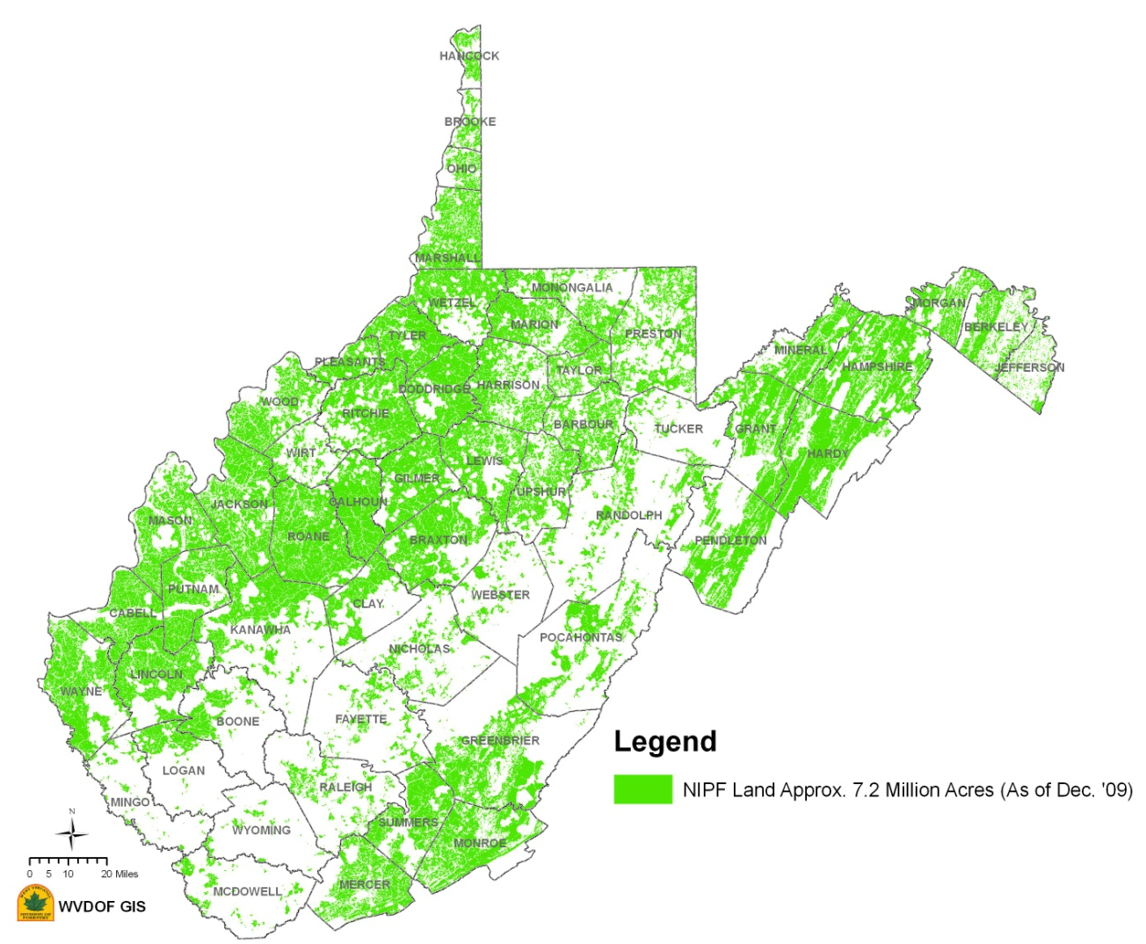
DOF Use of ArcGIS Explorer Online
Questions?
Thank You.

