Slide 1
ArcGIS Server
Versioning
And
Multi-user Editing

Slide 2
SDE Geodatabase
Install ArcGIS Server to network server
Some form of Microsoft SQL Server
In ArcCatalog expand Database Servers
Double click “Add Database Server”
Type in name of SQL server for connection
Not case sensitive
Add Database
Right click on Server name
Use option New Geodatabase
Type in new geodatabase name and click OK
Tip-Be sure of the name before you apply

Slide 3
Add Data
Add Feature Dataset or Feature Class
Right click on new geodatabase and choose “new” feature dataset, feature class, table, or raster OR “import” feature class, table, or raster
Right click on feature dataset if applicable and create “new” or “import” feature class
Right click to create “New” Topology if desired
Double click or Right click to rename data
Database name will be included in new Feature Class name

Slide 4
Versioning
Create new version
Right click on target geodatabase
Choose “Versions”
The Default version is created with creation of geodatabase
In version manager, right click on the default version to change name and/or create a new version
Name the new version something easily recognizable and choose permission desired
Public permission is the only permission that allows another user to edit

Slide 5
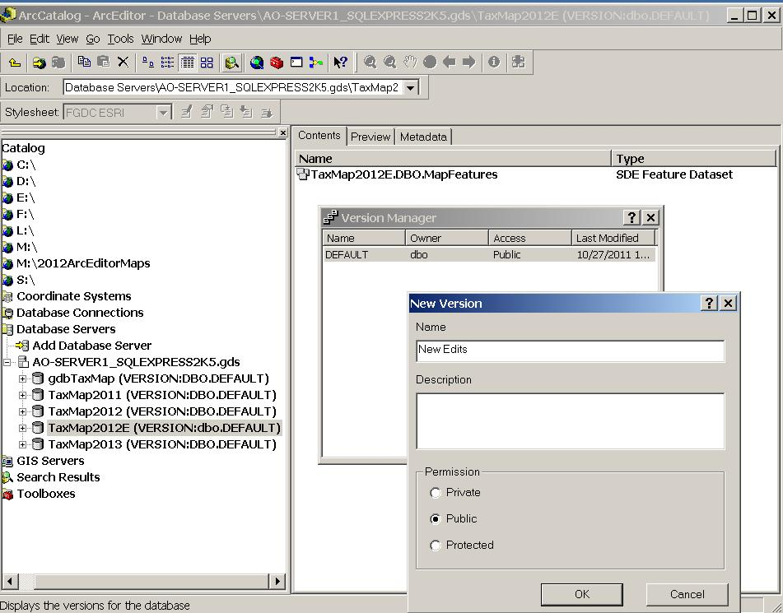

Slide 6
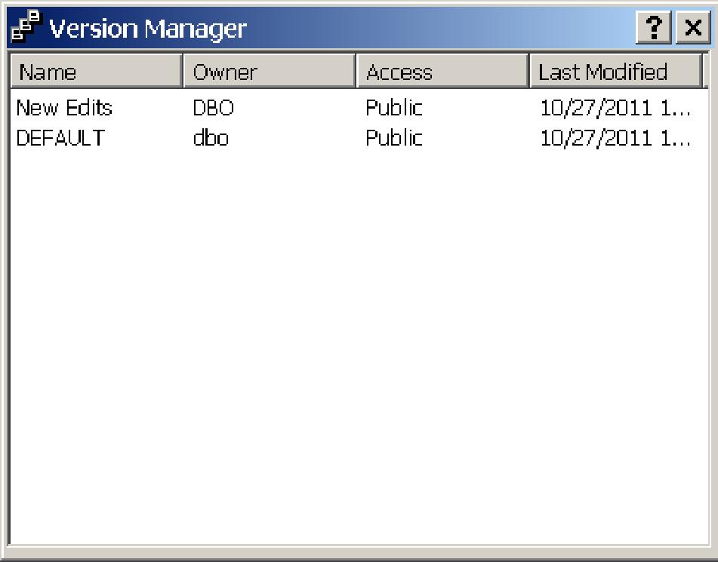

Slide 7
Register as Versioned
Right click on new Feature Dataset or Feature Class and click “Register as Versioned”

Slide 8
Multi-User Editing Permissions
Right click on Geodatabase and choose “Administration” and then “Permissions” to set permission to read, write, or administer geodatabase
Click name of person to do editing and give desired permission
You can right click Feature Data Sets or Feature Classes to give exclusive permissions

Slide 9
Editing
User opens existing mxd. file to choose version to edit
With source tab active in mxd., right click on the geodatabase to be edited
Choose “change version” then click on version to edit
Edits can be done and saved in this version

Slide 10
Reconcile and Post
Start from the version with the new edits to copy
Begin editing version you wish to copy
Click the reconcile button from the versioning tool bar
Choose how you want to define conflicts
Reconcile to the default version or the designated version to be updated
Click the post button on the versioning tool bar to post changes
You can also create a new version from this tool bar and choose to make it the active version

Slide 11
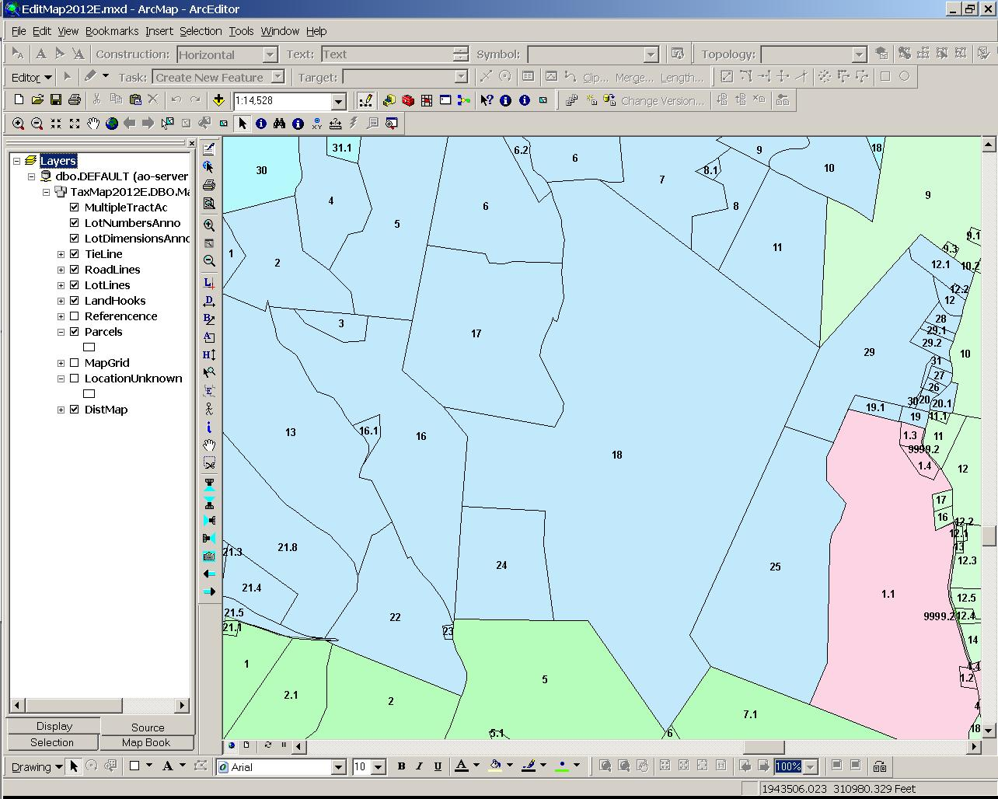

Slide 12
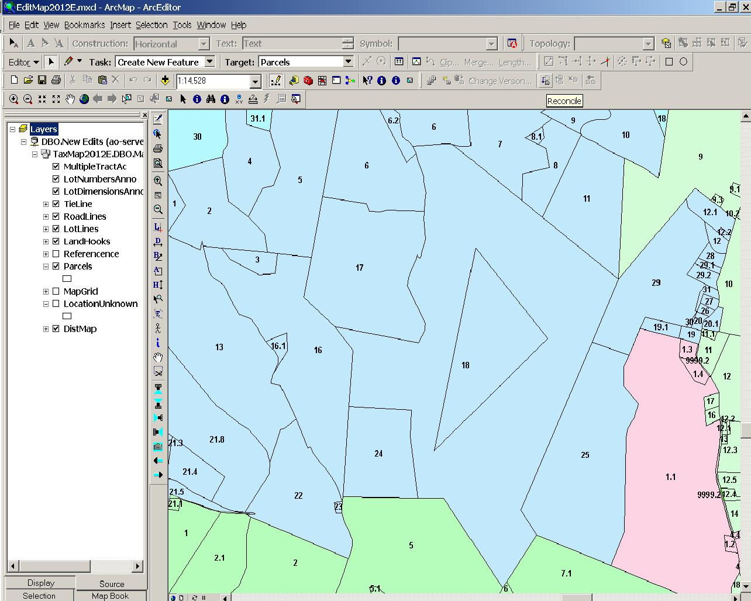

Slide 13
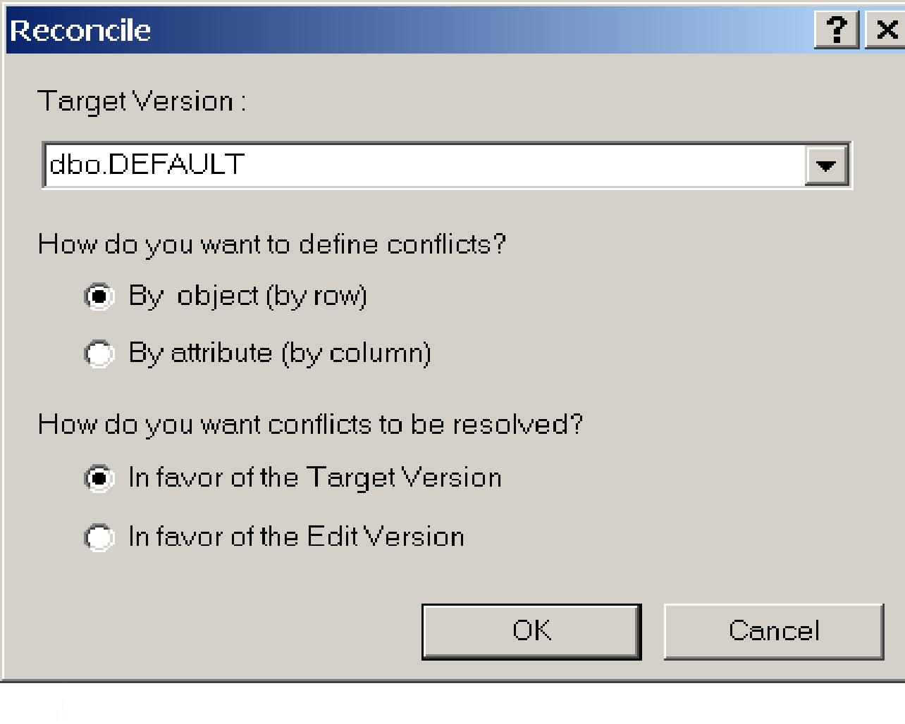

Slide 16
Connie R. Ervin, GISP
Preston County Assessor’s Office
106 W. Main St. Ste 101
Kingwood, WV 26537
304-320-1220
crervin@assessor.state.wv.us

