Slide 1
How to enter the world of Python Programming for ArcGIS
Or, a funny thing happened on the way from an ESRI conference
By Katherine Paybins
WVAGP Membership Meeting, November 3, 2011
Notes:
Opening..

Slide 2
Why use Python in ArcGIS 9 or 10?
With ArcGIS 10, Python scripting takes front place for programming repetitive tasks and creating custom functions for the ArcToolbox.
Python as a programming language has been around for awhile, and when your ArcGIS 10 was installed, Python 2.6.5 was also, with a GUI included called the Idle Python Shell. There are other GUIs out there, but the Idle GUI is one of the more popular for it’s ease of use.

Slide 3
From the Python Tutorial
Python is an easy to learn, powerful programming language. It has efficient high-level data structures and a simple but effective approach to object-oriented programming. Python’s elegant syntax and dynamic typing, together with its interpreted nature, make it an ideal language for scripting and rapid application development in many areas on most platforms.
The Python interpreter and the extensive standard library are freely available in source or binary form for all major platforms from the Python Web site, http://www.python.org/, and may be freely distributed. The same site also contains distributions of and pointers to many free third party Python modules, programs and tools, and additional documentation.

Slide 5
From ESRI help documents
Python was introduced to the ArcGIS community at 9.0. Since then, it has been accepted as the scripting language of choice for geoprocessing users and continues to grow. Each release has furthered the Python experience, providing you with more capabilities and a richer, more Python-friendly experience.
ESRI has fully embraced Python for ArcGIS and sees Python as the language that fulfills the needs of our user community. Here are just some of the advantages of Python:
Easy to learn and excellent for beginners, yet superb for experts
Highly scalable, suitable for large projects or small one-off programs known as scripts
Portable, cross-platform
Embeddable (making ArcGIS scriptable)
Stable and mature
A large user community
Python extends across ArcGIS and becomes the language for data analysis, data conversion, data management, and map automation, helping increase productivity.

Slide 6
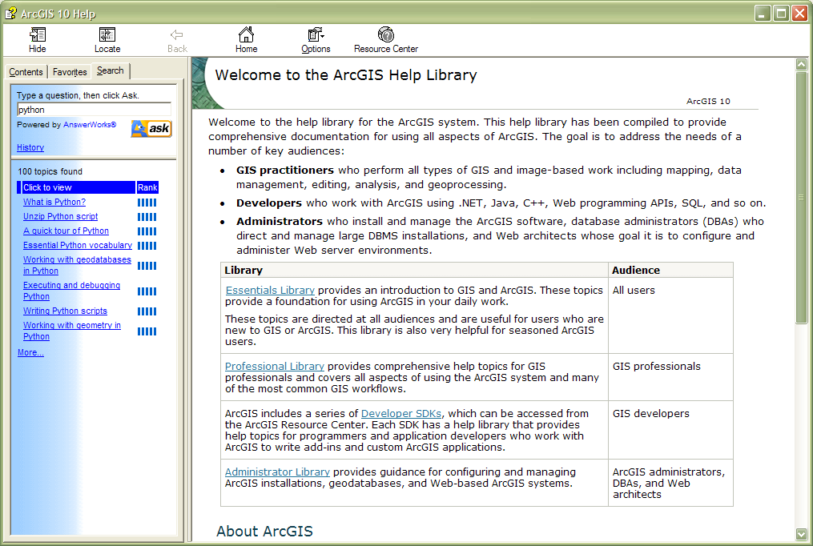

Slide 7
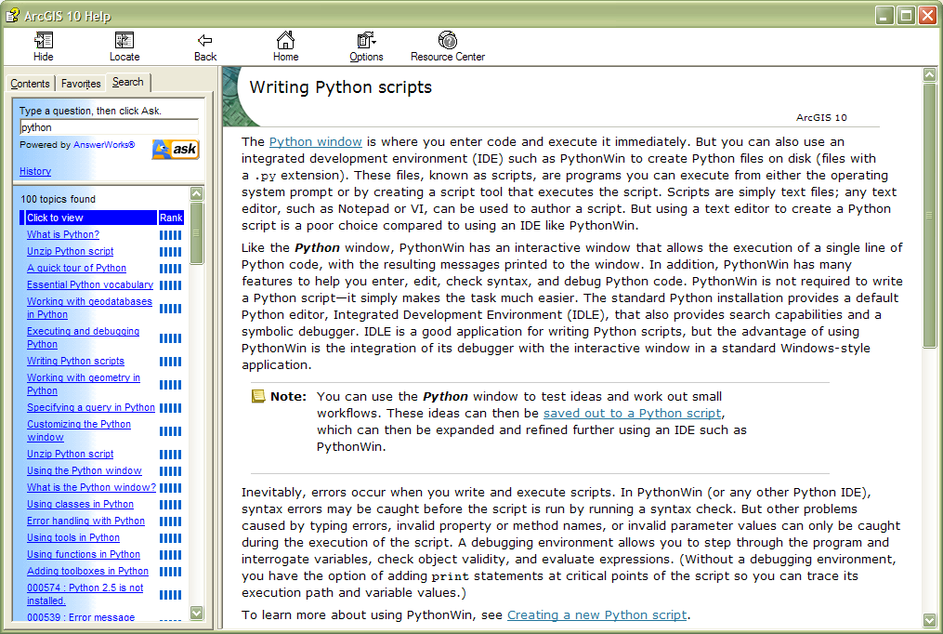
More help pages

Slide 8
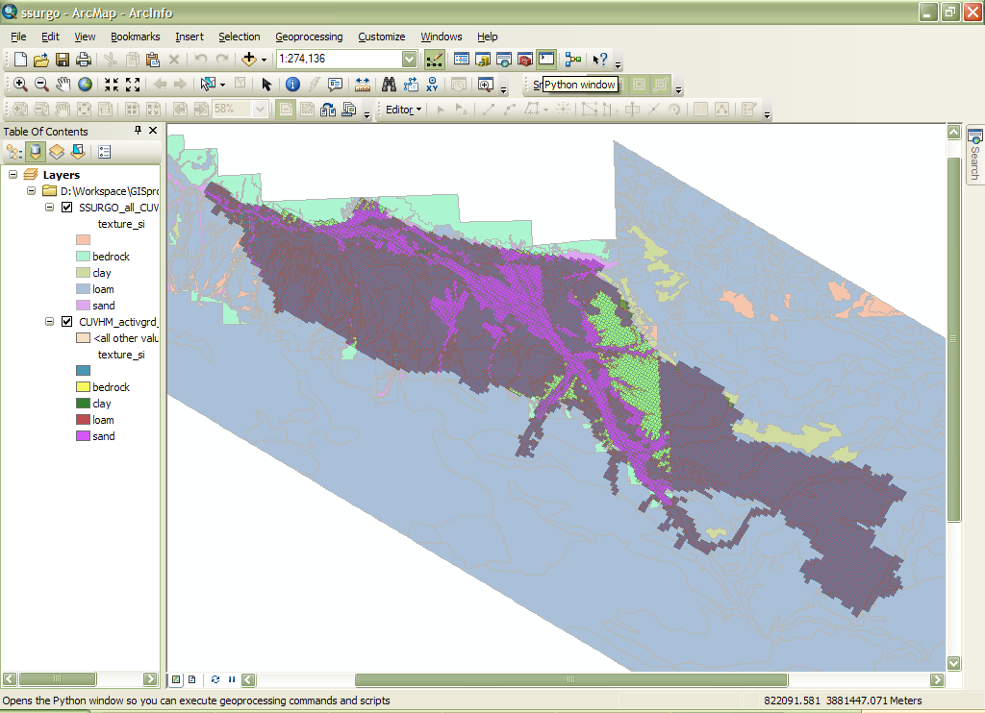
Where to find in ArcGIS?

Slide 9
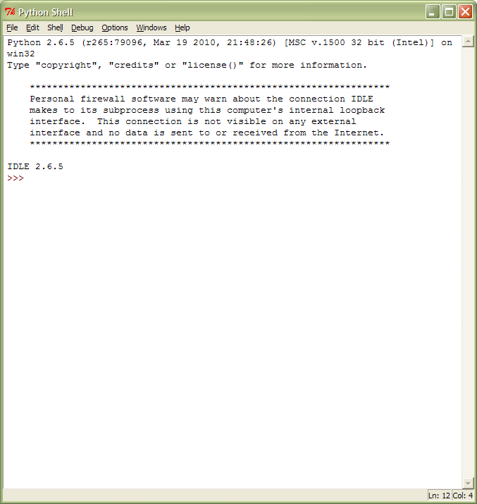
The IDLE python shell:

Slide 10
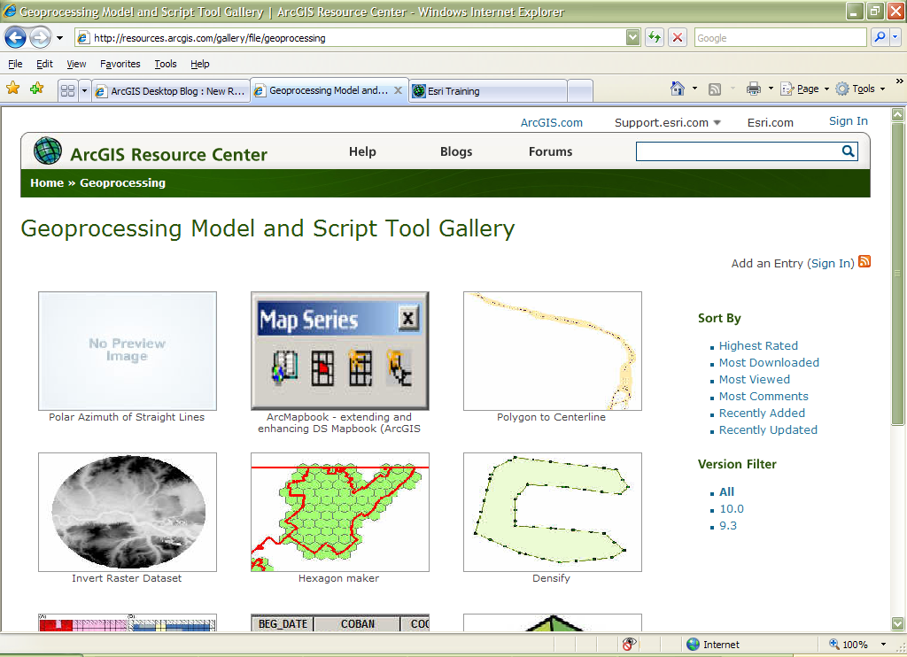
Look at the ESRI site for sample scripts to download, and also look within the ArcToolBox for scripts.

Slide 11
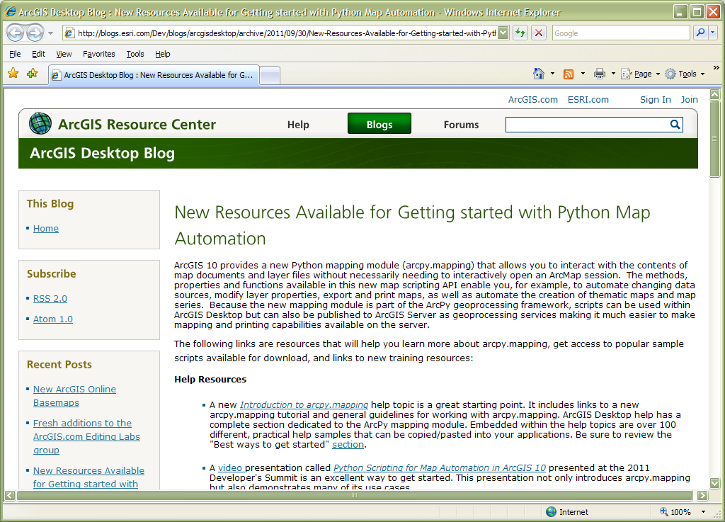

Slide 12
Online classes
The Python tutorial is available on several sites, but you have it on your computer if you have ArcGIS installed
ESRI offers twelve online courses relating directly to or referencing Python, including:
Basics of Python (for ArcGIS 10)
Python Scripting for Map Automation in ArcGIS 10
Python Scripting for Geoprocessing Workflows (ArcGIS 10)

Slide 13
An example of learning the software
First, conference sessions showing use of the new arcpy set of python scripts
Next, taking the tutorial and starting a notes for future reference/ copy and paste into Python.
Also, testing out running commands in the Python window
Purchased a couple of books on the topic- I like the Python Phrasebook by Brad Dayley, and Core Python Programming by Wesley Chun
As I work on projects, I try to view any Python scripts in the GeoProcessing tools

Slide 14
Taking notes is a good idea
For instance, here are some notes from the Tutorial that I have kept for reference and cut/paste.
________________________________________________________
Commands to start at beginning of interactive Python session, or in a script if I want the functionality included by using these commands.
import os
filename = os.environ.get('PYTHONSTARTUP')
if filename and os.path.isfile(filename):
execfile(filename)
import env
import arcpy
arcpy.sa
arcpy.mapping
arcpy.ga

Slide 15
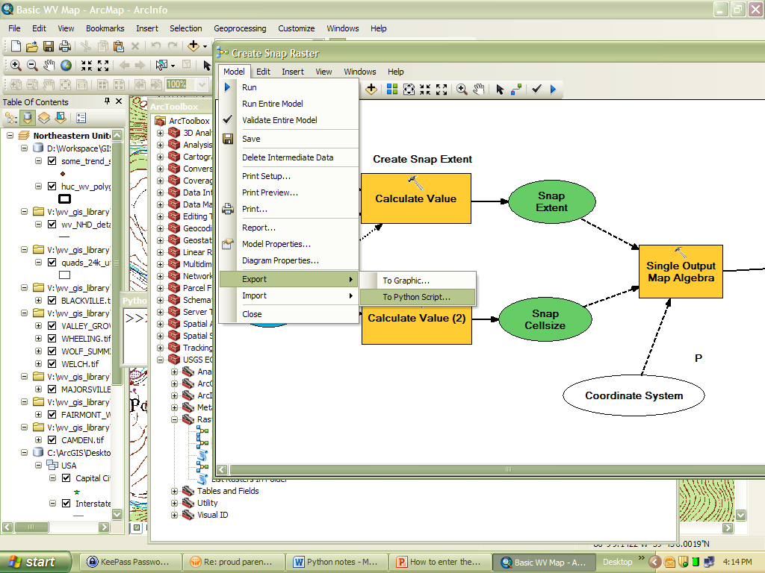
An easy way to make a python program from geoprocessing models:

Slide 16
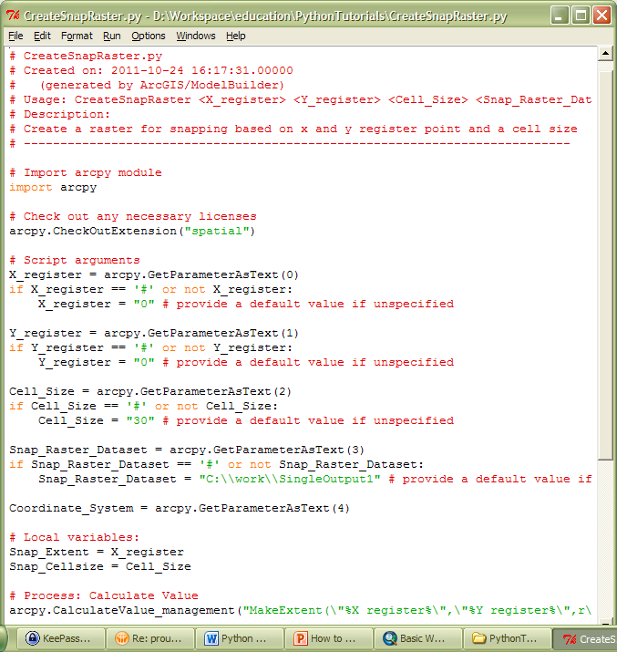
Here is that Python script:

Slide 17
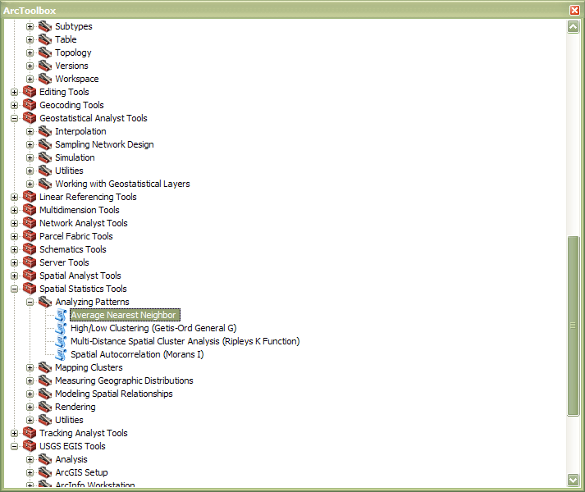
Open and view scripts from the ArcToolbox

Slide 18
Questions?

