Slide 1
Geospatial Transportation Information Section: Where we are?
Geospatial Transportation Information Section
Program Planning & Administration Division
Division of Highways
West Virginia Department of Transportation
Bldg. 5, Rm. A-816
1900 Kanawha Blvd., E
Charleston, WV 25305

Slide 2
History
Historically the West Virginia Department of Transportation (WVDOT) has been utilizing geospatial (GIS, Remote Sensing, & GPS) technology for planning, analysis, and mapping purposes ever since the technology became available.
In 2005 the WVDOT GIS Section was created to meet the growing needs for geospatial data and services in transportation.
In 2007 the GIS Section was reorganized as the GIS Unit and merged with the Highway Data Services (HDS) Unit, a program responsible for processing roadway additions, changes, or abandonment requests from the Districts, and the update and maintenance of the Roadway Inventory Log. The two units together formed the current Geospatial Transportation Information (GTI) Section.

Slide 3
Program Planning & Administration (CP) Division
Geospatial Transportation Information (GTI) Section
GIS Unit
Highway Data Services (HDS) Unit
Transportation GIS Data
-Geospatial Services
-Geospatial Applications
Roadway Inventory Log
-Roadway Statistics
-Public Certified Mileage
-Highway Performance Monitoring System

Slide 4
Gti’S PRODUCTS & SOLUTIONS
Public
GTI Portal
Continuously Operating Reference Stations (CORS) Network
GTIHelpDesk@wv.gov
WVDOT
GTI Portal
CORS
Fleet Management
Videolog Viewer
GIS Portal
Straight Line Diagram Viewer
WVDOH District GIS Coordinator Network
GIS/GPS Training
Other Services (Transportation GIS User Group, etc.)

Slide 5
GTI Portal
http://www.transportation.wv.gov/highways/programplanning/gti/Pages/default.aspx

Slide 6
Data Catalog
Bridges
Byways & Backways
Guardrails
Major Roads by Sign/District/County
Railroads
River Ports
Public Airports
WVDOT Facilities
WVDOT Rest Areas
WVDOT Substations
Etc.
http://www.transportation.wv.gov/highways/programplanning/gti/GIS/Pages/DataCatalog.aspx

Slide 7
GIS Services
Esri ArcGIS Server
REST & SOAP APIs
UTM & Web Mercator
Future GeoData Services
Future Image Services
Future Data Exchange Network
http://www.transportation.wv.gov/highways/programplanning/gti/GIS/Pages/WebMapServices.aspx

Slide 8
Maps
City Maps (205)
General Highway County Maps (55)
State Functional Classification Maps
State General Highway Maps
State Highway Base Map
Urban Area Maps (26)
http://www.transportation.wv.gov/highways/programplanning/gti/GIS/MAPS/Pages/default.aspx

Slide 9
Web Mapping Applications
WVDOT Facility Locations
WVDOT Statewide Transportation Improvement Program
WVDOT River Port Locations
WVDOT Airport Locations
WVDOT Snow Removal & Ice Control (SRIC)
WV American Recovery and Reinvestment (ARRA) Reporting
WVDOT Coal Resource Transportation System (CRTS)
http://www.transportation.wv.gov/highways/programplanning/gti/GIS/Pages/MappingApplications.aspx

Slide 10
WVDOT Snow Removal and Ice Control

Slide 11
HDS Unit web resources
Procedures & Guidelines
Additions & Changes
Roadway Abandonment
Data Resources
Annual Roadway Inventory Statistics 2008-2010
West Virginia Federal Aid Roads 2008-2010
District Status Reports
Pending District Addition/Change Request Status Report
Pending District Abandonment Request Status Report
Current Reserved Route Listing
Annual Highway Performance Monitoring System (HPMS) Data Profile
http://www.transportation.wv.gov/highways/programplanning/gti/Highway_Data_Services/Pages/default.aspx

Slide 12
WVDOT CORS & VRS

Slide 13
Newest Station
State Police in Franklin, WV
35 STATIONS TRANSMITTING TO NETWORK
169 Subscriptions
109 Organizations
187 Users
2011
22 WV STATIONS INSTALLED

Slide 14
WVCORS Network
Cooperative Effort
Site Owners Include
USCOE
NRAO
WVDNR
WVDEP
WVRJA
WVU, MU, FSU, SCTC, EWVTC, Marshall, Braxton, and Wirt County Schools
Partnerships – Surrounging State
Ohio
Kentucky
Pennsylvania
Virginia

Slide 15
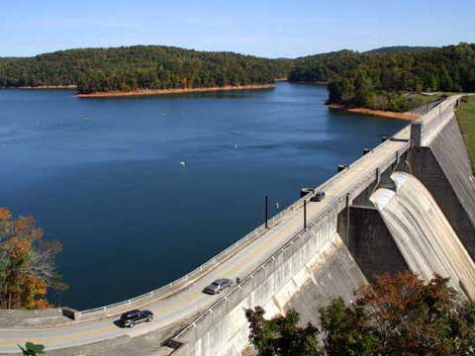
Infrastructure Enabled Applications
Precision Agriculture
Bridge and Damn Deformation monitoring
Scientific/engineering research
Surveying
Mine rescue
Construction
Machine control
Marine navigation and positioning
Mapping and GIS
Notes:
Precision Farming Seed corn = $220/bag
Que Creek mine rescue

Slide 16
WVDOT Fleet management

Slide 17
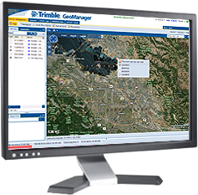
WVDOT GeoManager GPS Fleet Management
Upgrade to System
Embrace Latest Technology
User Friendly
Online Training for Managers
Fleet Productivity
Fuel Reduction
Driver Safety
Environmental Impact
Asset Utilization
Diagnostics & Messaging
NMEA GPS Data Feed
NMEA WiFi Data Feed
Upgrade Starts November 7

Slide 18
New Look
Features
Real-time location
Map View - View the real-time status and locations
Exception alerting - Includes speeding, idle time, battery
Configurable Dashboards
Vehicle Diagnostics - Fuel, carbon, odometer and fault codes
Landmarks (GeoFence) - 20 unique types
Vehicle Maintenance Schedule Notifications
PTO and Temperature Sensor Connection
Data integration to existing systems
On-line self paced user training

Slide 19
GIS Portal, Videolog Viewer, & Straight Line Diagram Viewer

Slide 20
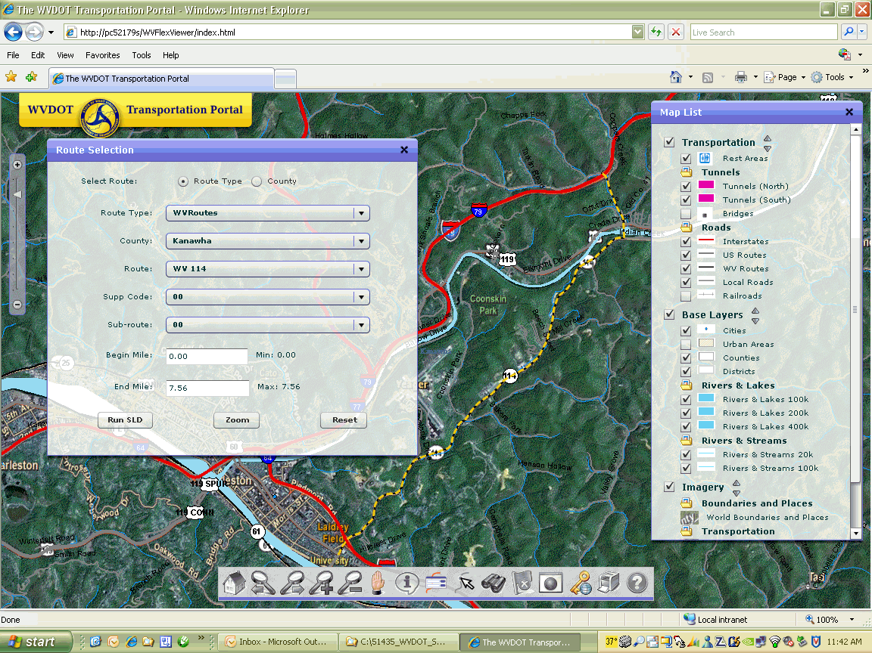

Slide 21
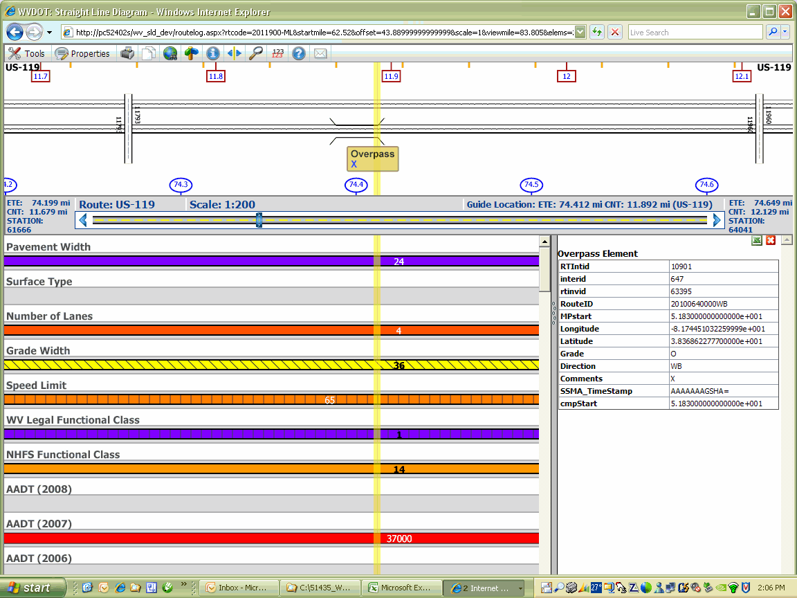

Slide 23
Current & Future Major Projects
ERP/Asset Management
CORS
HPMS Portal
Fleet Management
WV National Guard (WVNG) Flood Emergency Management
Enterprise GIS Framework Enhancement
Transportation GIS Data Model
Statewide Road Centerline Dataset
GIS Portal & Straight Line Diagram Viewer
Video Log Viewer
Highway Map Production
Web Mapping Applications
Transportation GIS Data Collection

Slide 24
QUESTIONS?
CORS
GTI PORTAL
FLEET MANAGEMENT
SLD
VIDEOLOG VIEWER
OTHERS

Slide 25
CONTACTs
Hussein Elkhansa | Section Head | Hussein.S.Elkhansa@wv.gov | (304) 558-9657
Janet Lemon | HDS Unit Leader | Janet.L.Lemon@wv.gov | (304) 558-9599
Yueming Wu | GIS Unit Leader | Yueming.Wu@wv.gov | (304) 558-7437
Marshall Burgess | Database Administrator | Marshall.L.Burgess@wv.gov | (304) 558-9528
Larry Douglas | Project Manager | Lawrence.A.Douglas@wv.gov | (304) 558-7402
Kyle Weatherholt | District GIS Coordinator | Kyle.S.Weatherholt@wv.gov | (304) 558-7434 or 528-5936
Michelle Frame | GIS Training Liaison | Michelle.L.Frame@wv.gov | (304) 558-9588

Slide 26
For those of you still awake, thanks for listening and have a great day.
Quote for the Day……
“Thanks to the Interstate Highway System, it is now possible to travel across the country from coast to coast without seeing anything.” - Charles Kuralt

