Slide 1
Stormwater and GIS
Eastern Panhandle WV GIS User Group Meeting
September 2, 2015
Jennifer Klages - Jennifer.L.Klages@wv.gov
Sebastian Donner - Sebastian.Donner@wv.gov
WV Department of Environmental Protection
Watershed Improvement Branch

Slide 2
GIS & STORMWATER
Municipal Separate Storm Sewer System - MS4 permit requirements
Construction Stormwater permit
Ordinance compliance
Flood plain management
Land use development
Chesapeake Bay TMDL
TMDL - Total Maximum Daily Load - West Virginia TMDLs @
http://www.dep.wv.gov/WWE/watershed/TMDL/Pages/default.aspx

Slide 3
MS4 – Regulatory Stormwater GIS Frontier
Municipal - Local Government Separate - Separated from Sanitary Sewer Storm - Rain Causing Runoff Sewer – Conveyance System - Structural

Slide 6
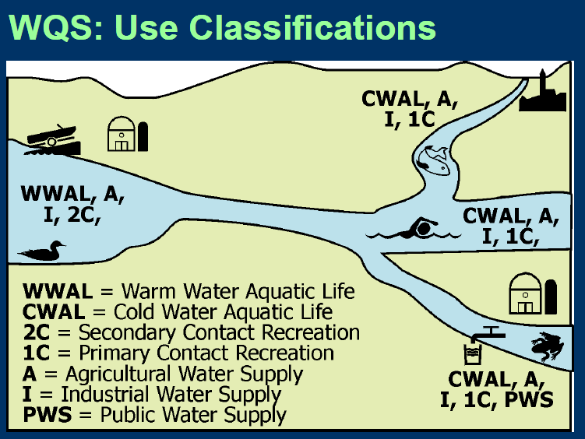
Water Quality Standards
Designated uses = Desired uses
Drinking, Agriculture, Industrial water supply
Human Contact Recreation
Catching/eating Fish
Aquatic life protection
Religious/cultural practices
water.epa.gov/learn/training/wacademy/archives.cfm#w20120321

Slide 7
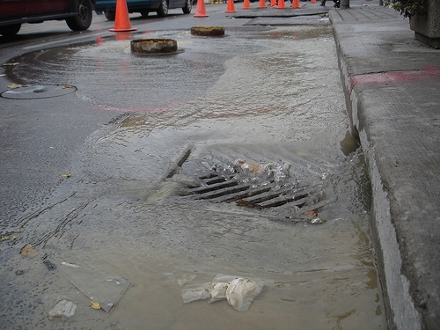
Stormwater Runoff
Precipitation flowing over land
Increased by impervious surfaces
Urban development
Hard – concrete, asphalt, roofs
No infiltration
Collects pollutants
Sediments
Debris
Chemicals
Nutrients
Heavy metals
Hydrocarbons
Endocrine disruptors
Typically not treated
Notes:
http://cfpub.epa.gov/npdes/home.cfm?program_id=6

Slide 9
Watershed Protection Elements
1. Minimize impervious surfaces
2. Preserve, protect, create and restore ecologically sensitive areas
3. Prevent or reduce thermal impacts to streams
4. Avoid or prevent changes to streams and other bodies of water
5. Protect trees and other vegetation
6. Protect native soils

Slide 11
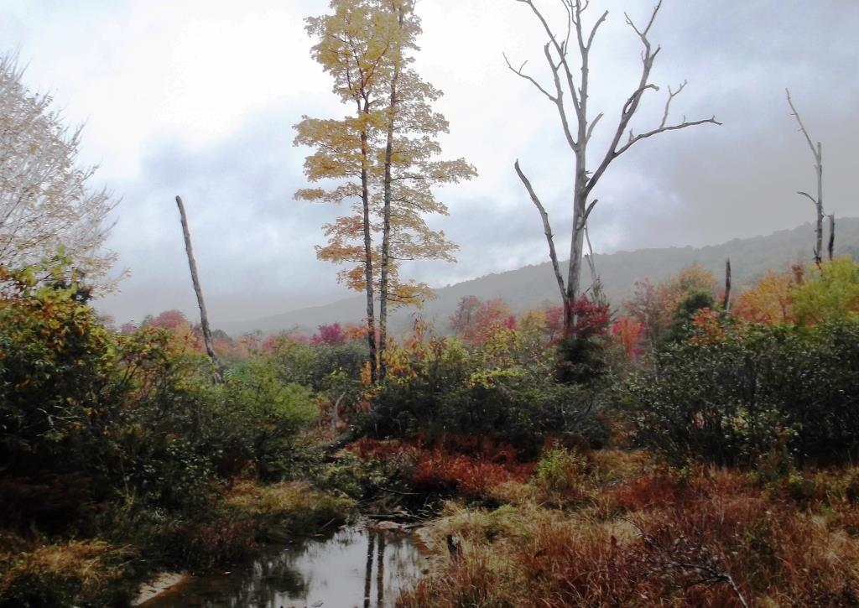

Slide 12
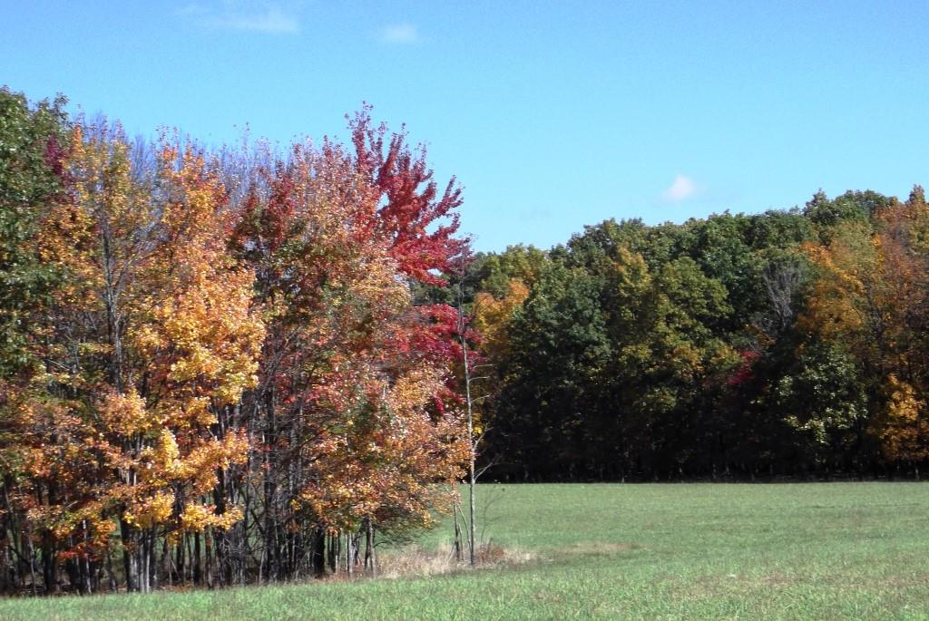

Slide 13
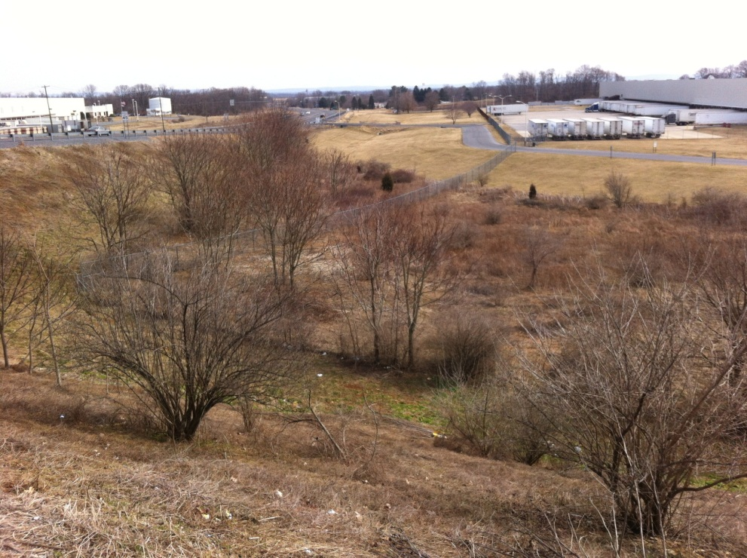
Preserve and Protect
Undisturbed Natural Areas
Ecologically Sensitive Areas
Natural Drainage Features
Porous, Erodible, and Native Soils
Valuable Habitat Areas
Trees and Vegetation
Riparian Buffer
Steep Slopes

Slide 17
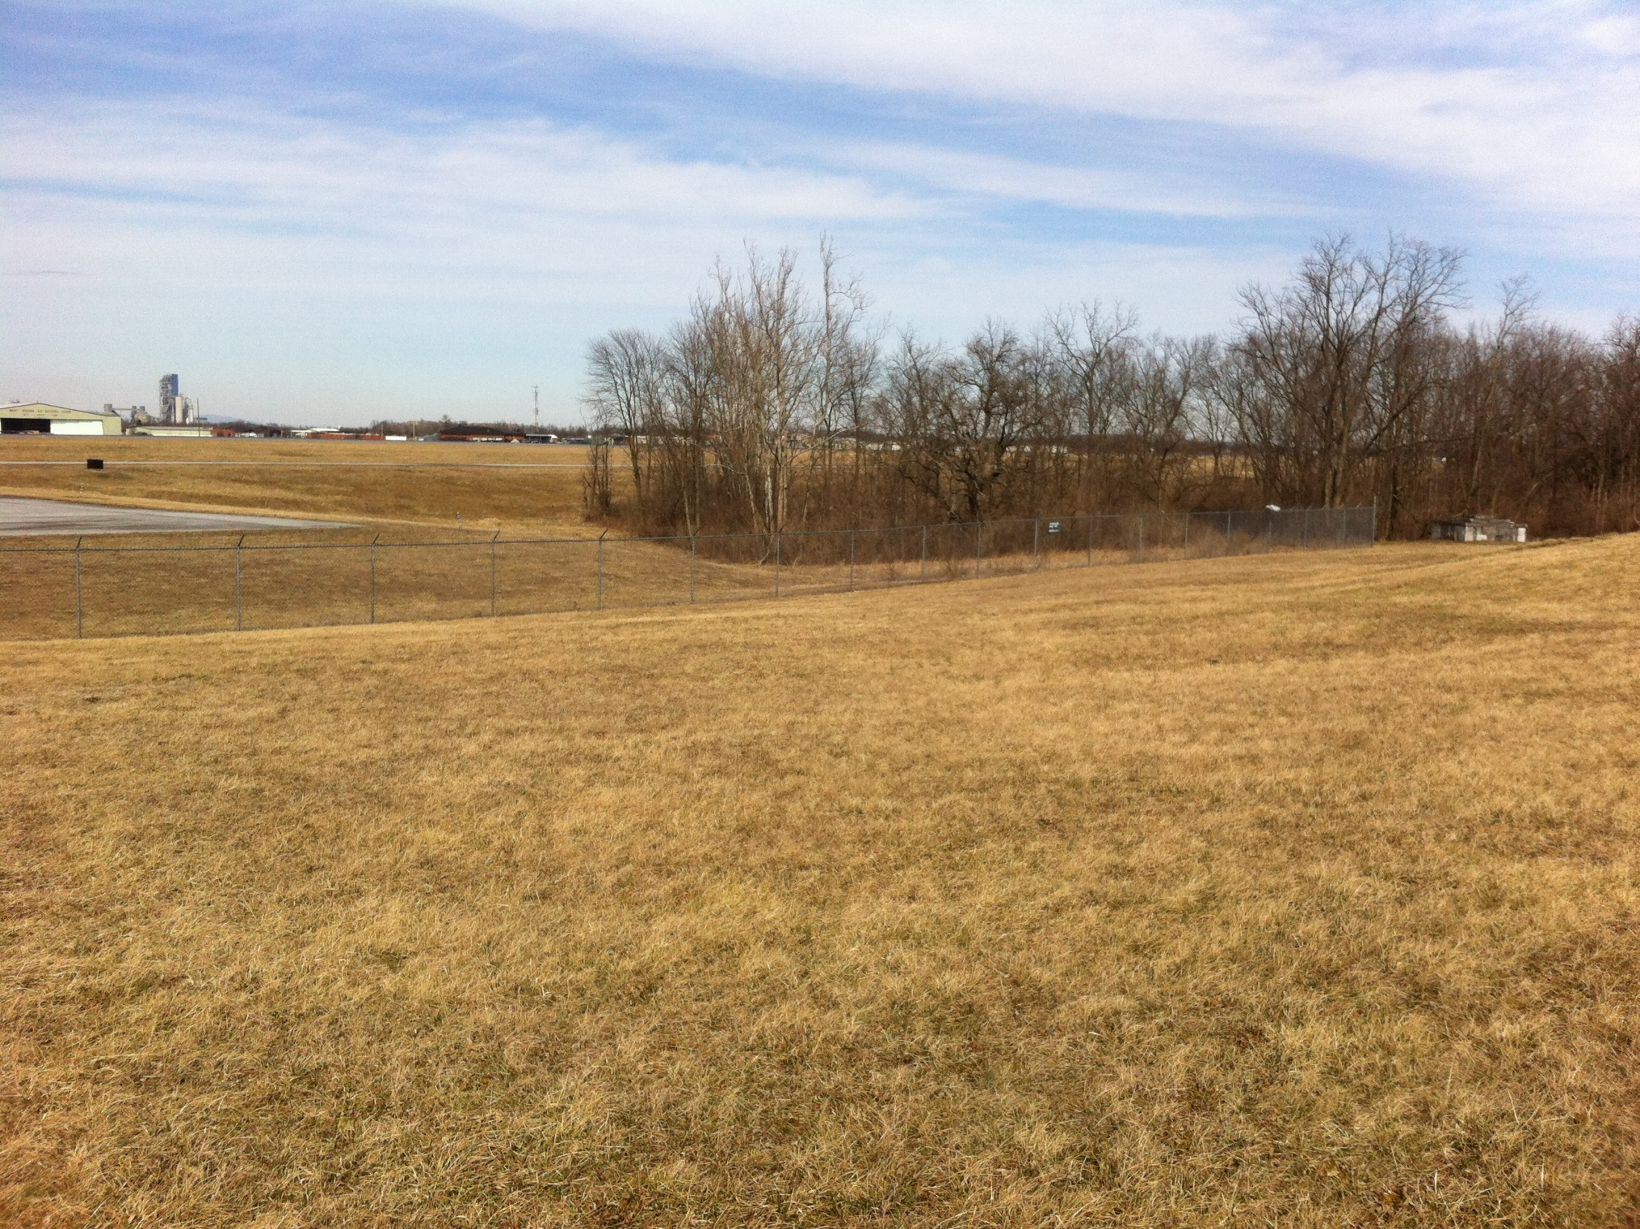

Slide 19
Incorporate
Landscaping Areas in Parking Lots
Alternative Culs-de-Sac
Shared driveways
Sidewalks on one side for low-traffic roads
Grass swales used in lieu of curb & gutter
Designs that Reduce Hydromodification and Stream Impacts

Slide 20
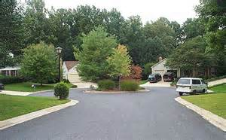

Slide 21
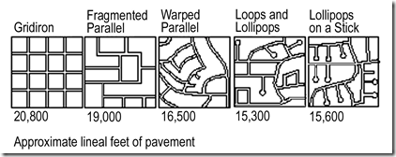
Reduce
Impervious Surfaces
Clearing and Grading Limits
Setbacks and Frontages
Roadway Lengths and Widths
Sidewalk and Driveway Lengths and Widths
Parking Lot Footprints
Building Footprints

Slide 22
Compensate
Implement Stormwater Control Measures, aka structural
Best Management Practices (BMPs)
Sheet Flow to Vegetated Filter Strips and Conservation Areas
Regenerative Stormwater Conveyance System
Impervious Surface Disconnection
Bioretention
Infiltration
Filtration
Permeable Pavement
Grass Swale
Rainwater Harvesting
Vegetated Roofs
Stormwater Wetlands

Slide 23
Essential Smart Growth Fixes for Rural Planning, Zoning, and Development Codes
http://www.dep.wv.gov/WWE/Programs/stormwater/MS4/permits/Documents/Essential_Smart_Growth_Fixes_Rural_Development_%202012.pdf
Determine Areas for Growth and for Preservation
Incorporate Fiscal Impact Analysis in Development Reviews
Reform Rural Planned Unit Developments
Use Wastewater Infrastructure Practices That Meet Development Goals
Right-Size Rural Roads
Encourage Appropriate Densities on the Periphery
Use Cluster Development to Transition From Town to Countryside
Create Annexation Policies and Development Standards That
Preserve Rural Character
Protect Agricultural and Sensitive Natural Areas
Plan and Encourage Rural Commercial Development

Slide 24
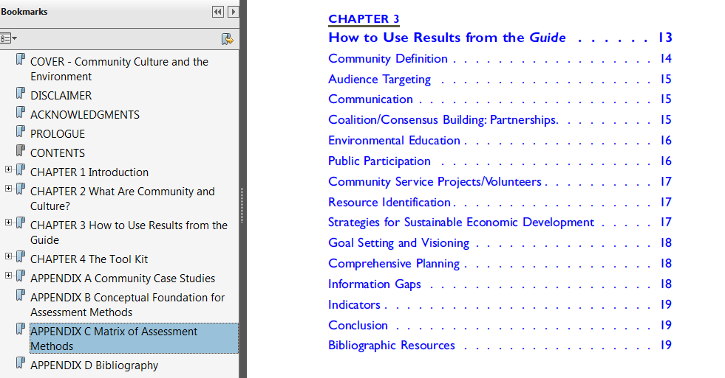
Community Culture and the Environment
Comprehensive EPA guide with case studies
http://www.epa.gov/care/library/community_culture.pdf

Slide 25
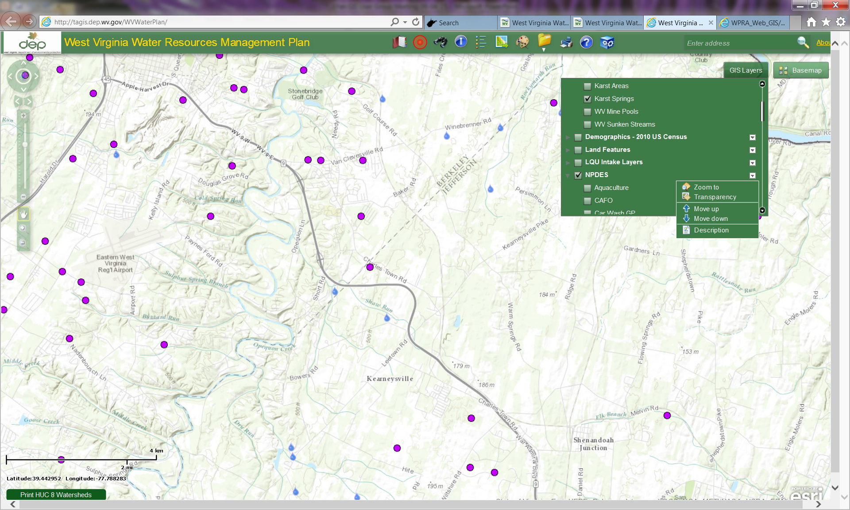
How To Keep Track? - GIS
http://tagis.dep.wv.gov/WVWaterPlan

Slide 26
BMP Tracking & Reporting
MS4 permit and Chesapeake Bay
1. Project type/category (new/re development, retrofit)
2. BMP name(s)
3. Stormwater Treatment or Runoff Reduction
4. Volume of water treated at a site
5. Impervious acres treated by the practice(s)
6. Total site acres treated by the practice(s)
7. Location (lat/long)
8. Date installed
9. Date inspected
10. Practice duration

Slide 27
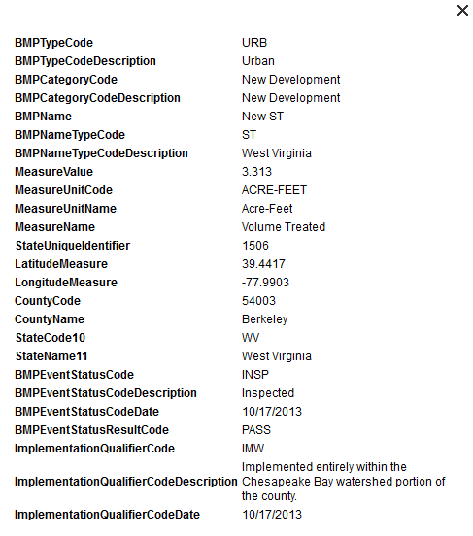

Slide 28
Land Use Change Verification
Land use changes 2011 through 2014
Chesapeake Bay Watershed
Eight County Eastern Panhandle
Assessment of changes in nutrient & sediment loads due to development
“Holding the Line” to avoid net increases in the urban/developed lands sector

Slide 29
Observed Land Use Changes
 |  | Total | Berkeley | Grant | Hampshire | Hardy | Jefferson | Mineral | Morgan | Pendelton
Permitted Acres |  | 5621 | 2464 | 833 | 58 | 158 | 1737 | 270 | 53 | 49
Land use change acres |  | 4190 | 1775 | 797 | 17 | 44 | 1370 | 159 | 18 | 10
% Permit Acres developed |  | 75% | 72% | 96% | 29% | 28% | 79% | 59% | 34% | 20%
% Permit Acres not used |  | 25% | 28% | 4% | 71% | 72% | 21% | 41% | 66% | 80%
% of TOTAL Land Use Changes |  | 100% | 42% | 19% | 0.4% | 1.1% | 33% | 4% | 0.4% | 0.2%
Preliminary Results

Slide 30
TOTAL Land Use Change Summary |  |  |  | Percent of
Land Use | Acres |  |  | Total Land Use Change |  | Change in Delivered Loads (lbs/year)
 | PRE | POST | Δ Acre | PRE | POST | TN | TP | TSS
rid | 125 | 393 | 268 | 3.0% | 9.4% | 1,873 | 244 | 112
nid | 94 | 351 | 257 | 2.2% | 8.4% | 1,389 | 233 | 107
rpd | 390 | 944 | 554 | 9.3% | 22.5% | 3,091 | 143 | 32
npd | 319 | 652 | 333 | 7.6% | 15.6% | 2,450 | 121 | 27
rcn | 440 | 58 | (382) | 10.5% | 1.4% | (4,610) | (1,580) | (2,933)
hay | 71 | 54 | (17) | 1.7% | 1.3% | (54) | (5) | (1)
row | 1,236 | 63 | (1,173) | 29.5% | 1.5% | (28,785) | (1,378) | (173)
pas | 55 | 8 | (47) | 1.3% | 0.2% | (74) | (15) | (9)
trp | 4 | - | (4) | 0.1% | 0.0% | (222) | (36) | (13)
urs | 2 | - | (2) | 0.0% | 0.0% | (288) | (80) | (3)
for | 990 | 702 | (289) | 23.6% | 16.8% | (383) | (27) | (6)
hyo | 375 | 966 | 591 | 8.9% | 23.1% | 1,773 | 21 | 29
hvf | 90 | - | (90) | 2.1% | 0.0% | (810) | (34) | (13)
TOTAL LUC | 4,190 | 4,190 | (0) | 100% | 100% | (24,650) | (2,393) | (2,844)

Slide 31
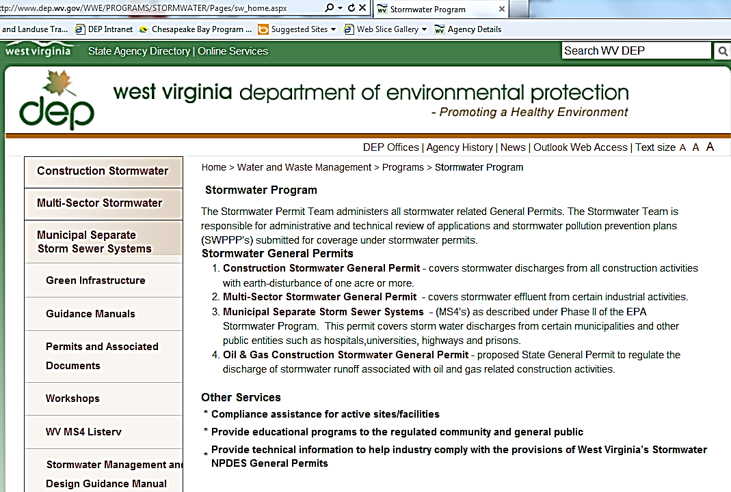
WV BMP Guidance Manual
West Virginia Stormwater Management and Design Guidance Manual
http://www.dep.wv.gov/WWE/Programs/stormwater/MS4/Pages/StormwaterManagementDesignandGuidanceManual.aspx
www.dep.wv.gov
Water & Waste
– Permitting
– Stormwater
Permits

Slide 32
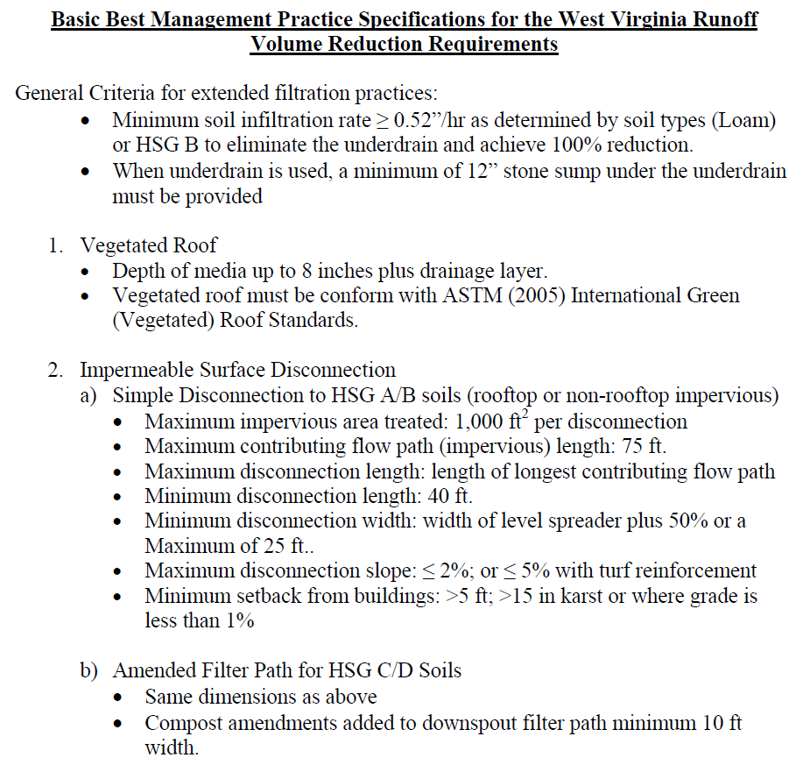
http://www.dep.wv.gov/WWE/Programs/stormwater/MS4/permits/Pages/ToolsandGuidance.aspx

Slide 33
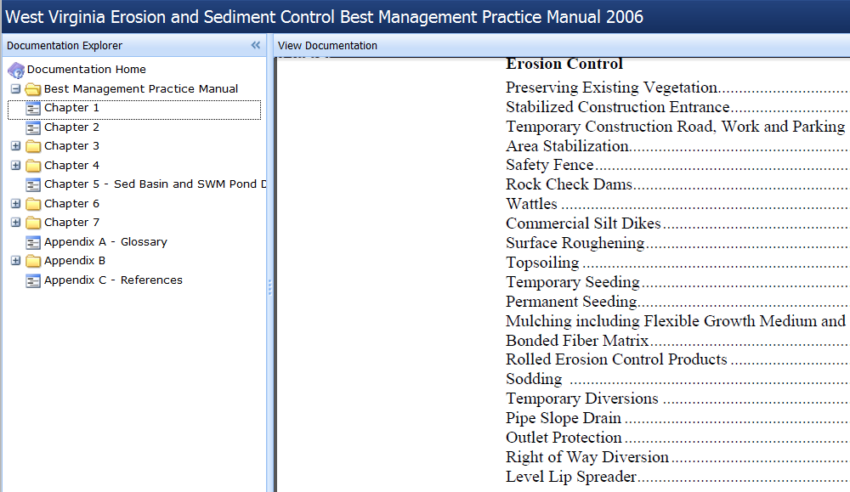
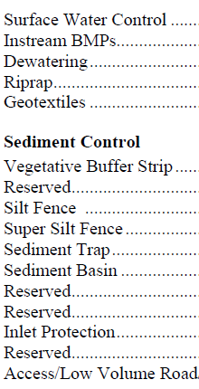
Erosion & Sediment Control https://apps.dep.wv.gov/dwwm/stormwater/BMP/index.html

Slide 34
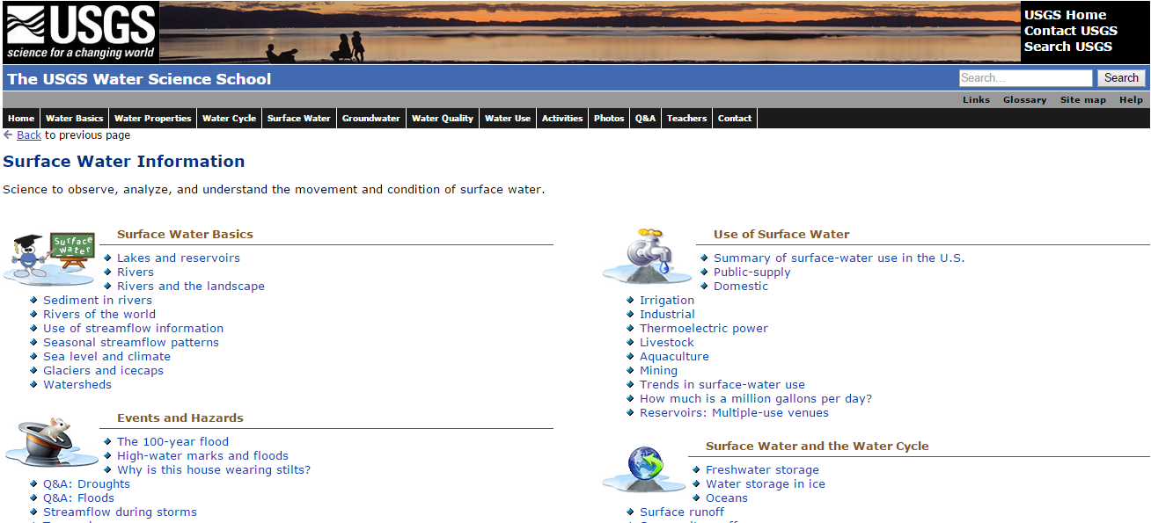
US Geological Survey
http://water.usgs.gov/edu/

Slide 35
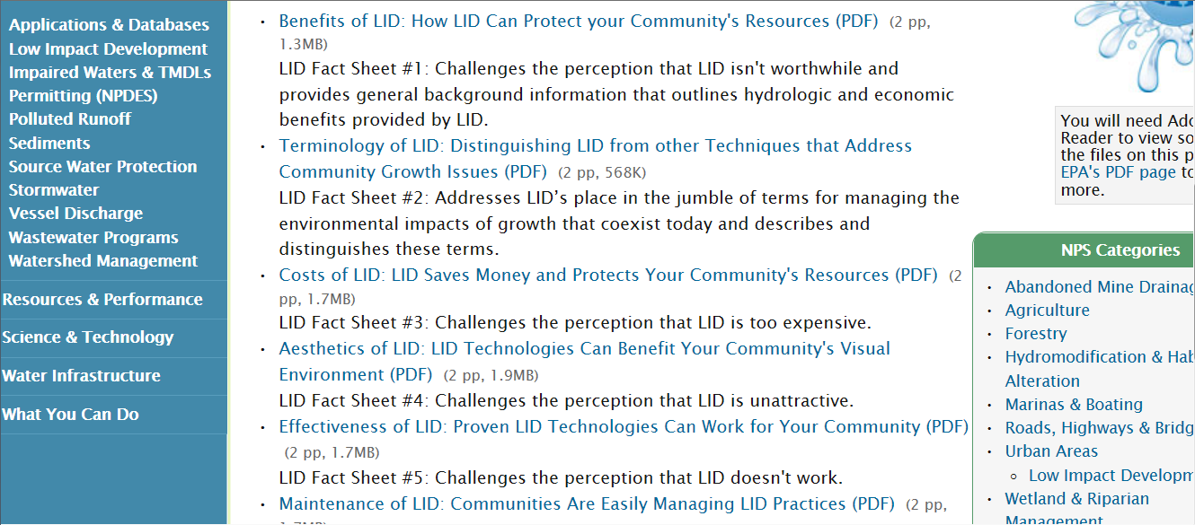
LID "Barrier Busters" Fact Sheet Series
http://water.epa.gov/polwaste/green/bbfs.cfm

Slide 36
Bay Resources
Chesapeake Bay Program
www.chesapeakebay.net
Chesapeake Stormwater Network
www.chesapeakestormwater.net
Center for Watershed Protection
www.cwp.org
www.youtube.com/user/CenterforWatershed/videos
Watershed Implementation Tools
http://www.chesapeakebay.net/about/programs/watershed_implementation_plan_tools

